Slide 1
DeviceMaster®
Serial and Ethernet Solutions from
Comtrol Corporation

Slide 2
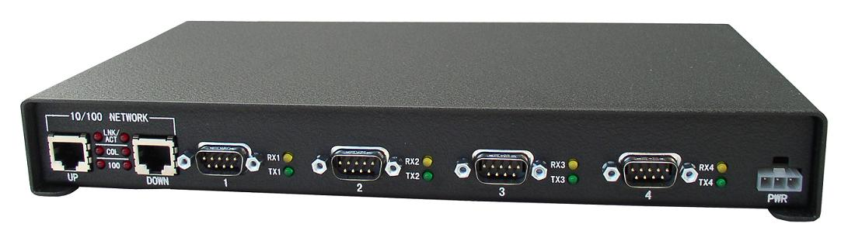
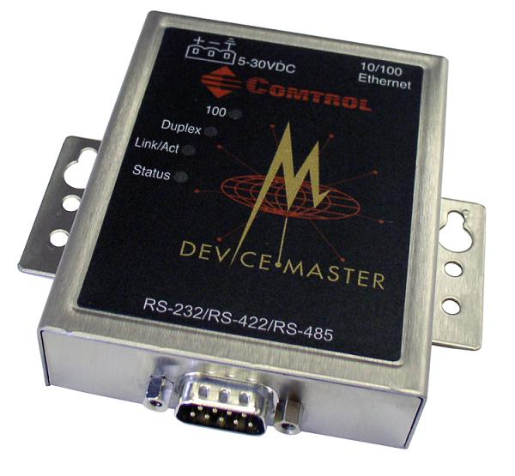
DeviceMaster® RTS
Connecting Serial to Ethernet
NS Link *
Socket Server *
Bootloader *
*Can also run on DeviceMaster ® UP hardware

Slide 3
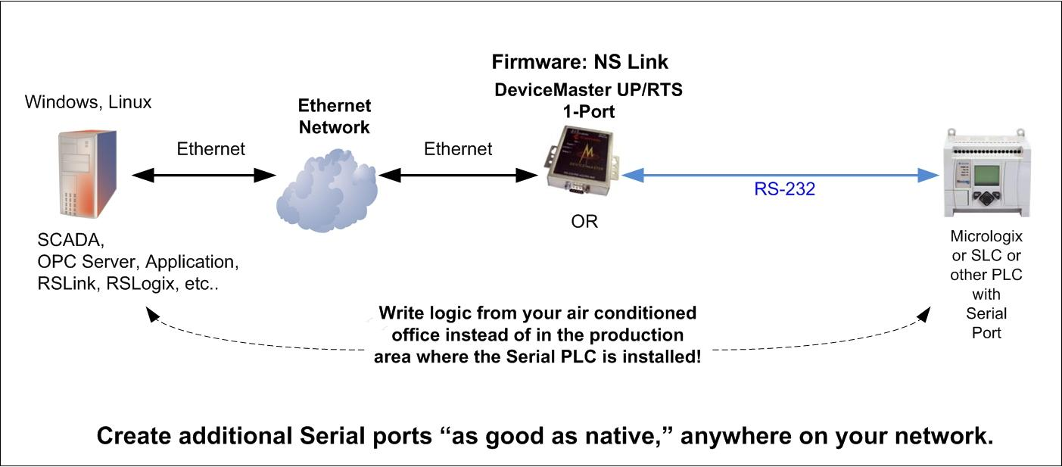
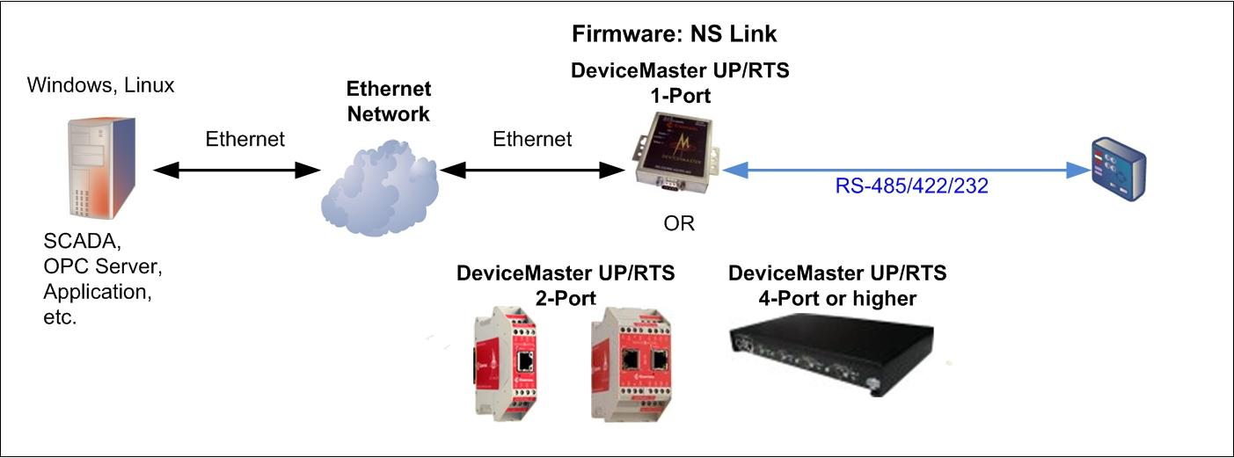
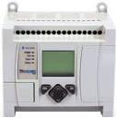
DeviceMaster® RTS
Connecting Serial to Ethernet
NS Link Firmware
Micrologix (or other PLC that can be programmed through it’s serial port)
Additional “like native” COM ports appear.

Slide 4
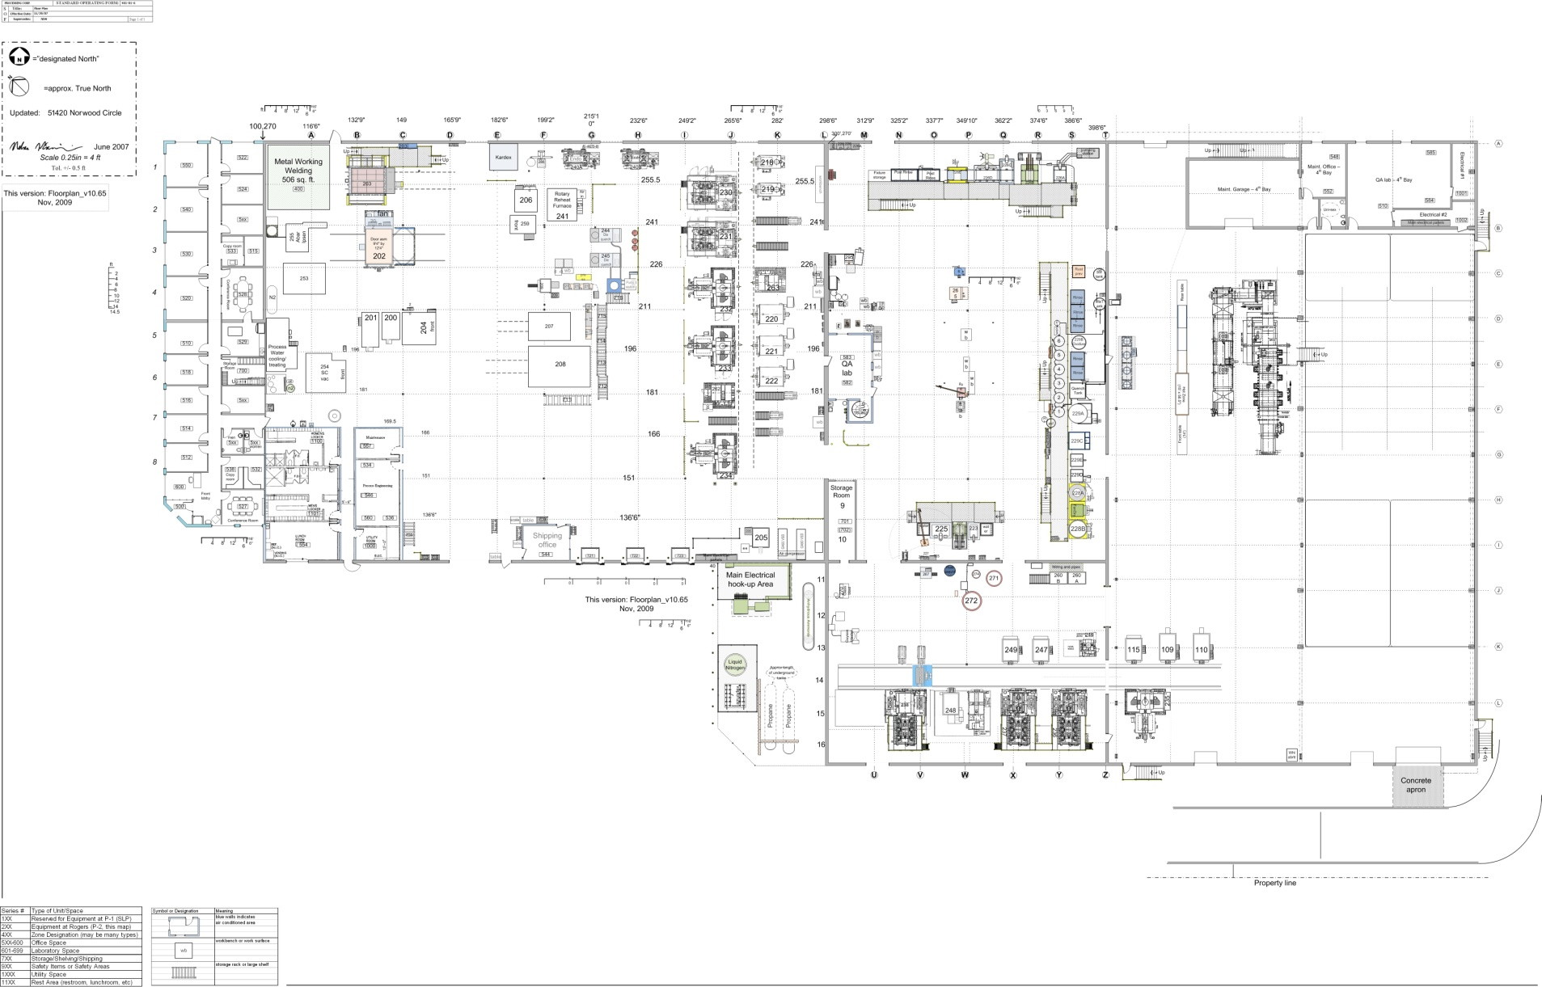
DeviceMaster® RTS
A large factory may have a huge variety of sensors, instruments, devices, PLCs, and Industrial Computers. More often than not, they are of mixed heritage.

Slide 5
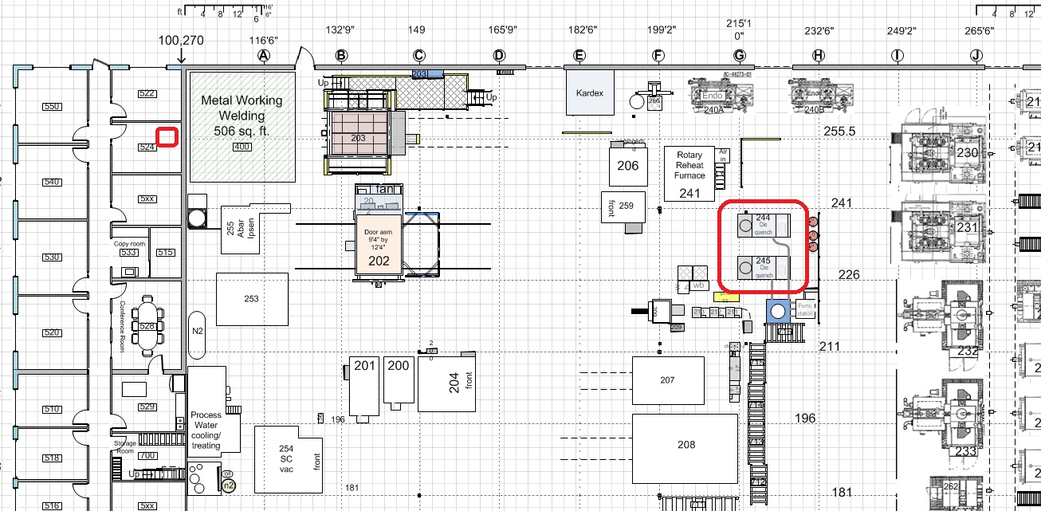

DeviceMaster® RTS
Remote programming can increase safety, comfort, and uptime.

Slide 6
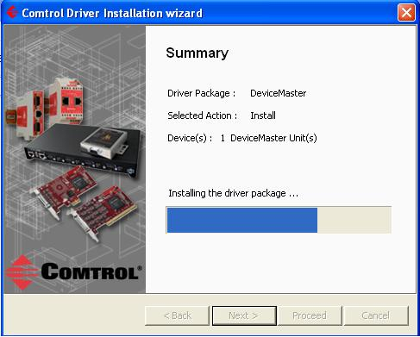
DeviceMaster® RTS
Connecting Serial to Ethernet
NS Link Firmware – Installation Summary

Slide 7
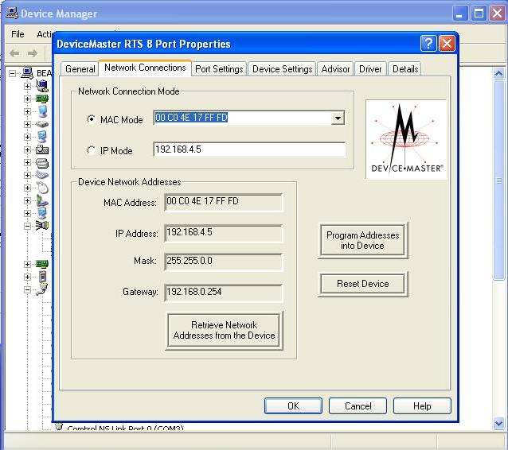
DeviceMaster® RTS
Connecting Serial to Ethernet
NS Link Firmware – Installation Summary

Slide 8
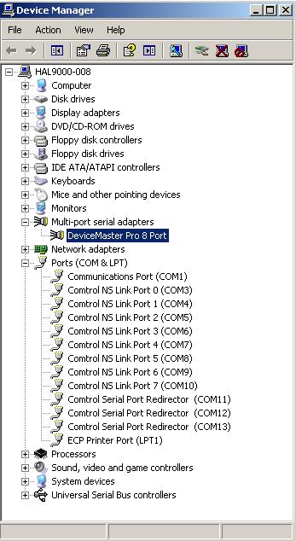
DeviceMaster® RTS
Connecting Serial to Ethernet
NS Link Firmware – Installation Summary

Slide 9
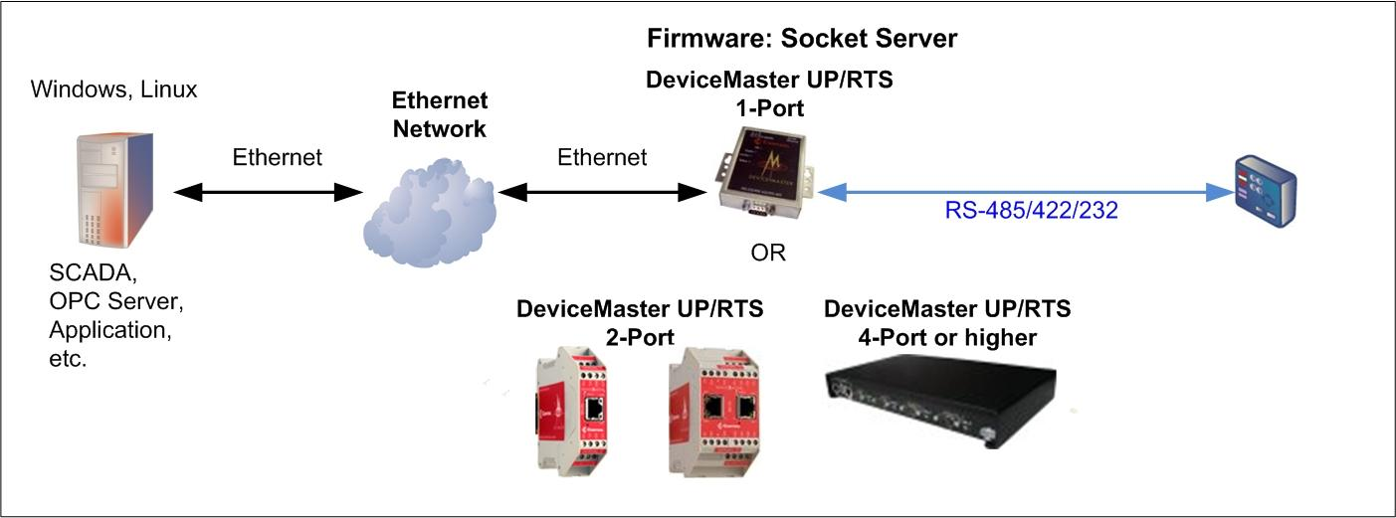
DeviceMaster® RTS
Connecting Serial to Ethernet
Socket Server Firmware
Data appears on a socket port.

Slide 10
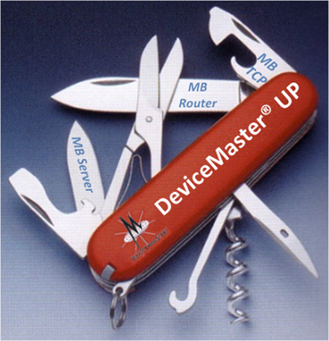
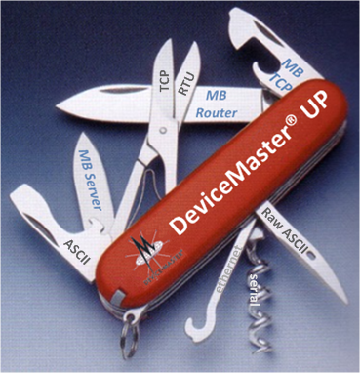
DeviceMaster® UP
Data Protocol Solutions from Comtrol Corporation

Slide 11
DeviceMaster® UP
UP stands for “Universal Protocol,” but…
What is an INDUSTRIAL DATA PROTOCOL?

Slide 12
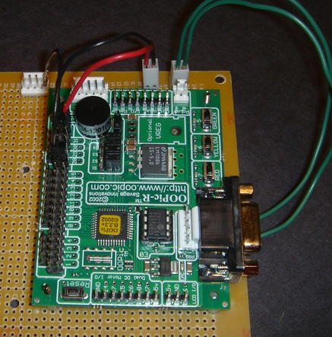
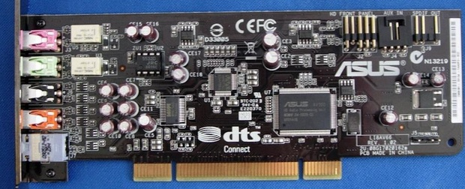
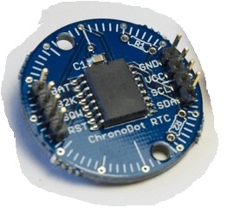
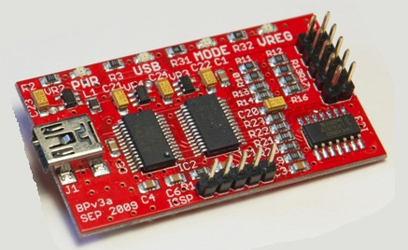
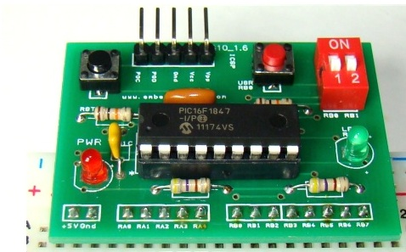
Industrial Data Protocol
X
X
X
X
X

Slide 13
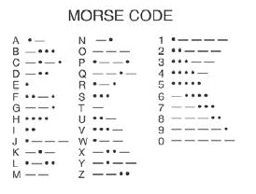
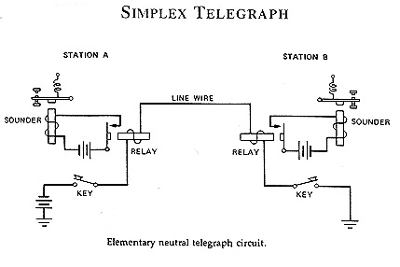
Industrial Data Protocol
Morse Code = NOT an Industrial Data Protocol, but one could consider an early ancestor, in a crude way…
Is this the first protocol specification?
The “physical layer” is simply a crude 2 wire arrangement with high power loss, limited range, and VERY low baud rate. Today’s physical media include fiber optic, CAT5/5E/6, and DB9 (Serial) among others.

Slide 14
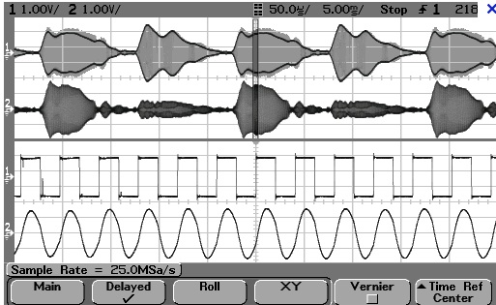
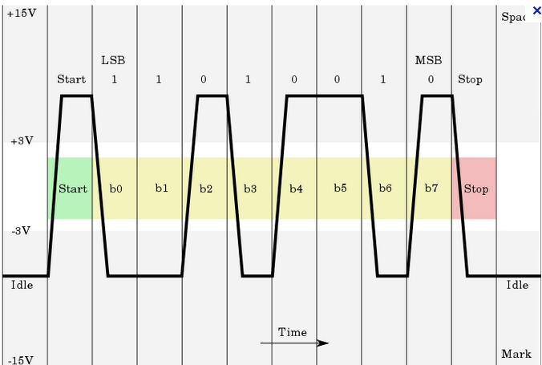
Industrial Data Protocol
Electrical information on a wire can be analog, which has an infinite number of possible values, or digital, which must have certain “discrete” values. (Ramp versus steps)
The signal on the right is digital. In fact, it is a capture of an RS232 signal. This particular trace represents the ASCII code for the letter “K”

Slide 15
DeviceMaster® UP
Data Protocol Solutions from Comtrol Corporation

Slide 16
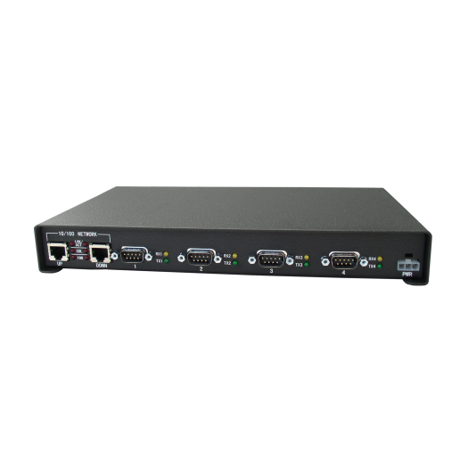
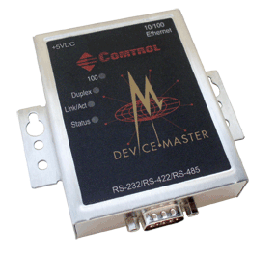
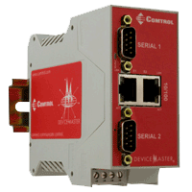
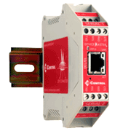



DeviceMaster UP Product Overview
Industrial Ethernet Connectivity
Protocol flexibility — EtherNet/IP, Modbus/TCP, Modbus RTU/ASCII,
PROFINET IO
Connectivity to both serial and Ethernet TCP/IP devices
Available models — 1-port, 2-port 1E, 2-Port 2E, 4-port, and embedded
Rugged housing—with panel, rack, and DIN rail mounting options
Daisy Chaining — on select models, use of dual Ethernet ports for daisy
chaining network connections between multiple units
Variable power input — eliminates the need for power converters
Temperature rated for extreme conditions — operating temperature
of –37° to 74°C enables DeviceMaster UP to function in a wide variety of
harsh environments

Slide 17
DeviceMaster® UP
“Universal Protocol”
EtherNet/IP
Profinet IO
Modbus
  3 major firmware builds
    Modbus Server*
    Modbus Router
    Modbus TCP
NS Link* and SocketServer*
*Can also run on DeviceMaster ® RTS hardware

Slide 18
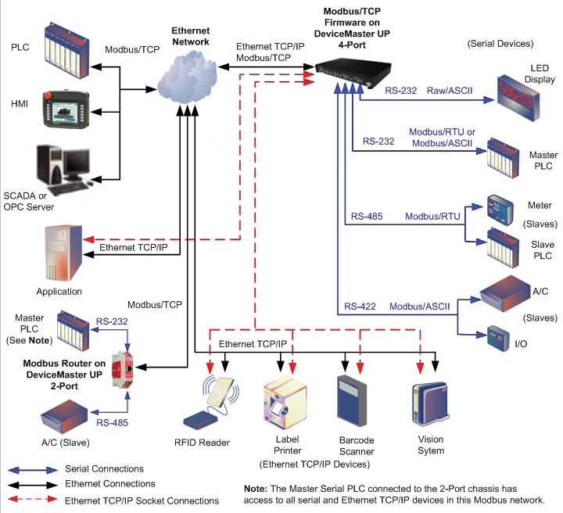
Modbus Solution Highlights
Three separate firmware applications for maximum flexibility.
Modbus/TCP Firmware
• Many unique Raw/ASCII handling features
• Multiple Modbus master and slave types
• Automatic protocol conversion and
routing
Modbus Router Firmware
• More Modbus master and slave types
• Automatic protocol conversion and
routing
• Turn serial Modbus masters into
Modbus/TCP masters for network wide
connectivity
Modbus Server Firmware
• Modbus/RTU over Ethernet TCP/IP master(s) to serial slave(s)
• Up to six Ethernet connections per serial
port

Slide 19
What is a PLC?
Ruggedized digital computer used to automate electromechanical processes.
Designed to interact with numerous digital and/or analog inputs and outputs.
Real time operation.
Programmable
Often used in factory automation, control of lighting, amusement parks, and other large electromechanical systems.
Includes communication ports such as serial and/or Ethernet, often with support for various Ethernet and serial protocols.

Slide 20
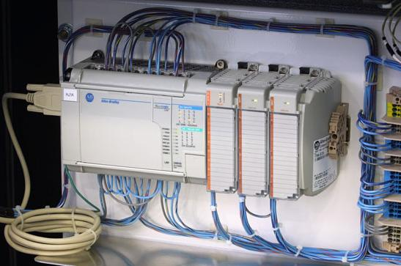
What is a PLC?
“Brick” PLC incorporates CPU, integrated IO, and comms (serial) all into one case
Expansion modules provide extra IO. Some brick PLCs support the use of expansion modules.
Indicator lights show status of IO. In some installations, this is the only “HMI”.

Slide 21
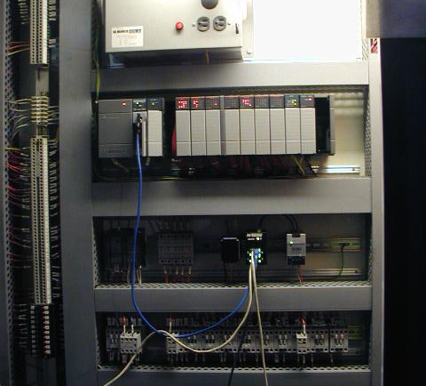
What is a PLC?
“Rack” type PLC has a standard chassis into which can be placed a number of different cards.
Cards may add discrete or analog IO, additional communication options, or other specialized capabilities.
This CPU is just to right of power supply, and includes the native serial and ethernet ports.

Slide 22
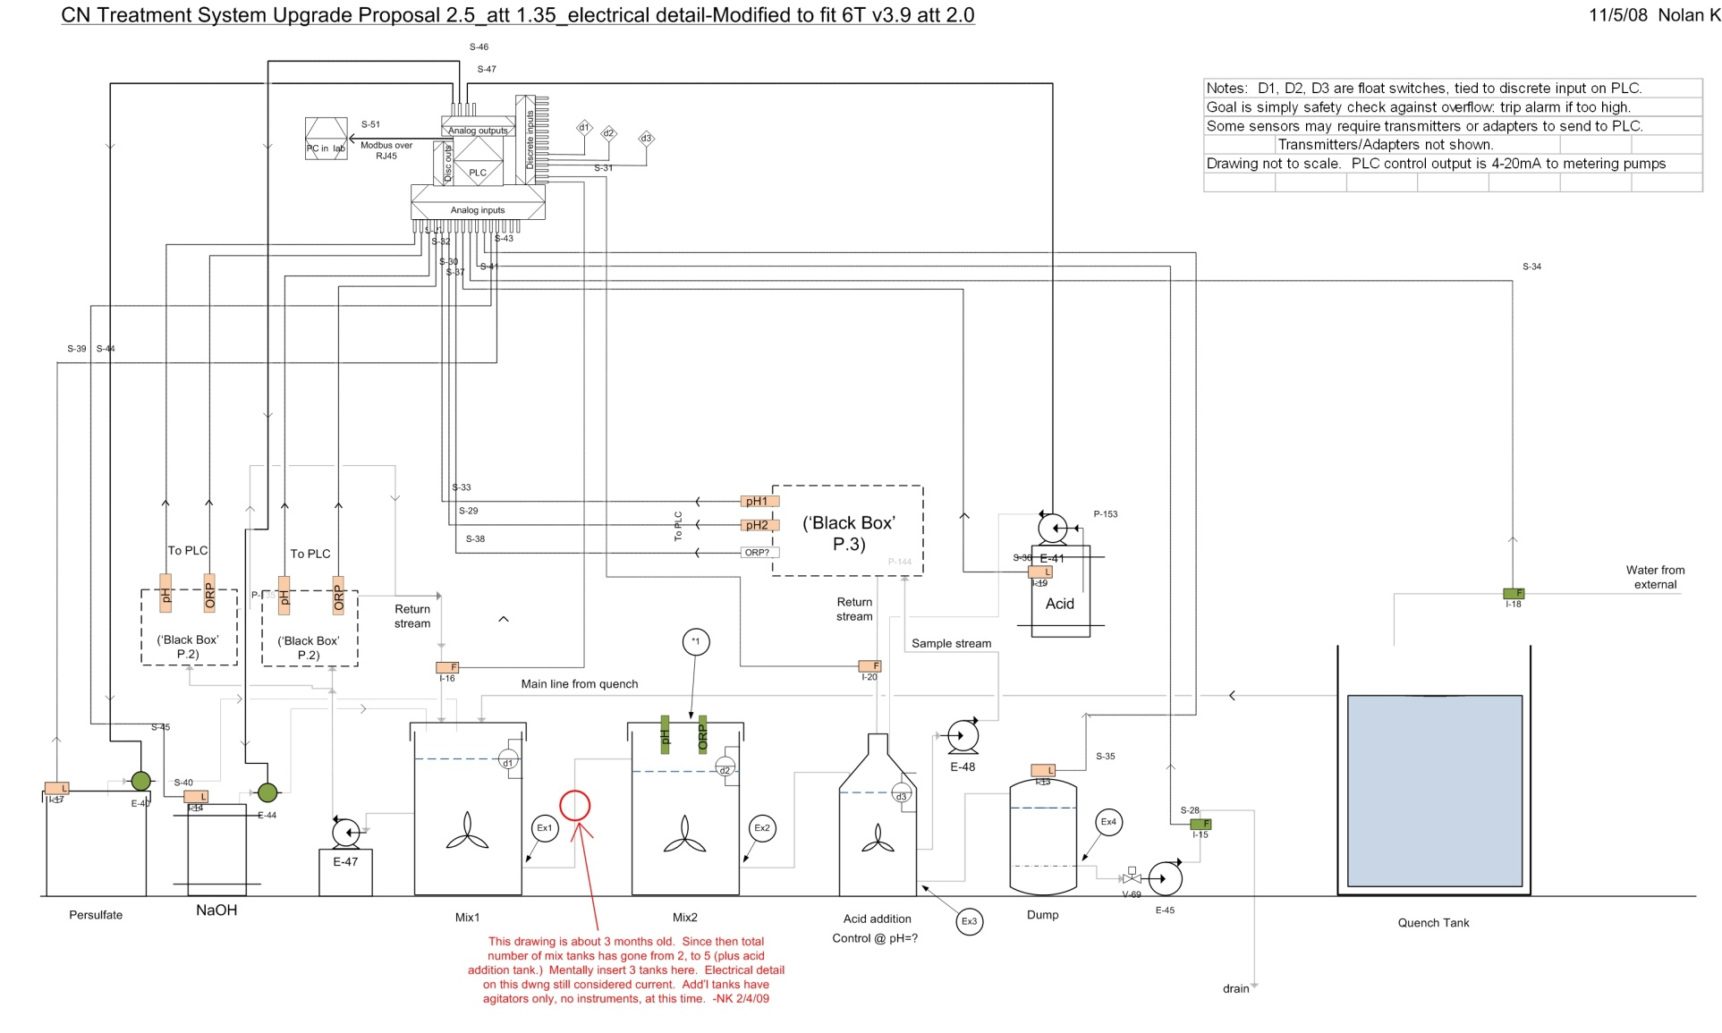
What is a PLC?

Slide 23
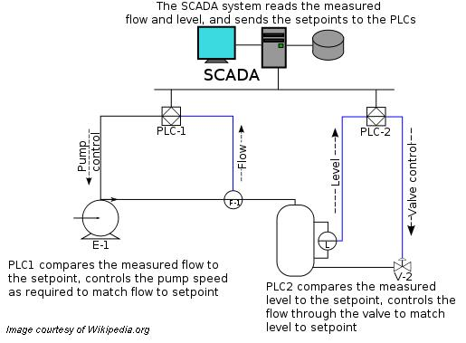
What is SCADA?
Supervisory Control and Data Acquisition
Serves as a “control center” or “dashboard”
Centralized system that monitors and may control entire sites or complexes of systems
One to many relationship; SCADA system often required to talk to end devices that communicate through different protocols. In these cases converters/ gateways may be used.

Slide 24
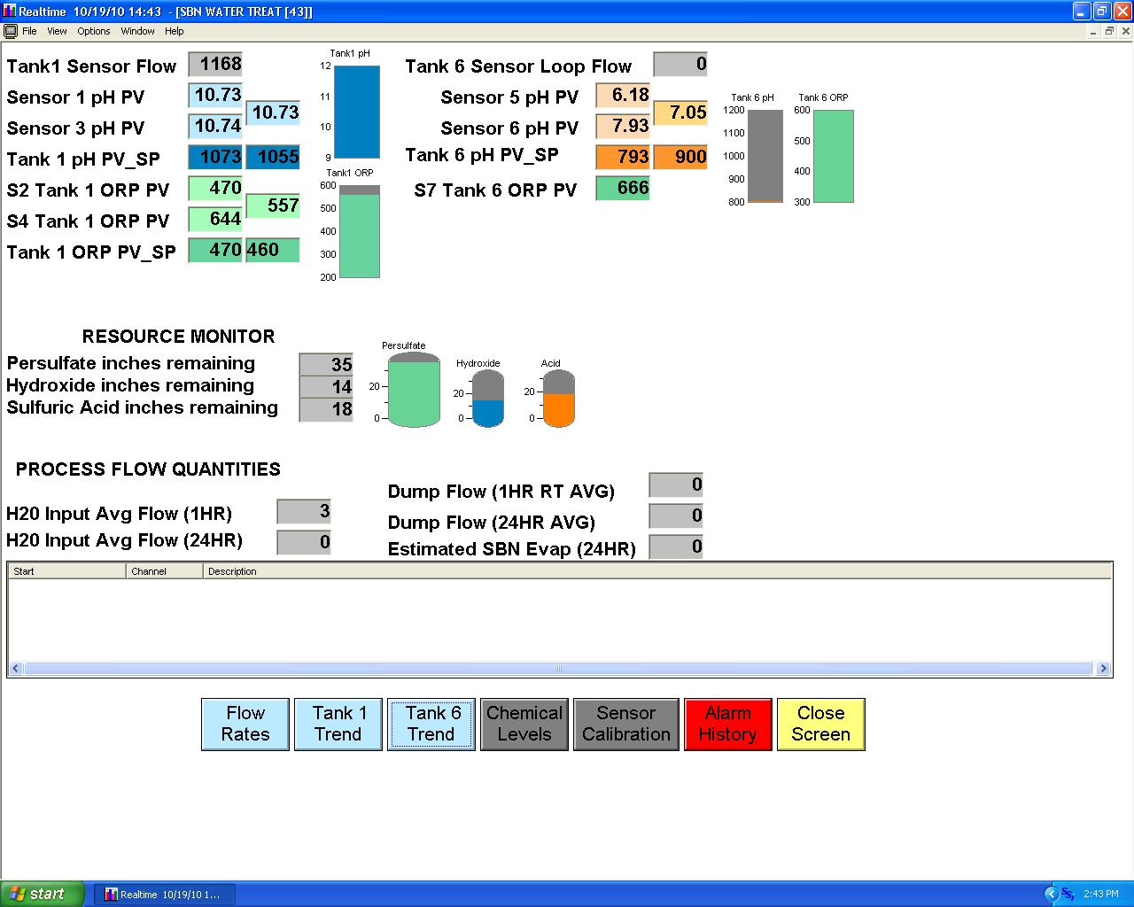
What is SCADA?
Supervisory Control and Data Acquisition
Serves as a “control center” or “dashboard”
Centralized system that monitors and may control entire sites or complexes of systems
One to many relationship; SCADA system often required to talk to end devices that communicate through different protocols. In these cases converters/ gateways may be used.

Slide 25
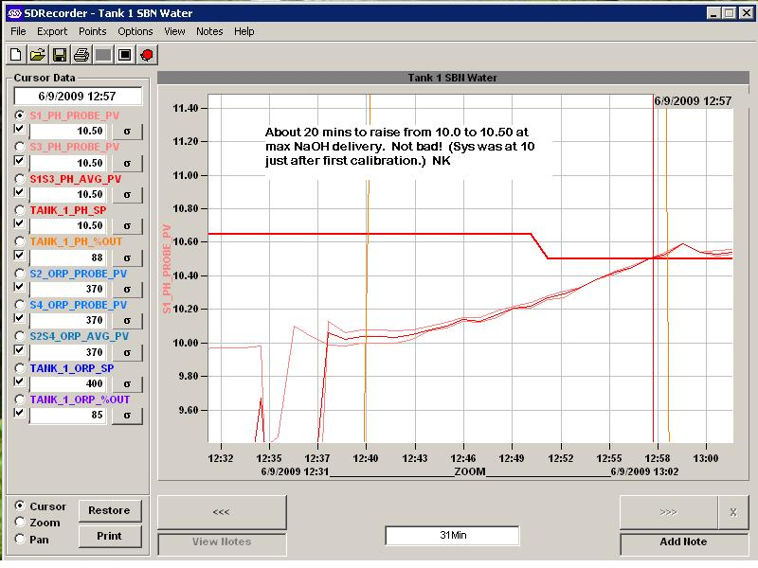
What is SCADA?

Slide 26
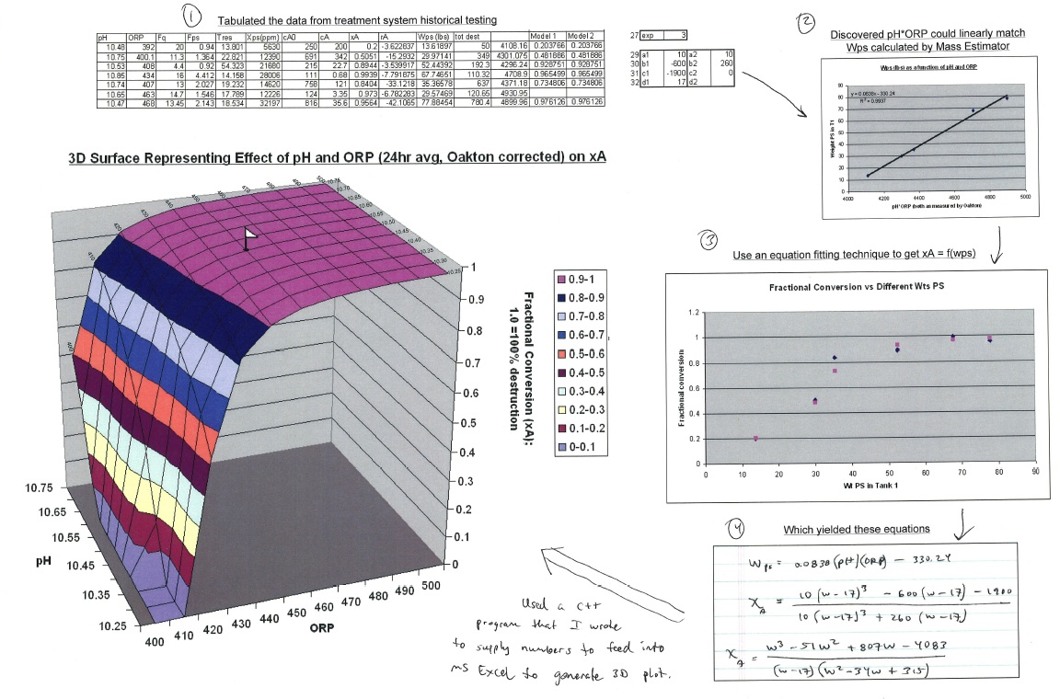
What would motivate one to use SCADA?

Slide 27
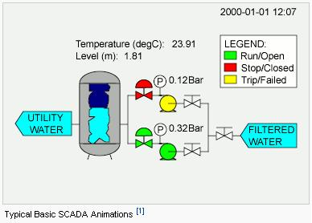
What does SCADA look like?
Many SCADA systems have HMI packages that use animation such as pictured here.

Slide 28
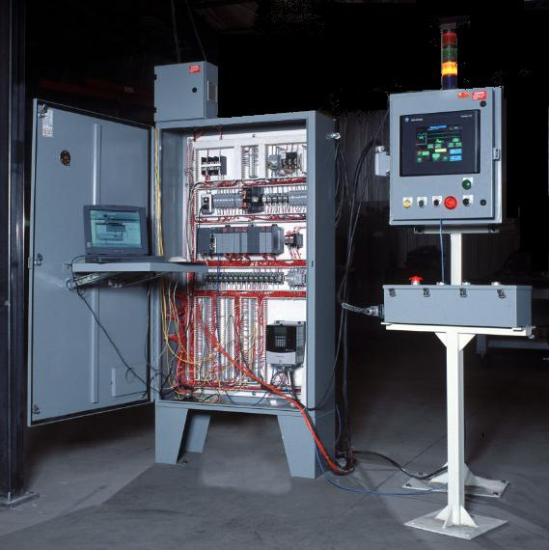
What is an HMI?
HMI stands for “Human-Machine Interface”
May be stand alone hardware or a software application running on a PC or Server.
A stand alone HMI is essentially a ruggedized GUI
May include certain special features. (Flash Memory card reader, data logging, etc…)

Slide 29
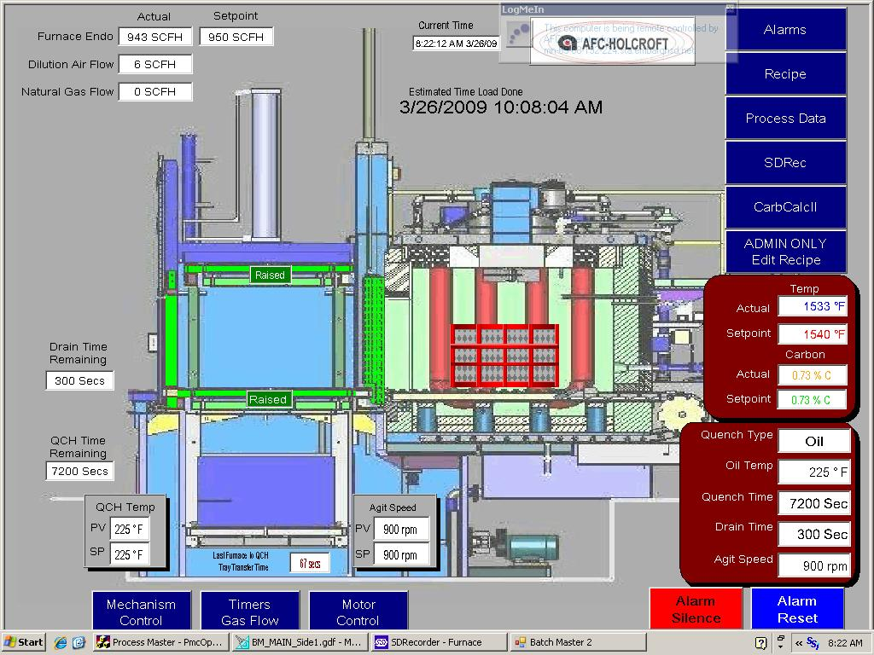
What is an HMI?
This interface runs on a Windows XP based touchscreen PC.

Slide 30
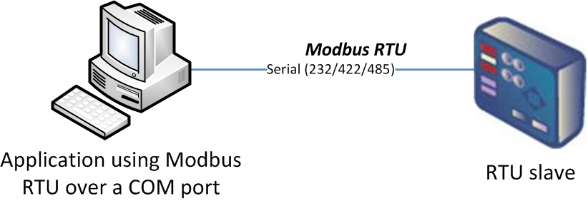
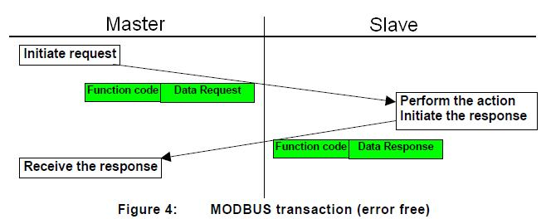
What is the “Master and Slave” concept?

Slide 31
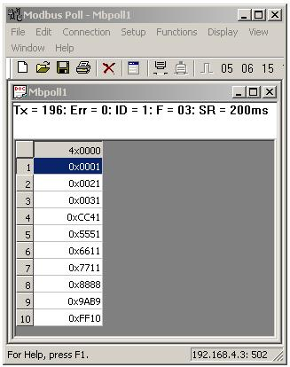
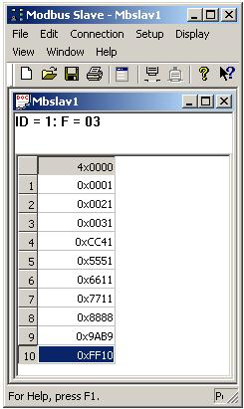
What is the “Master and Slave” concept?
Master Simulator
Slave Simulator
Request
Response

Slide 32

What is the “Master and Slave” concept?
Excerpt from the DeviceMaster ® UP Serial Logs
Request
Master Simulator
Response
Slave Simulator
Request
Response

Slide 33
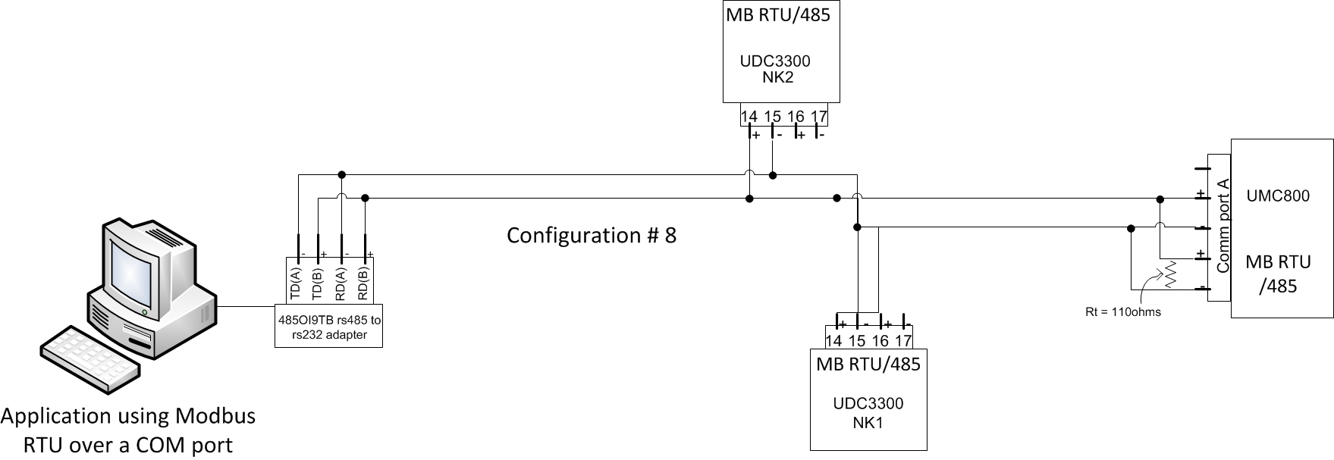
What is the “Master and Slave” concept?
This could be considered a “classic” older installation that does not benefit from modern Modbus capabilities. PC must handle serial Modbus RTU, user must purchase an adapter, and all wiring connections pictured above are hardwired. All devices understand traditional MB RTU signals only. Distances are limited.

Slide 34
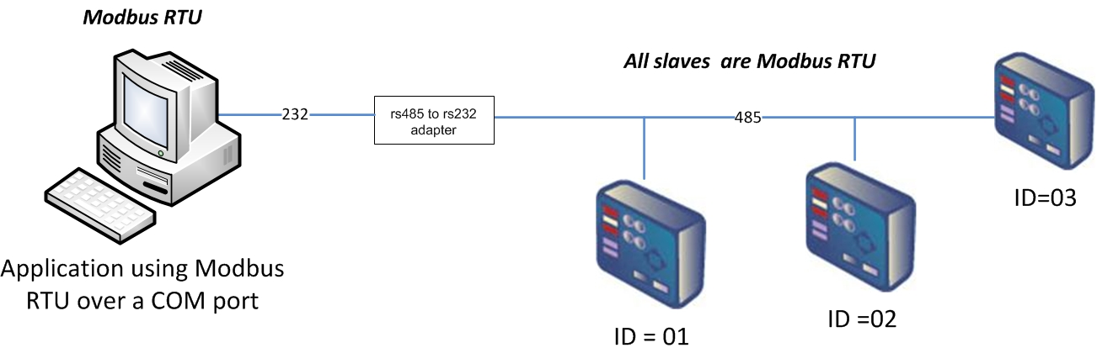
What is the “Master and Slave” concept?
This could be considered a “classic” older installation that does not benefit from modern Modbus capabilities. PC must handle serial Modbus RTU, user must purchase an adapter, and all wiring connections pictured above are hardwired. All devices understand traditional MB RTU signals only. Distances are limited.

Slide 35


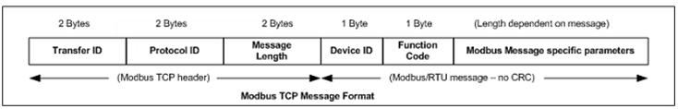
What are some important types of Modbus?
Modbus RTU
Modbus RTU is native Modbus in hexadecimal format. These are the base Modbus messages that contain simple read and write requests. The format is as follows:
*
*
Modbus ASCII
Modbus ASCII is native Modbus in ASCII format. Like Modbus RTU, Modbus ASCII contains the base Modbus messages that contain simple read and write requests. Unlike MB RTU, message data is sent in (hexadecimal) ASCII format, so the message length is twice as long. It requires two ASCII characters per byte of data. Also, MB ASCII uses LRC instead of the CRC used by MB RTU.
The format is as follows:
Modbus/TCP
Modbus TCP is an Ethernet network based protocol that contains a Modbus RTU message, with the exception of the 2 byte CRC. The Modbus TCP message contains a header with information designed to provide message identification and routing information. The format is as follows:
*
RTU and ASCII can also be run within the TCP/IP framework. Modbus over Ethernet,
or “RTU/ASCII over TCP/IP” is different than Modbus TCP!
We support all 5 types.

Slide 36

Modbus Solution Highlights
Three separate firmware applications for maximum flexibility.
Modbus/TCP Firmware
• Many unique Raw/ASCII handling features
• Multiple Modbus master and slave types
• Automatic protocol conversion and
routing
Modbus Router Firmware
• More Modbus master and slave types
• Automatic protocol conversion and
routing
• Turn serial Modbus masters into
Modbus/TCP masters for network wide
connectivity
Modbus Server Firmware
• Modbus/RTU over Ethernet TCP/IP master(s) to serial slave(s)
• Up to six Ethernet connections per serial
port

Slide 37
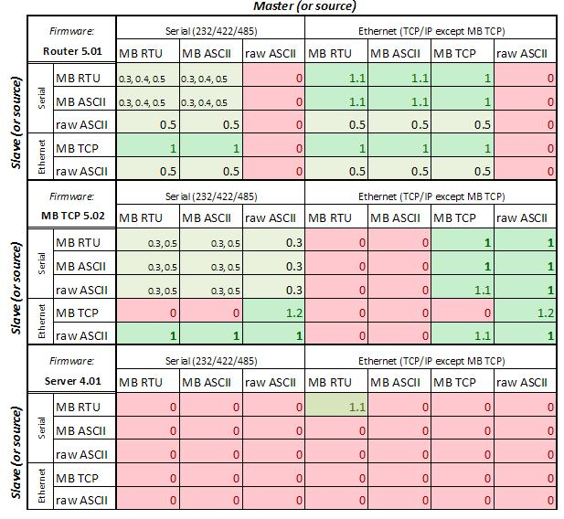
Modbus Solution Highlights
Three separate firmware applications for maximum flexibility.
Modbus Router Firmware
• Most Modbus master and slave types
• Best choice if no raw ASCII devices, and no “C2C” needed
Modbus/TCP Firmware
• Handles raw ASCII devices
• Unique Controller to Controller capabilities (Master to Master, Slave to Slave)
Modbus Server Firmware
• Modbus RTU Only, but runs on RTS
• Up to 32 ports, above only runs 4

Slide 38
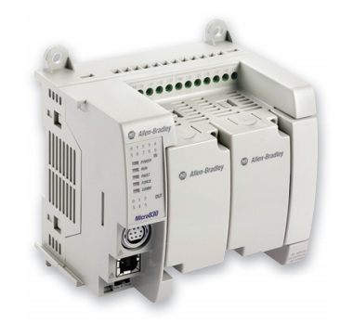
Expanding the marketability of Modbus Equipment
A specific look at the new Micro800, esp. the Micro830

Slide 39
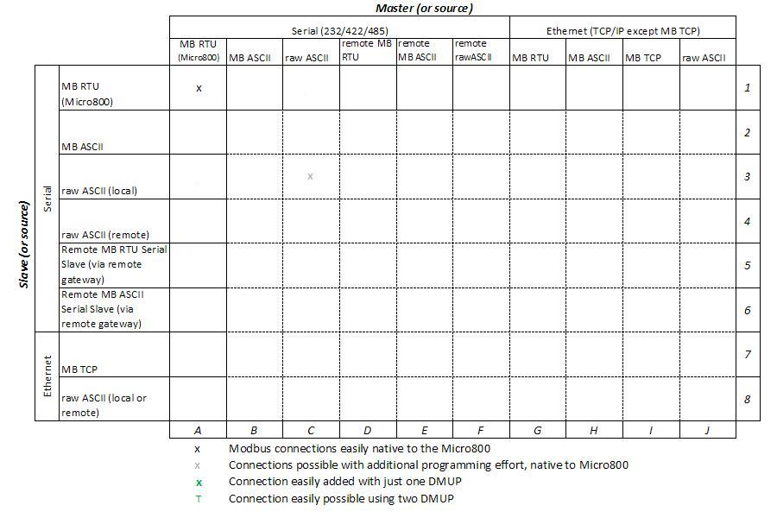
Expanding the marketability of Modbus Equipment
A specific look at the new Micro800, esp. the Micro830

Slide 40
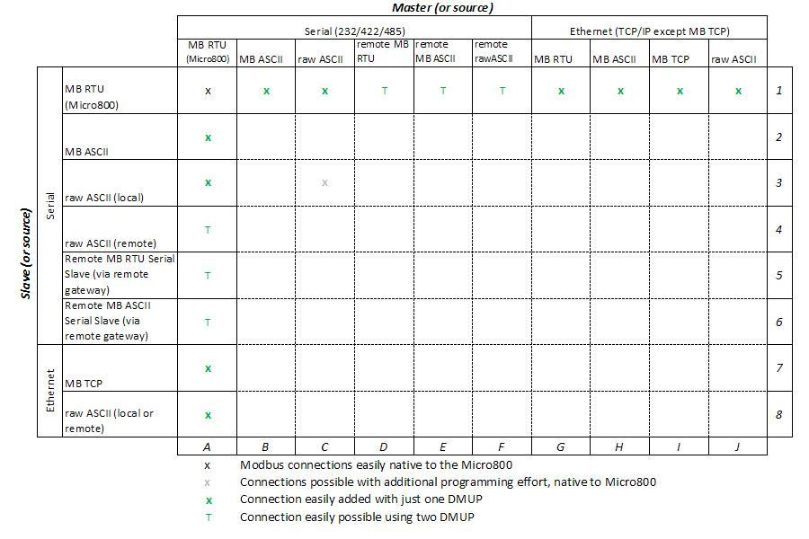
Expanding the marketability of Modbus Equipment
A specific look at the new Micro800, esp. the Micro830

Slide 41
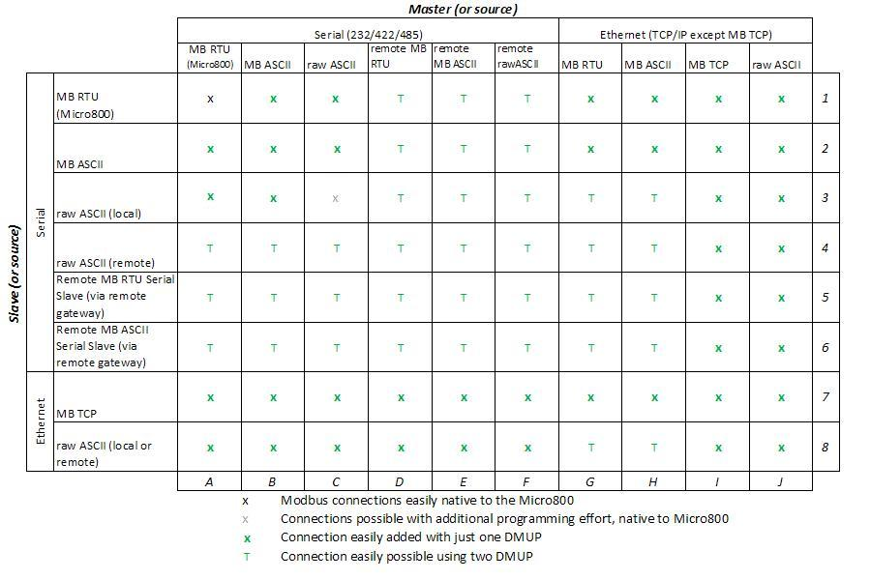
Expanding the marketability of Modbus Equipment
A specific look at the new Micro800, esp. the Micro830
This matrix indicates Devicemaster UP (Modbus) connectivity in the FULL, or general context, not specific to the Micro830

Slide 42
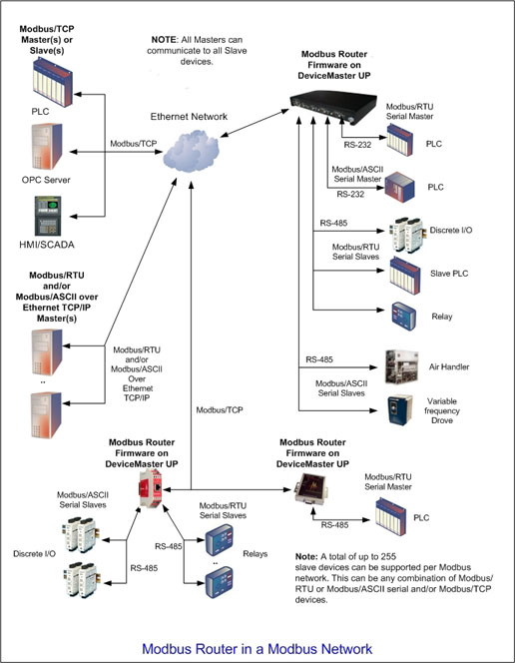
Modbus Router Firmware
Pure Modbus, more Modbus master and slave types , remote and local devices
Provides increased Modbus connectivity
options
More Modbus master and slave types
Automatic protocol conversion and
routing
Turn serial Modbus masters into
Modbus/TCP masters for network wide
connectivity
Connect Modbus masters to Modbus
devices anywhere on a network
Simultaneously connect multiple Modbus
masters to individual slave devices

Slide 43

Modbus Router Firmware
Pure Modbus, more Modbus master and slave types , remote and local devices

Slide 44

Modbus Router Firmware
Pure Modbus, more Modbus master and slave types , remote and local devices

Slide 45

Modbus Router Firmware
Pure Modbus, more Modbus master and slave types , remote and local devices

Slide 46

Modbus Router Firmware
Pure Modbus, more Modbus master and slave types , remote and local devices

Slide 47

Modbus Router Firmware
Pure Modbus, more Modbus master and slave types , remote and local devices

Slide 48
Modbus Router Highlights
Masters
o Modbus/TCP
o Modbus RTU/ASCII serial
o Modbus RTU/ASCII over Ethernet TCP/IP
Slaves
o Modbus/TCP
o Modbus RTU/ASCII serial
o Remote Modbus RTU/ASCII serial
· All masters can communicate to all slaves – whether local or remote
· Up to 255 Modbus slave devices per gateway
· No limit on number of slave devices per serial port
· Automatically locates slave devices and routes messages
Automatic protocol conversion and routing·
Advanced serial port and slave device specific diagnostic capabilities via embedded web pages

Slide 49



Slide 50


Slide 51

Turn serial Modbus masters into Modbus/TCP masters for network wide connectivity…

Slide 52


Modbus Router Firmware : Solutions to Common Problems
#1: Moving a Modbus Device
Existing Implementation: Modbus/RTU serial master communicating to a number of Modbus slave devices on a RS-485 loop.

Slide 53
Modbus Router Firmware : Solutions to Common Problems
#1: Moving a Modbus Device
Requirements:
One or more of the slave devices must be moved and the distance is too great to remain on the RS-485 serial loop.
It is desired that the PLC program remain unchanged.

Slide 54

Modbus Router Firmware : Solutions to Common Problems
#1: Moving a Modbus Device
Solution:
Connect a 2-Port DeviceMaster UP running Modbus Router between the Modbus/RTU master and the remaining serial devices.
Connect a 1-Port DeviceMaster UP running Modbus Router to the moved devices.
Connect the two DeviceMasters to an Ethernet network.
Configure the DeviceMasters:
  1-Port DeviceMaster serial port set to Modbus/RTU-to-Slaves.
  2-Port DeviceMaster 1:
    Serial port 1 set to Modbus/RTU-to-Master (to the PLC)
    Serial port 2 set to Modbus/RTU-to-Slaves
    Devices connected to the 1-Port DeviceMaster configured as remote.
No changes required to the PLC program. All system changes are transparent.

Slide 55

Modbus Router Firmware : Solutions to Common Problems
#1: Moving a Modbus Device : Solved
Over half the devices populating the loop have been relocated with very little effort!
The PLC program did not change one iota. In fact, the PLC is not even aware that anything is different!
The devices have successfully been relocated without paying for engineering time on the PLC!

Slide 56
Modbus Router Firmware : Solutions to Common Problems
#2: Adding Ethernet Modbus Masters to an Existing System
Existing Implementation: Modbus/RTU serial master communicating to a number of Modbus slave devices on a RS-485 loop.

Slide 57
Modbus Router Firmware : Solutions to Common Problems
#2: Adding Ethernet Modbus Masters to an Existing System
Requirements:
One or more Ethernet Modbus masters must be added to the system and provide access to the Modbus slaves.
It is desired that the PLC program remain unchanged.

Slide 58
Modbus Router Firmware : Solutions to Common Problems
#2: Adding Ethernet Modbus Masters to an Existing System
Solution:
Connect a 2-Port DeviceMaster UP running Modbus Router between the Modbus/RTU master and serial devices.
Connect the DeviceMaster UP to an Ethernet network.
Configure the DeviceMaster UP:
  Serial port 1 set to Modbus/RTU-to-Master (to the PLC)
  Serial port 2 set to Modbus/RTU-to-Slaves
  If required, configure the Modbus RTU/ASCII over Ethernet TCP/IP interface.
No changes required to the existing PLC program. All system changes are transparent to the existing PLC.

Slide 59

Modbus Router Firmware : Solutions to Common Problems
#2: Adding Ethernet Modbus Masters (HMI) to an Existing System : Solved
Ethernet Modbus Master(s) added easily to the existing system
Since your connections are now passing through a Devicemaster, you can access advanced communication stats and diagnostic data!
The master(s) have been successfully added without spending time on the PLC!

Slide 60




Modbus Router: One of the many helpful diagnostics screens
Detailed Communication Statistics are automatically generated continuously and can be found on a separate page by clicking here.
“Modbus/TCP interface diagnostics” will automatically track various errors and provide descriptions of problems
Remote Devices have been added…

Slide 61

Modbus Router: Real Configuration Example

Slide 62



Modbus Router: Real Configuration Example: Shared Memory allows Master to Master communications in addition to other traffic
If desired, HMI B can communicate to HMI C without any of the RTU devices 1-9 being involved at all. One Master writes into DMUP shared memory, and the other reads from there.

Slide 63

Modbus Router: Real Configuration Example: Shared Memory allows Master to Master communications in addition to other traffic

Slide 64
Modbus Router: Real Configuration Example: Shared Memory allows Master to Master communications in addition to other traffic
There are 8 x 200 holding registers and 8 x 160 coils

Slide 65

Modbus Router: Real Configuration Example: Shared Memory allows Master to Master to Master to Master communications in addition to other traffic

Slide 66

Modbus Router: Special Features: Selective Broadcast with Remote Devices

Slide 67

Modbus Router: Special Features: Selective Broadcast with Remote Devices

Slide 68

Modbus Router: Special Features: Read Only Mode
Can you think of at least two uses for Read Only mode?
Cyber Security
Preventing unauthorized changes internally

Slide 69

Modbus Router: Special Features: Alias and Offset

Slide 70

100 Fifth Avenue NW
New Brighton, MN 55112
763.957.6000
sales@comtrol.com
www.comtrol.com

