Slide 1
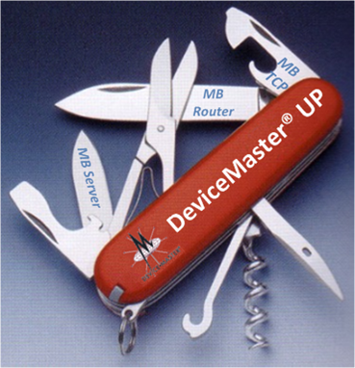
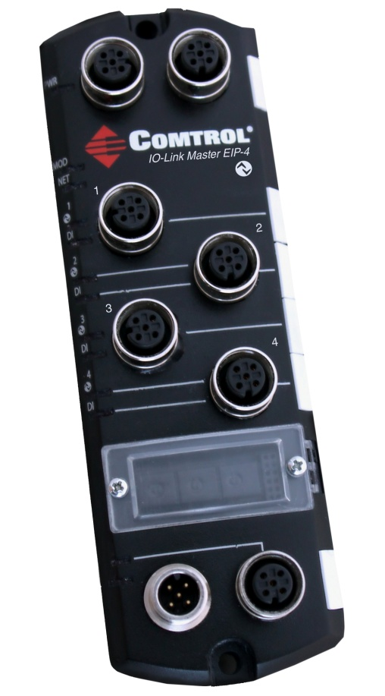
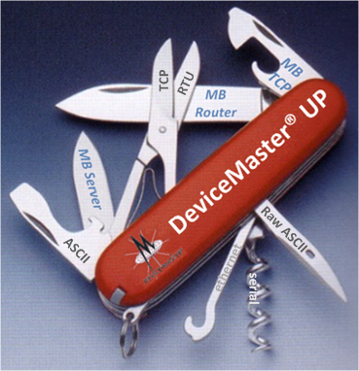
DeviceMaster® UP
and
Data Protocol Solutions from Comtrol Corporation

Slide 2
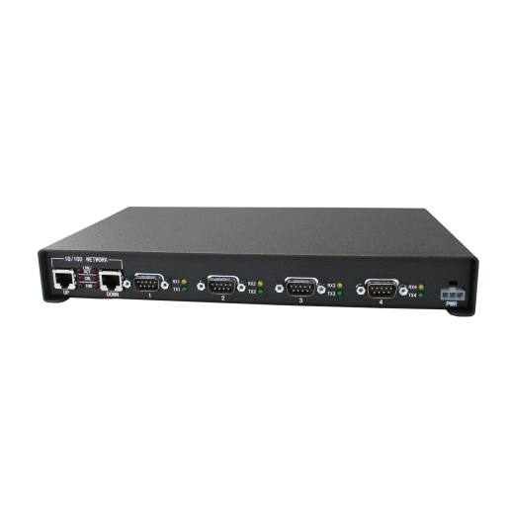
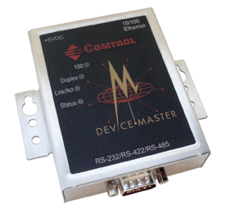
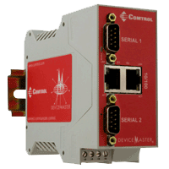
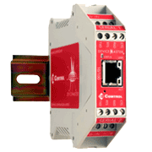
DeviceMaster UP Product Overview
Industrial Ethernet Connectivity
Protocol flexibility — EtherNet/IP, Modbus/TCP, Modbus RTU/ASCII, PROFINET IO
Connectivity to both serial and Ethernet TCP/IP devices
Available models — 1-port, 2-port 1E, 2-Port 2E, 4-port, and embedded
Rugged housing—with panel, rack, and DIN rail mounting options
Daisy Chaining — on select models, use of dual Ethernet ports for daisy chaining network connections between multiple units
Variable power input — eliminates the need for power converters
Temperature rated for extreme conditions — operating temperature of –37° to 74°C enables DeviceMaster UP to function in a wide variety of harsh environments

Slide 3
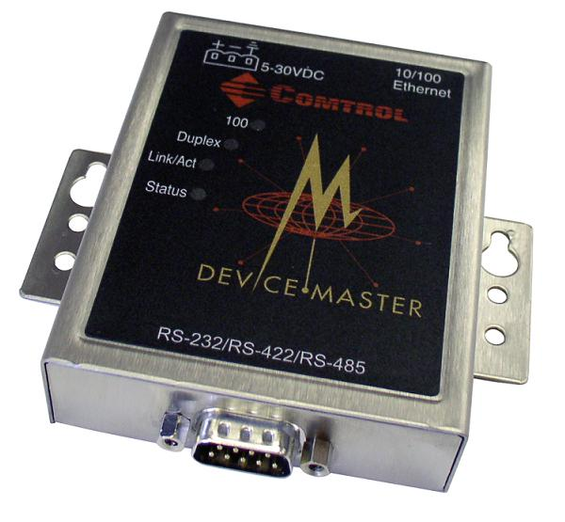
DeviceMaster® UP
“Universal Protocol”
EtherNet/IP
Profinet IO
Modbus
3 major firmware builds
Modbus Server*
Modbus Router
Modbus TCP
NS Link* and SocketServer*
*Can also run on DeviceMaster ® RTS hardware

Slide 4
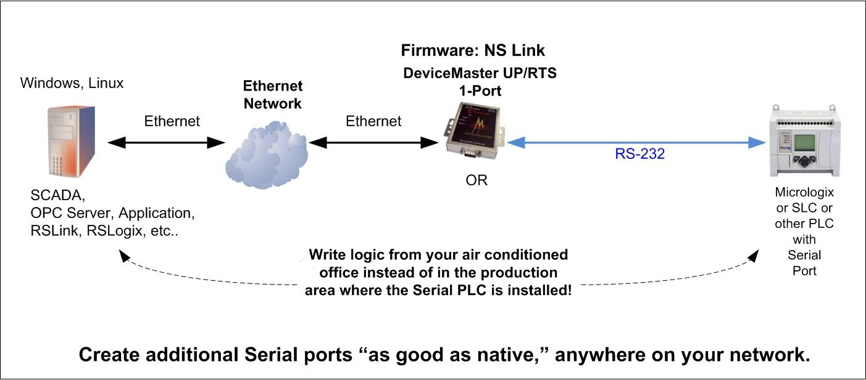
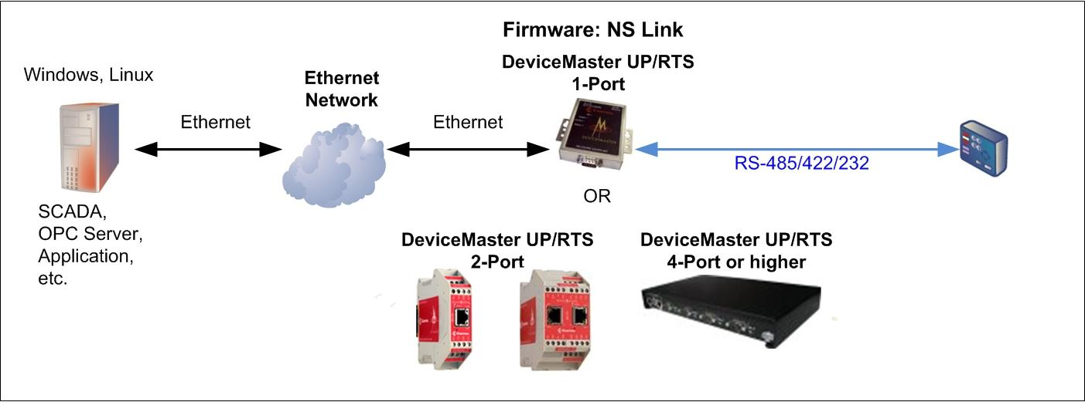
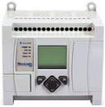
DeviceMaster® RTS
Connecting Serial to Ethernet
NS Link Firmware
Micrologix (or other PLC that can be programmed through it’s serial port)
Additional “like native” COM ports appear.

Slide 5
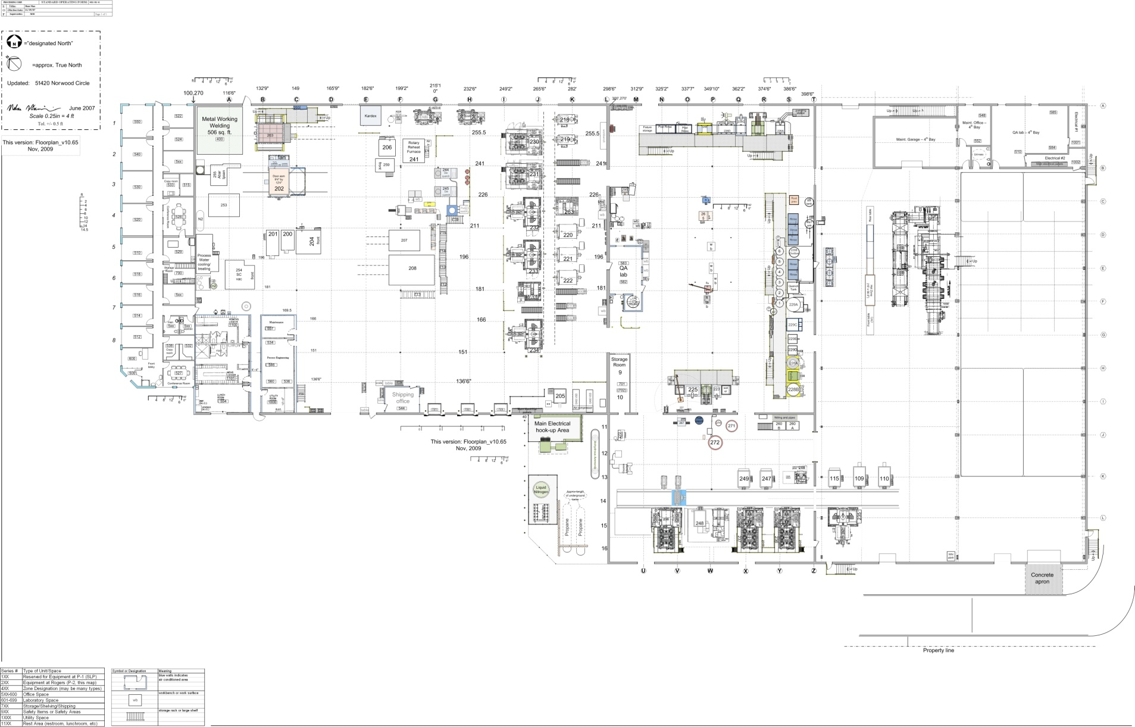
DeviceMaster® RTS
A large factory may have a huge variety of sensors, instruments, devices, PLCs, and Industrial Computers. More often than not, they are of mixed heritage.

Slide 6
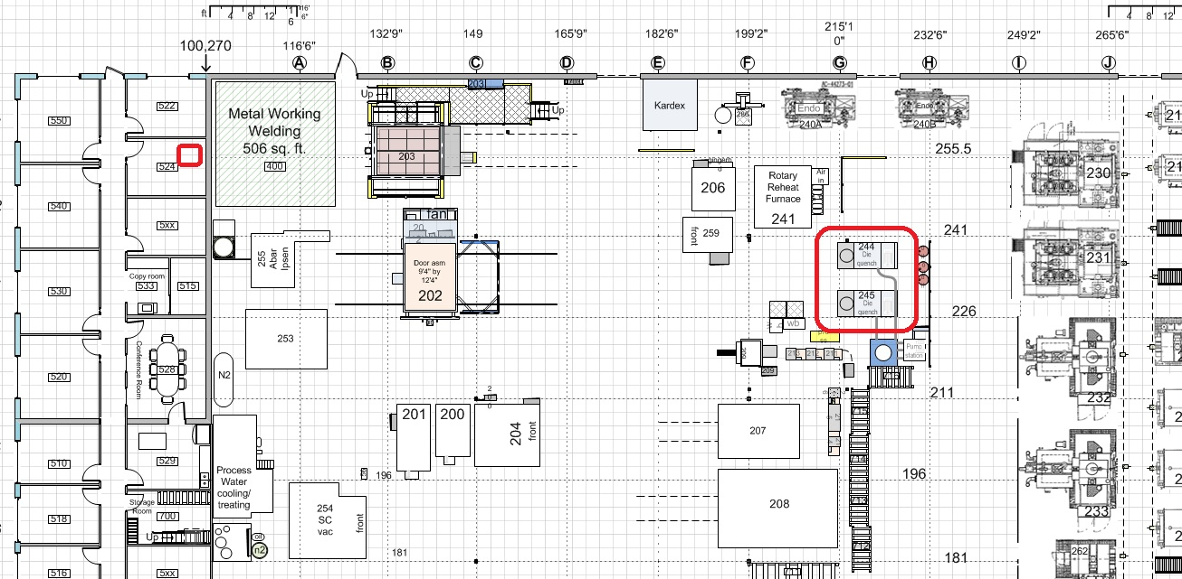
DeviceMaster® RTS
Remote programming can increase safety, comfort, and uptime.

Slide 7
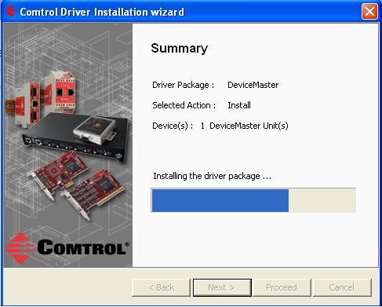
DeviceMaster® RTS
Connecting Serial to Ethernet
NS Link Firmware – Installation Summary

Slide 8
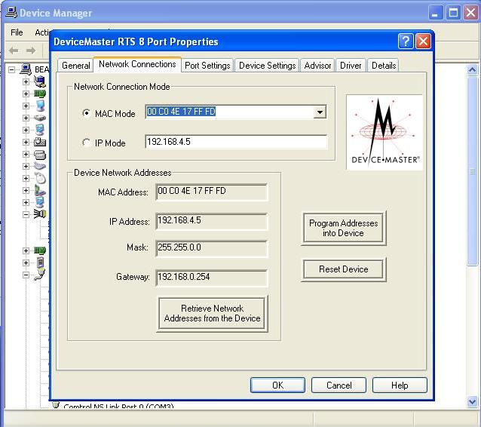
DeviceMaster® RTS
Connecting Serial to Ethernet
NS Link Firmware – Installation Summary

Slide 9
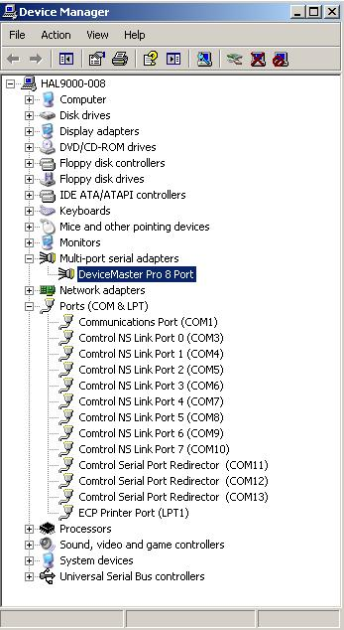
DeviceMaster® RTS
Connecting Serial to Ethernet
NS Link Firmware – Installation Summary

Slide 10
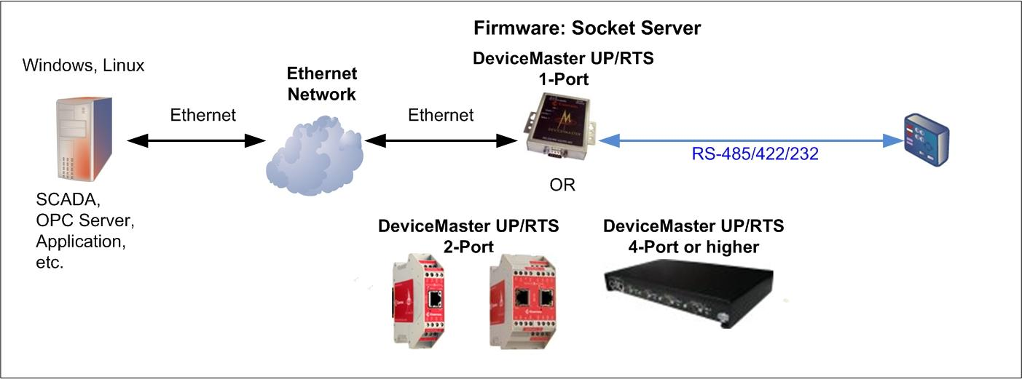
DeviceMaster® RTS
Connecting Serial to Ethernet
Socket Server Firmware
Data appears on a socket port.

Slide 11
DeviceMaster® UP
Data Protocol Solutions from Comtrol Corporation

Slide 12
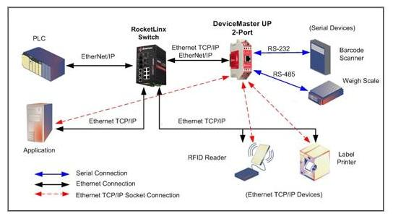
EtherNet/IP Firmware
Ethernet/IP to serial and Ethernet TCP/IP raw/ASCII devices

Slide 13
EtherNet/IP Firmware
• Connectivity – Ethernet/IP to serial and Ethernet TCP/IP raw/ASCII devices • Low-latency updates of received packets to PLC memory. Typically less than 10 ms • Connectivity to high-speed devices. Supports message rates as high as 50 updates per second when receive mode is configured to Write-to-Tag/File
• Large received packet support – up to 1518 bytes serial and 2048 bytes Ethernet TCP/IP
• Received packet size control – truncate or drop oversized packets
• Message Throttling – ensures PLC can process each received data packet
• Intelligent packet identification – start and end of transmission character detection/appending
• Three methods of receive communication to the PLC – Write-to-Tag/File, Write-to-Tag/File-Synced, and Polling
• Vendor Specific CIP objects – configuration, data transfer, and statistics

Slide 14
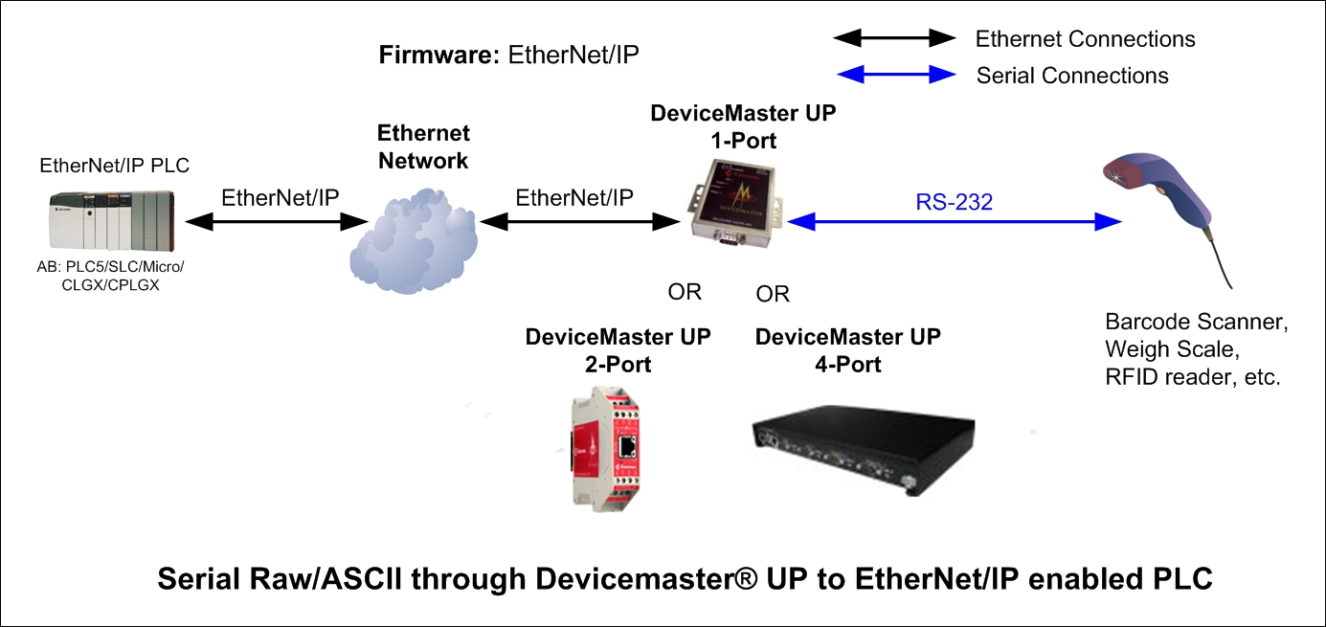
EtherNet/IP Firmware: Specific Configuration Example
How would I configure this?

Slide 15
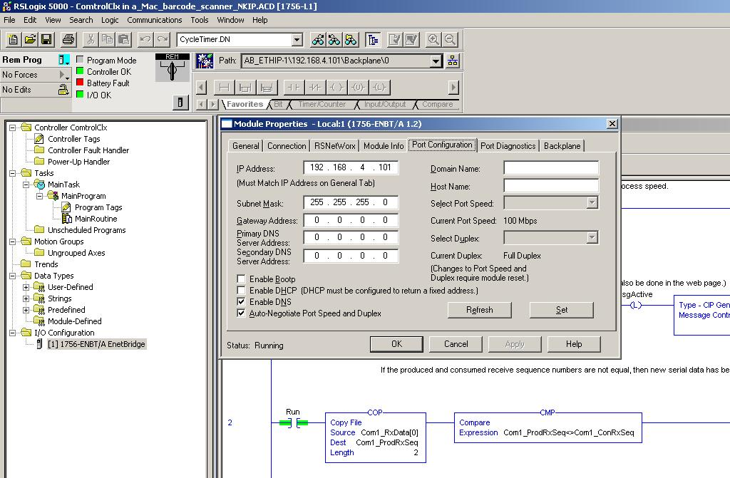
EtherNet/IP Firmware: Specific Configuration Example
[Establish that your PLC and Devicemaster can see each other.]
How would I configure this?

Slide 16
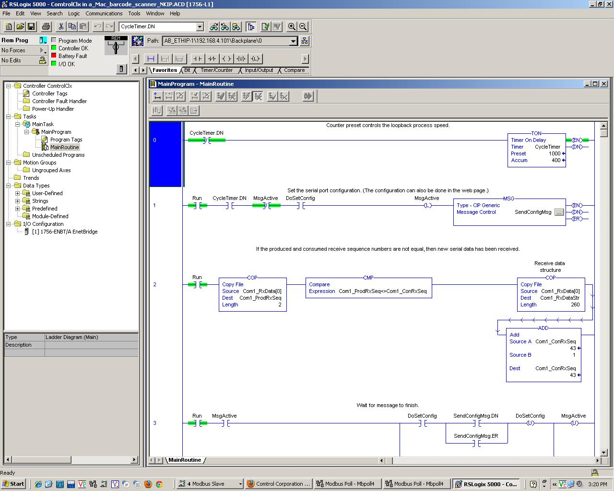
EtherNet/IP Firmware: Specific Configuration Example
Write your own PLC logic, or borrow/use/ keep/modify our examples provided on the CD with every Devicemaster
How would I configure this?

Slide 17
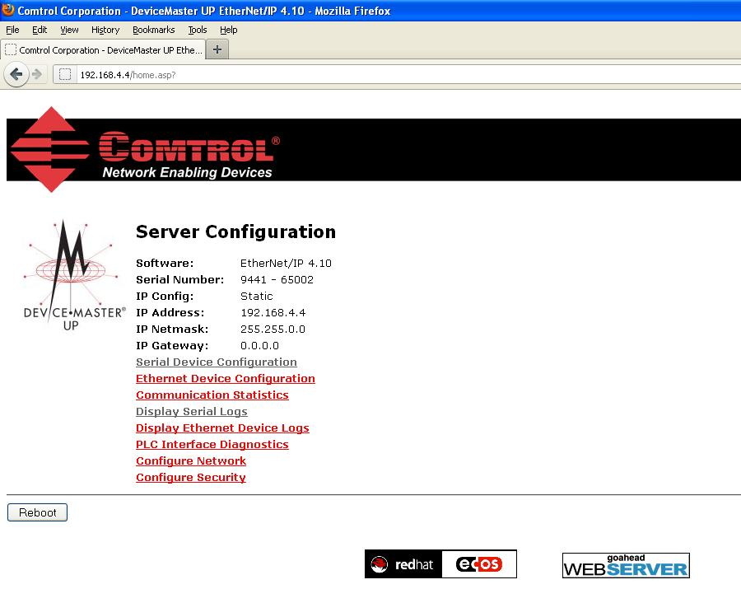
EtherNet/IP Firmware: Specific Configuration Example
How would I configure this?

Slide 18
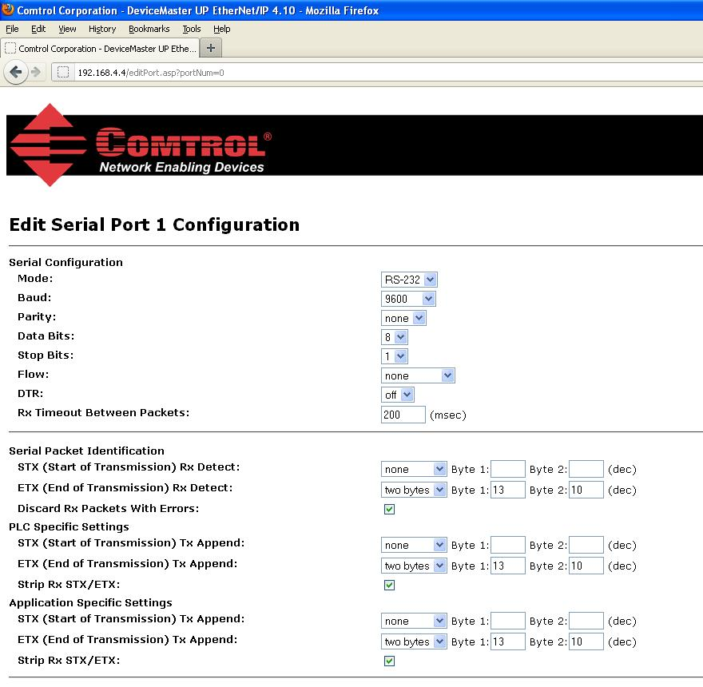
EtherNet/IP Firmware: Specific Configuration Example

Slide 19
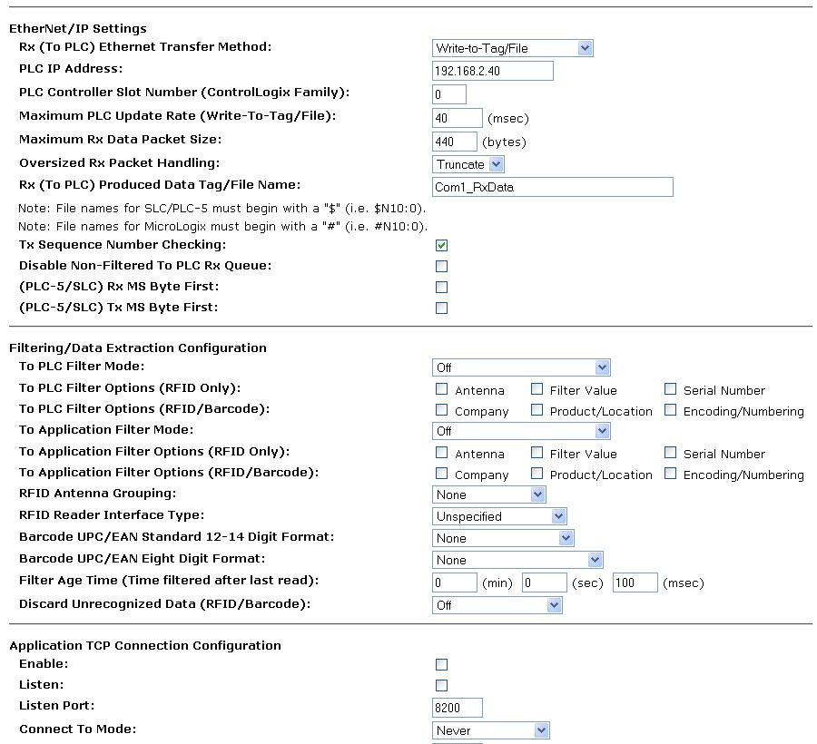
EtherNet/IP Firmware: Specific Configuration Example

Slide 20
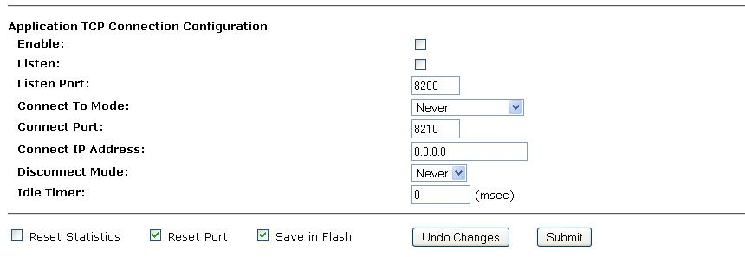
EtherNet/IP Firmware: Specific Configuration Example
How would I configure this?

Slide 21
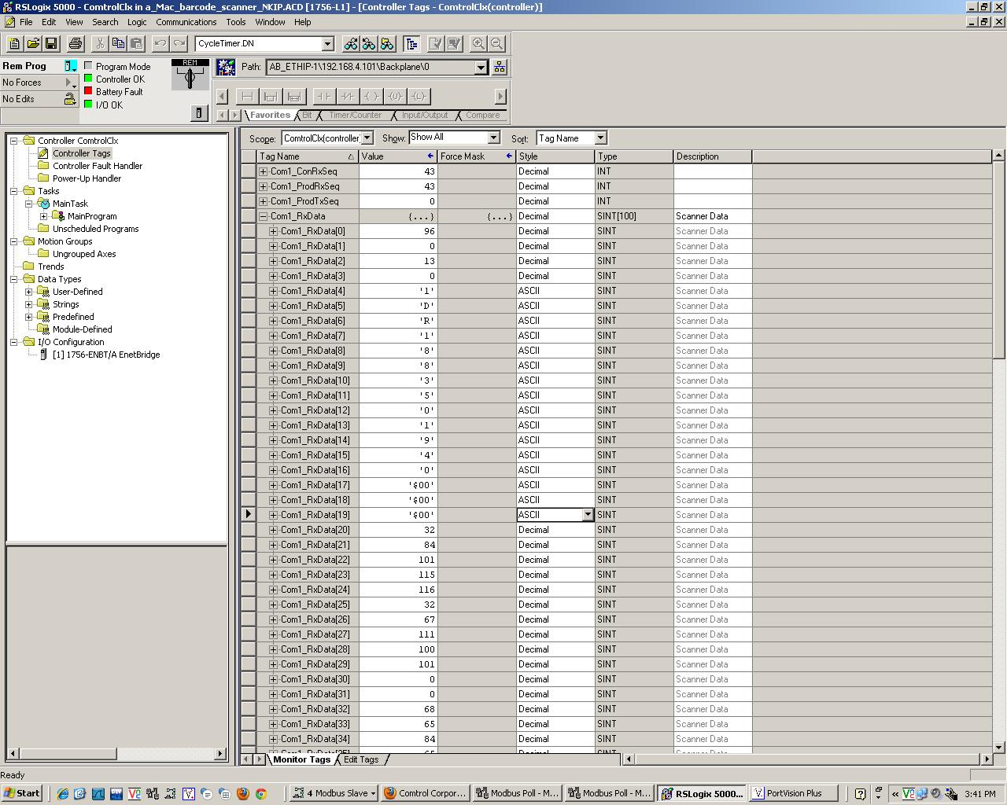
EtherNet/IP Firmware: Specific Configuration Example
In the DMUP, for each path you can specify which data tag to write to. The payload will be prepended by two registers showing sequence # and length (bytes).
How would I configure this?

Slide 22
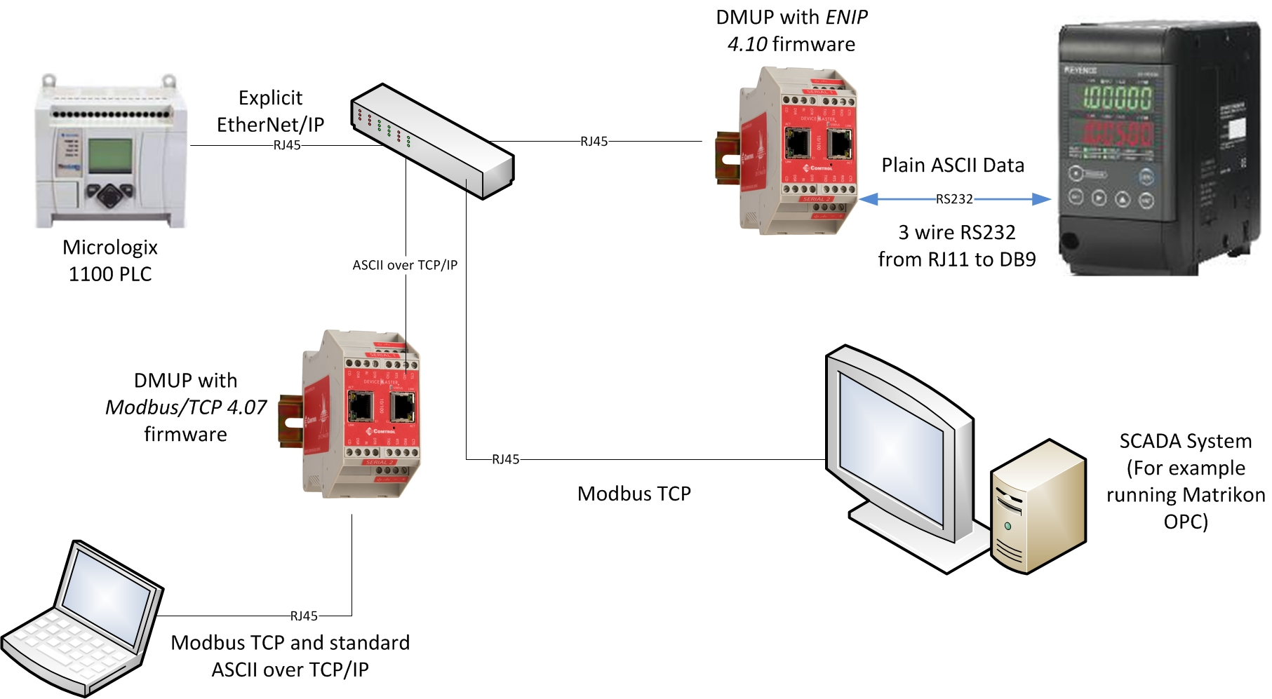
EtherNet/IP Firmware: Specific Configuration Example
How would I configure this?

Slide 23
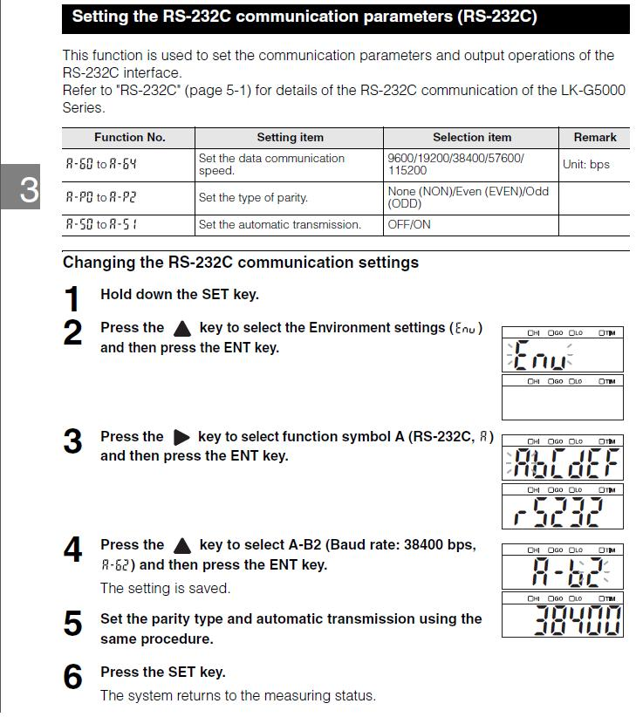
EtherNet/IP Firmware: Specific Configuration Example
Configure the appropriate serial port settings for the LK-G5000 RJ11 RS232C. There are many valid choices that will work for the LK-G and the DeviceMaster UP
How would I configure this?

Slide 24
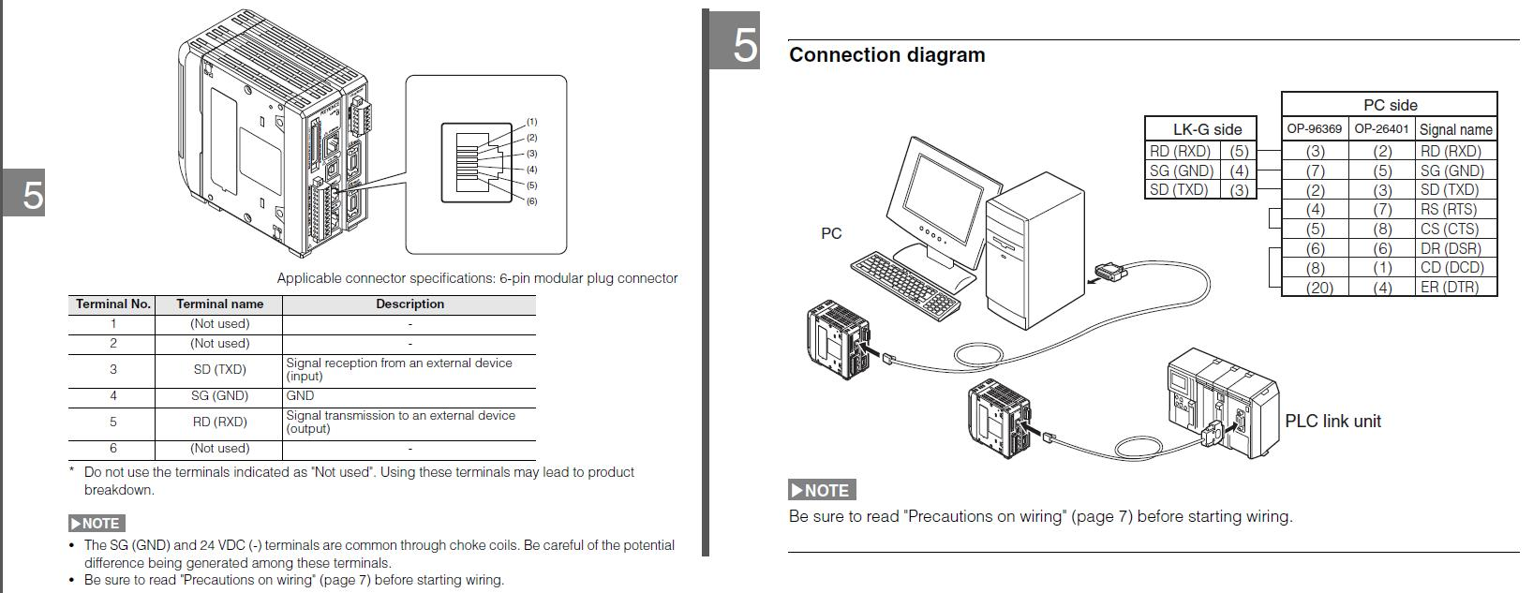
EtherNet/IP Firmware: Specific Configuration Example
Using the pinouts referenced in manuals for both devices, create cabling that matches up the proper pins on both ends of the serial connection. In my case, I cut an RJ11 cable and a standard DB9 cable and spliced the three necessary wires together. (Custom cable.)
How would I configure this?

Slide 25
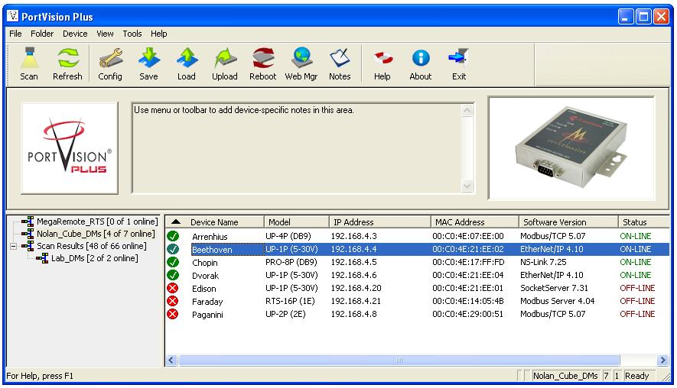
EtherNet/IP Firmware: Specific Configuration Example
How would I configure this?

Slide 26
EtherNet/IP Firmware: Specific Configuration Example
How would I configure this?

Slide 27
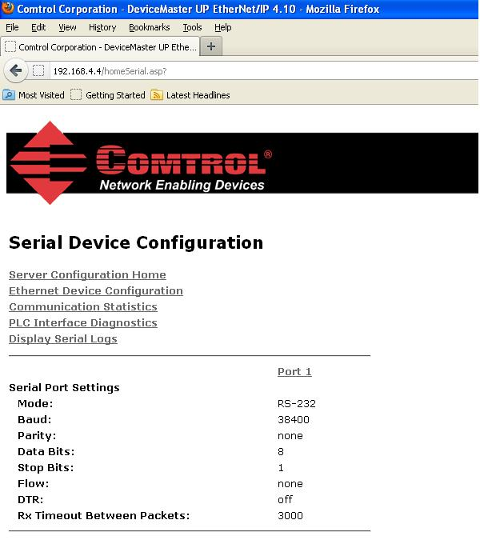
EtherNet/IP Firmware: Specific Configuration Example

Slide 28
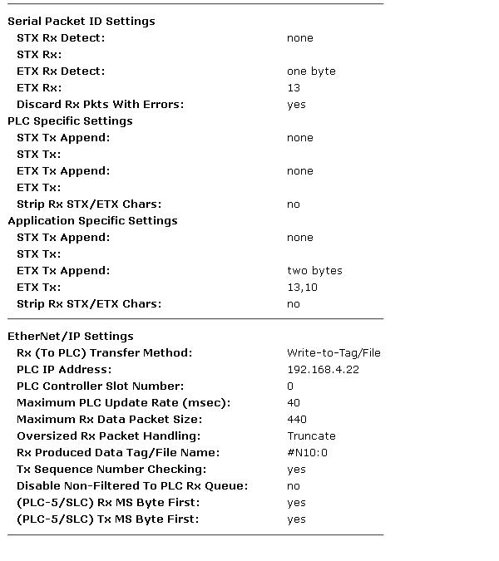
EtherNet/IP Firmware: Specific Configuration Example

Slide 29
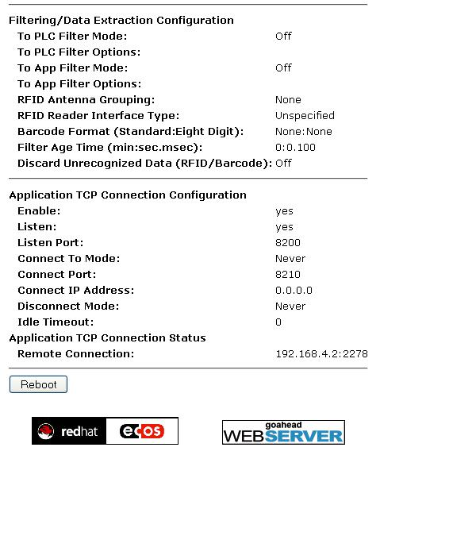
EtherNet/IP Firmware: Specific Configuration Example
How would I configure this?

Slide 30
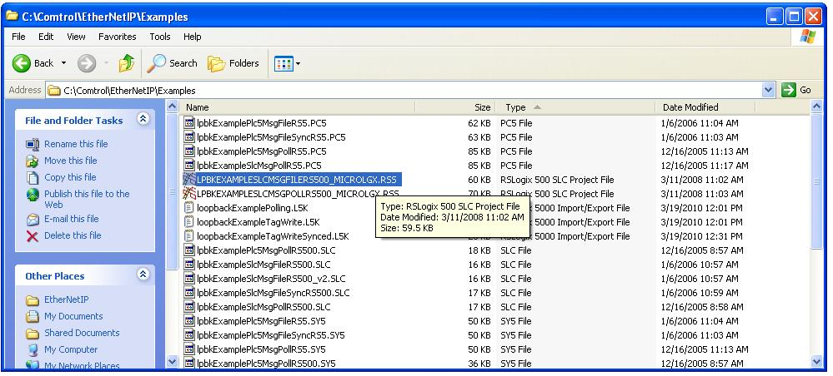
EtherNet/IP Firmware: Specific Configuration Example
Write your own PLC logic, or borrow/use/ keep/modify our examples provided on the CD with every Devicemaster
How would I configure this?

Slide 31
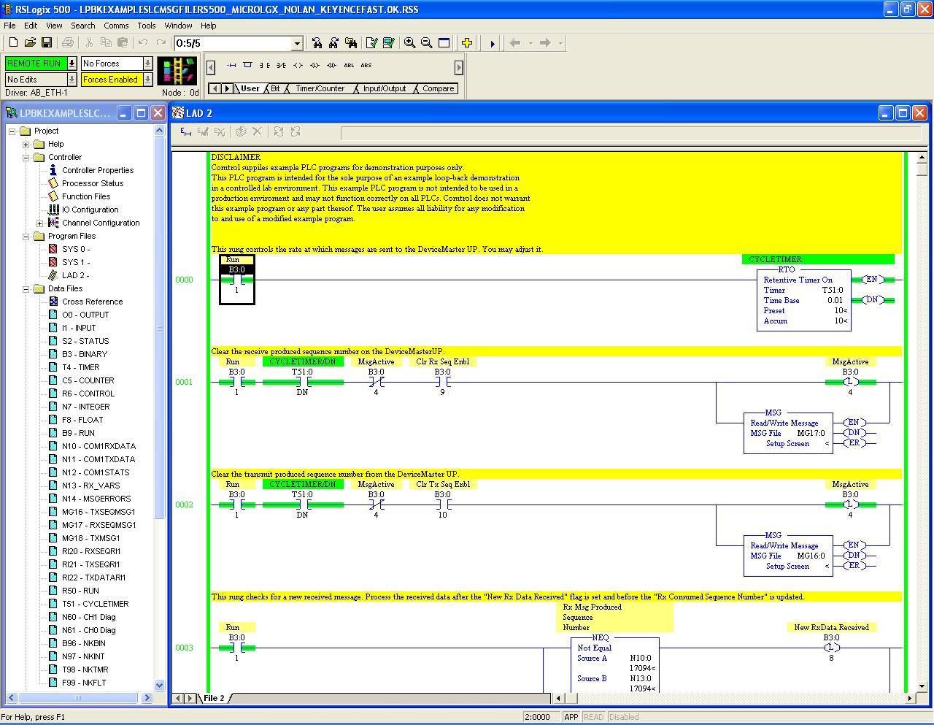
EtherNet/IP Firmware: Specific Configuration Example
Write your own PLC logic, or borrow/use/ keep/modify our examples provided on the CD with every Devicemaster
How would I configure this?

Slide 32
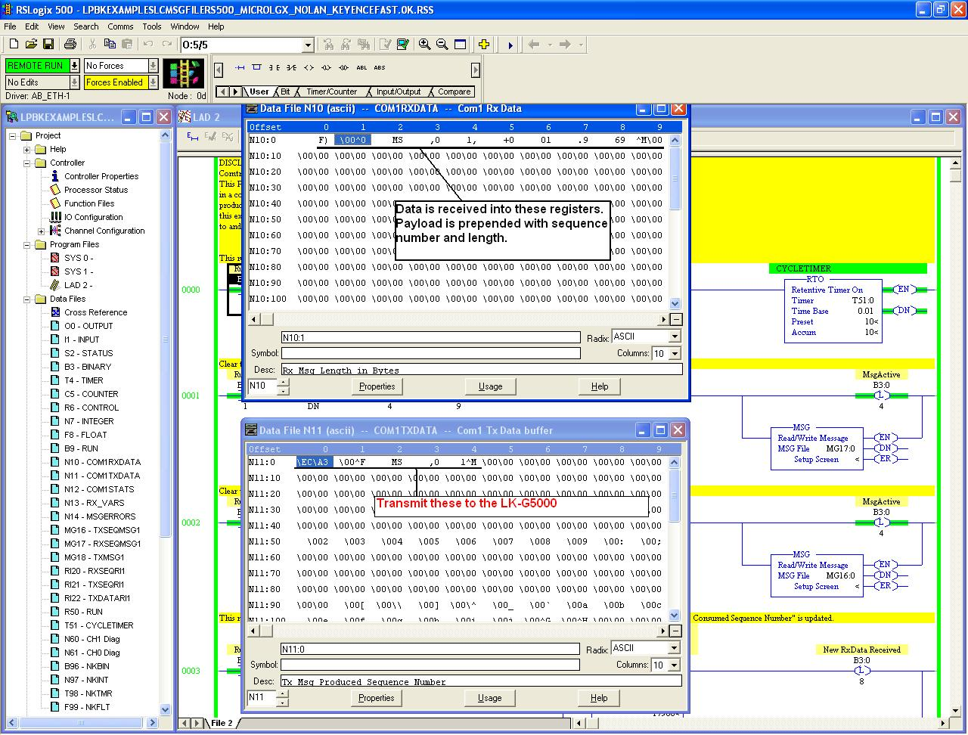
EtherNet/IP Firmware: Specific Configuration Example
Put outbound data (writes) in the write block of registers, and the data returned by the LK-G5000 will be automatically written into the read block of registers specified in DMUP
How would I configure this?

Slide 33
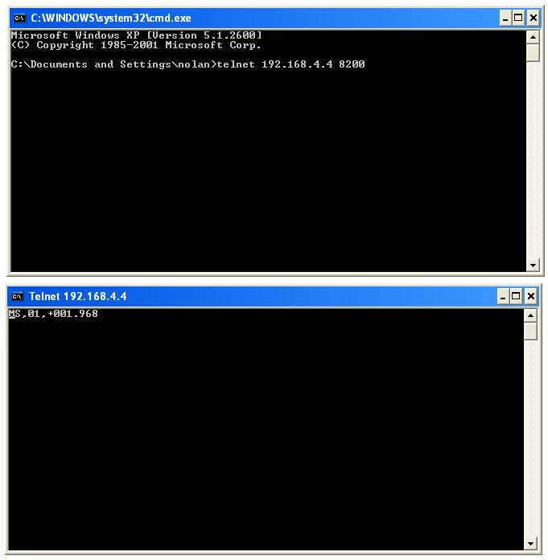
EtherNet/IP Firmware: Specific Configuration Example
Using Dual Connect: Open a telnet or hyperterminal session (or other TCP/IP test tool) to view the plain ASCII data over a TCP port (specified by you in DMUP)
How would I configure this?

Slide 34
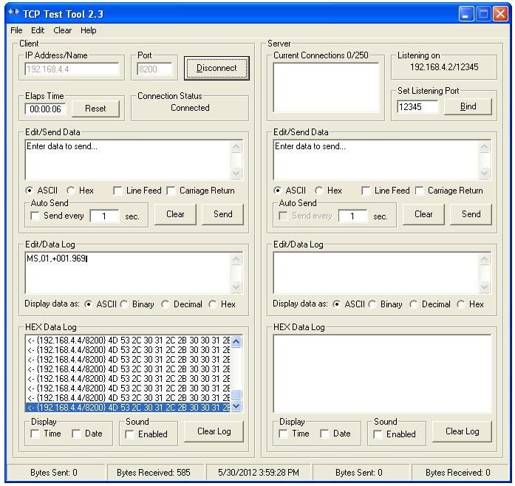
EtherNet/IP Firmware: Specific Configuration Example
Using Dual Connect: Open a telnet or hyperterminal session (or other TCP/IP test tool) to view the plain ASCII data over a TCP port (specified by you in DMUP)
How would I configure this?

Slide 35
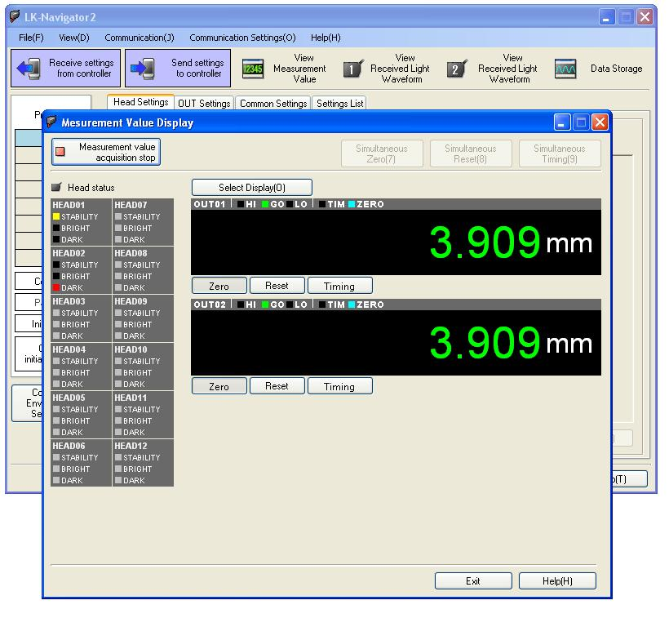
EtherNet/IP Firmware: Specific Configuration Example
The LK-H2 software has been opened. (It’s connected via Ethernet port on the LK-G5000.)
How would I configure this?

Slide 36
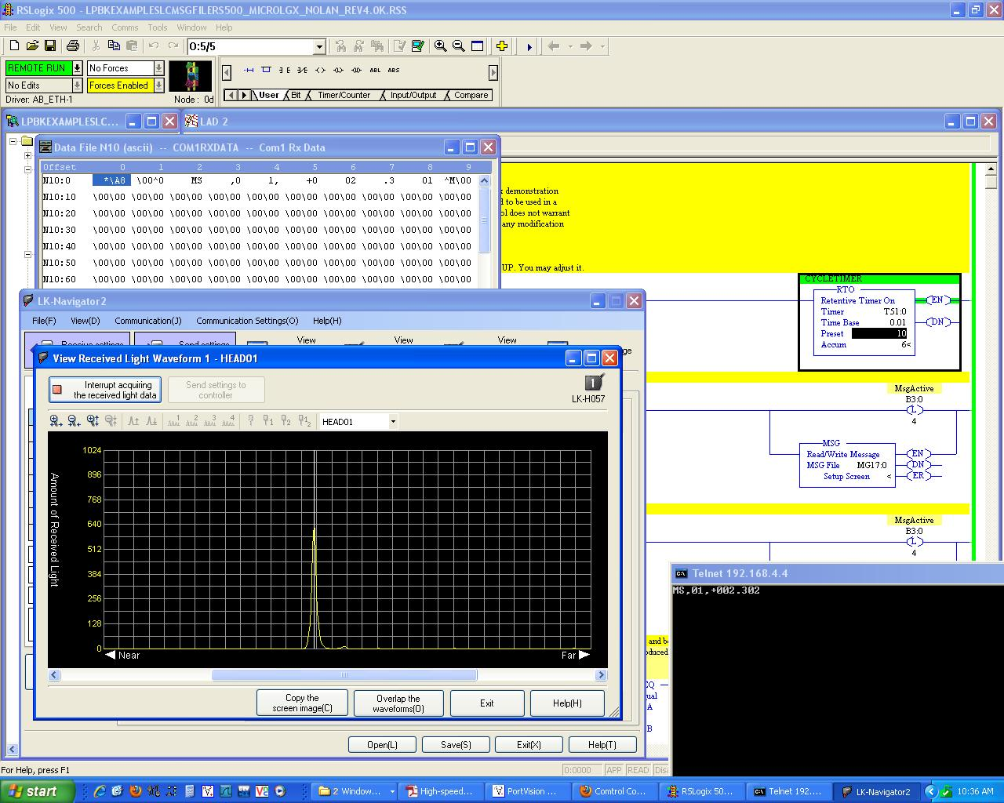
EtherNet/IP Firmware: Specific Configuration Example
Here the LK-H2 software can be seen receiving data at the same time as an EtherNet/IP PLC, and a (plain ASCII over TCP) Telnet session.
How would I configure this?

Slide 37
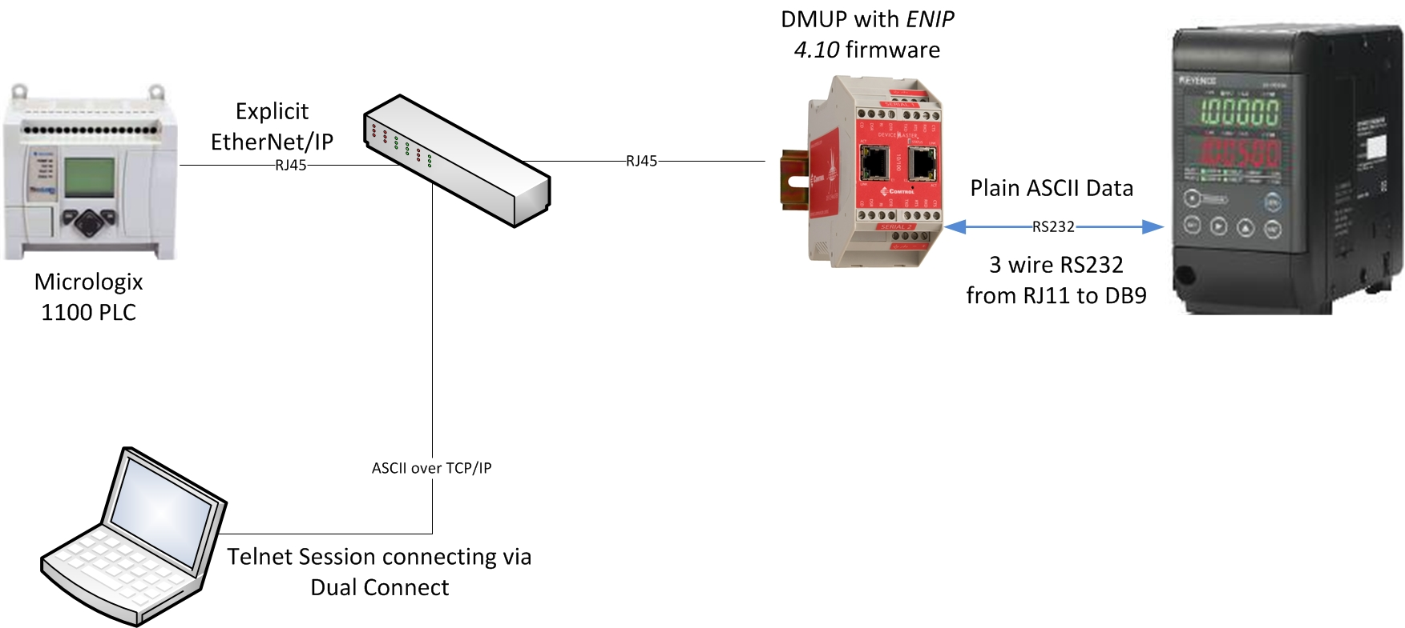
EtherNet/IP Firmware: Specific Configuration Example
The LK-G5000 has been connected as shown above, with a Telnet session utilizing the Dual Connect option (plain ASCII now available on TCP/IP).
How would I configure this?

Slide 38
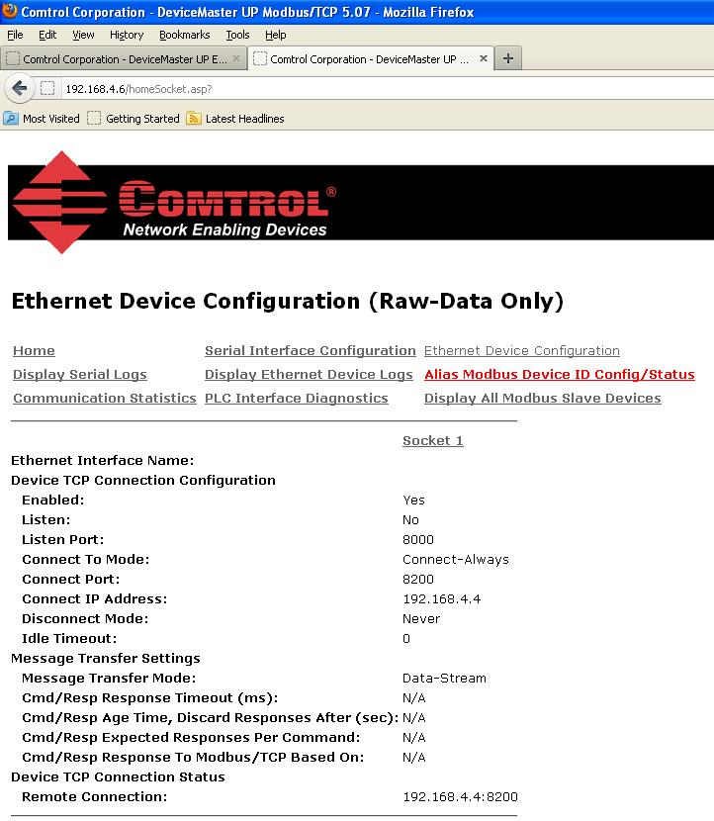
Modbus/TCP Firmware: Specific Configuration Example
The embedded web page for the other DeviceMaster is opened, and Modbus TCP encapsulation begins…

Slide 39
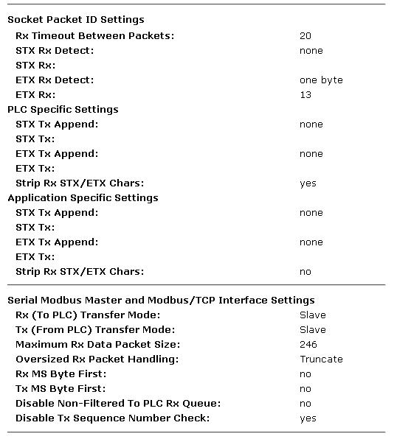
Modbus/TCP Firmware: Specific Configuration Example
The embedded web page for the other DeviceMaster is opened, and Modbus TCP encapsulation begins…

Slide 40
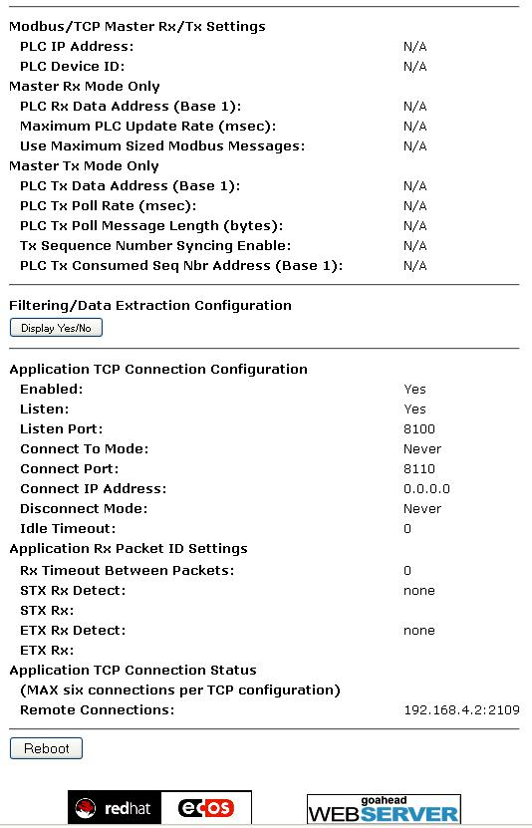
Modbus/TCP Firmware: Specific Configuration Example
Once again, at the bottom of the configuration interface, an Application TCP connection is enabled.
(Dual Connect)

Slide 41
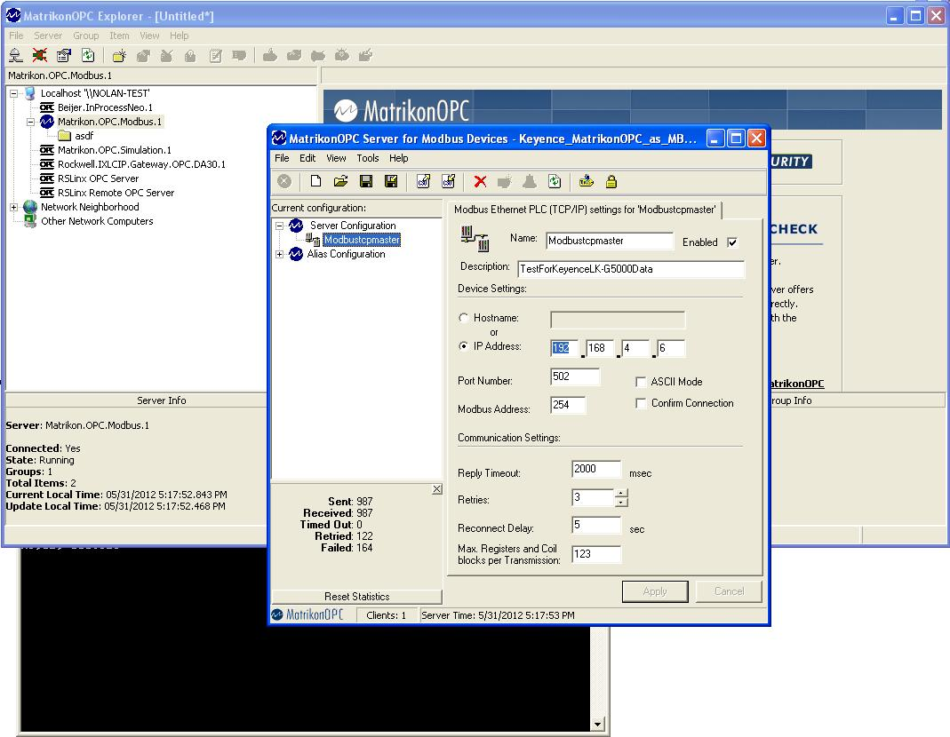
Modbus/TCP Firmware: Specific Configuration Example
Matrikon OPC is opened and a Modbus TCP Master server is created. Specific Modbus IDs and addresses must be used in order to encapsulate plain ASCII data into Modbus.

Slide 42
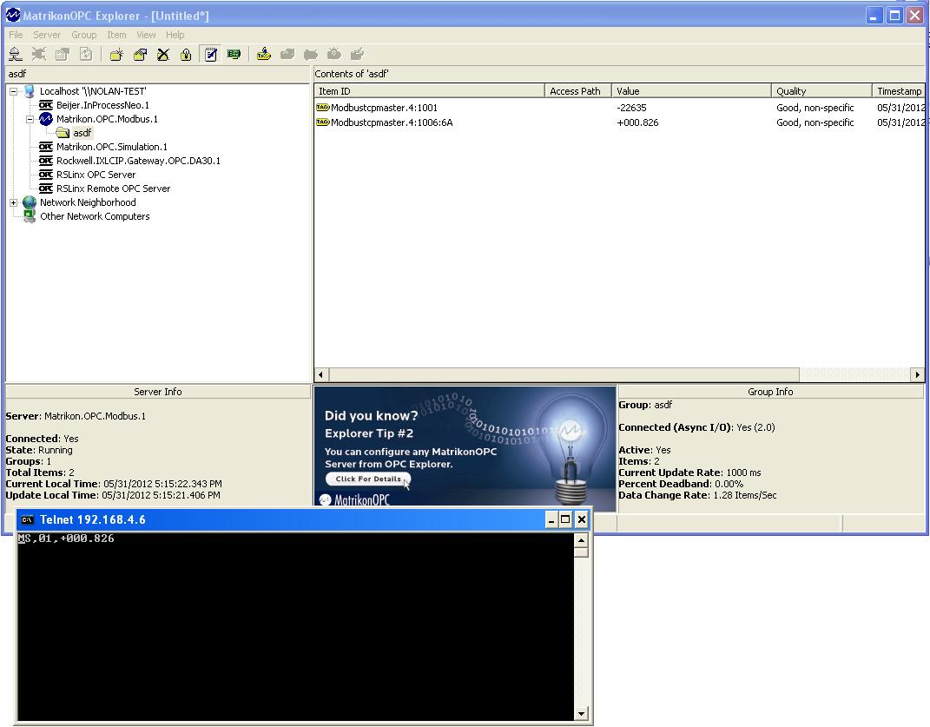
Modbus/TCP Firmware: Specific Configuration Example
The Matrikon OPC “tags” are successful. Also pictured is a Telnet session connecting via the “Dual Connect” Application TCP port.

Slide 43
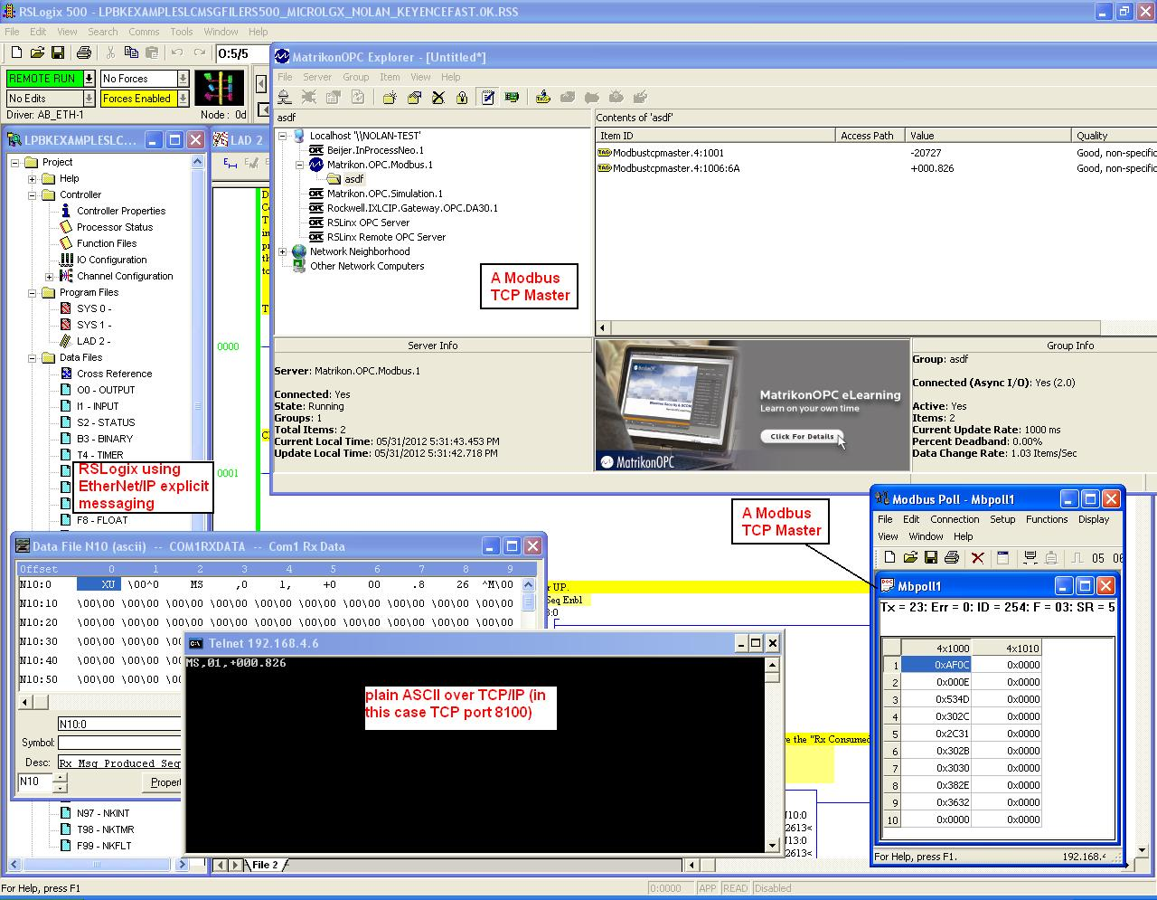
Multiple Firmware: Specific Configuration Example
And here we have two MBTCP Masters, an EtherNet/IP connection, and a telnet session ALL accessing the data from the ONE LK-G5000 RJ11 port. Simultaneously.

Slide 44
EtherNet/IP Firmware: Specific Configuration Example
The LK-G5000 has been connected as shown above, with a Telnet session and Modbus TCP connected simultaneously with the EtherNet/IP PLC!

Slide 45
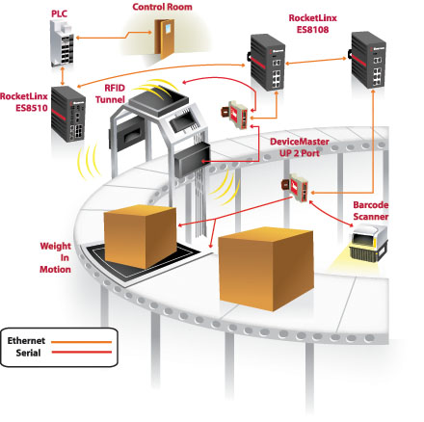
Connecting the automation environment
Control Room
PLC
DeviceMaster
UP
RFID Readers
Scanners
Weigh Scales
Printers
Sorters
Sensors
INDUSTRIAL application
4/30/2019

Slide 46
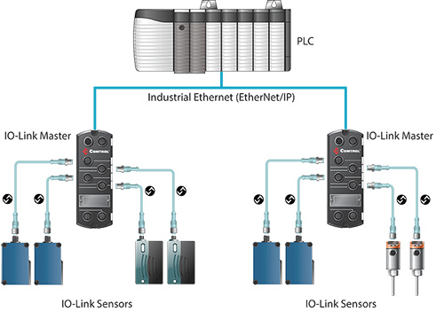
What is IO-Link?
IO-Link is a point-to-point serial communication protocol used to communicate with sensors and/or actuators

Slide 47
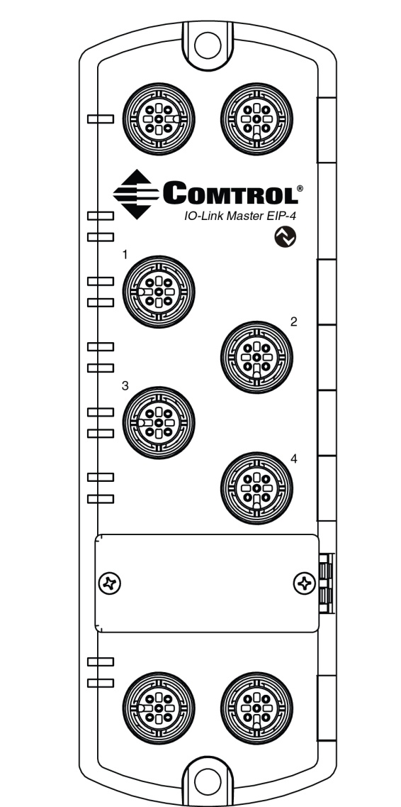
IO-Link Master EIP-4 Highlights
Four channel IO-Link Master to EtherNet/IP
EtherNet/IP access to IO-Link sensor process, event and service data
Class 1 (Implicit) and Class 3 (Explicit) interfaces
Write-to-Tag/File, Read-from-Tag/File
Modbus TCP access to IO-Link sensor process, event and service data
Rugged IP67 housing with M12 connectors for harsh environments
DLR for fast network recovery
Windows app and web GUI for configuration and diagnostics
Wide operating temperature (0° to +70°C)
LEDs for device, network and port status
Additional digital input on every port
Powerful web configuration
IO-Link V1.1 compatibility
IO-Link COM1, COM2 and COM3 support (230K baud rate)
Slim-line machine-mount installation
Innovative QuickLinx technology

Slide 48
IO-Link Master Features
Rugged IP67 machine mount design
EtherNet/IP support for ControlLogix, CompactLogix, MicroLogix, SLC, PLC5 PLCs and more
Multi-side LED visibility
Four M12 IO-Link ports supporting COM3 (230K) connection
Rotary switches for optional manual IP configuration
Each IO-Link port supports an auxiliary digital input on pin 2
Two M12 Ethernet connectors with DLR support for sub-millisecond network recovery
Bus through power for easy deployment

Slide 49
Simultaneously Provide IO-Link
Device Access to Multiple Controllers
Enjoy the flexibility of simultaneously connecting both EtherNet/IP and Modbus TCP based controllers to IO-Link devices.
Provide simultaneous access to the PLC and the HMI
Simultaneously control and monitor with a variety of systems

Slide 50
HMI Demo Interface Screen Shots

Slide 51
Customers that Benefit from Comtrol’s Connectivity Technology
Industries
Factory Automation
Process Automation
Food and Beverage
Energy
Consumer Packaging
Automotive Manufacturing
Pharmaceutical

Slide 52
100 Fifth Avenue NW
New Brighton, MN 55112
763.494.4100
sales@comtrol.com
www.comtrol.com

