Slide 1
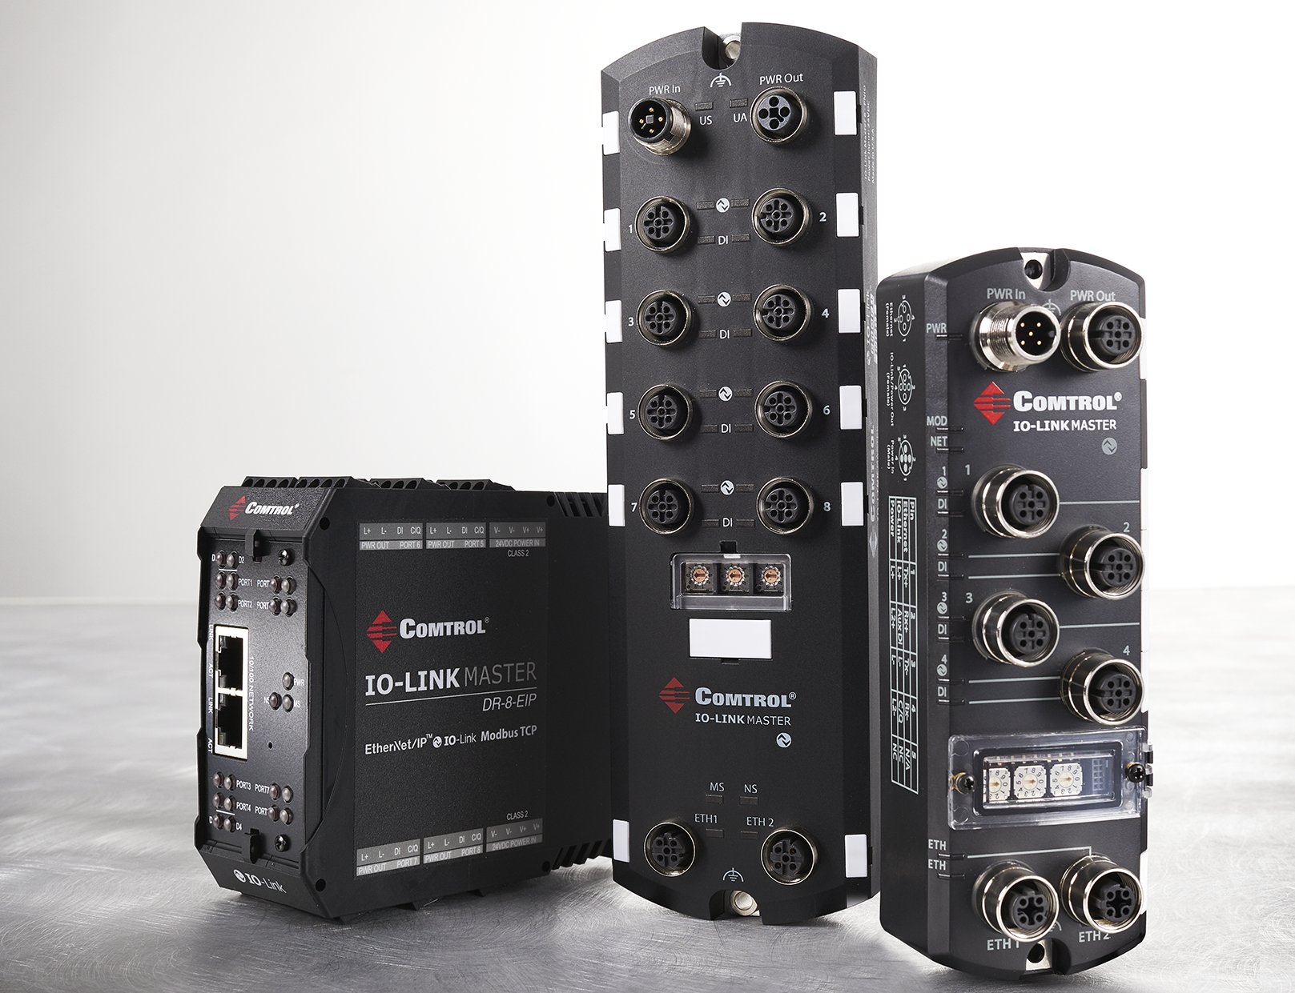

Slide 2
Who is Comtrol?
Focuses on providing intelligent, ruggedized Ethernet, fiber and serial communication products
30 years of innovation
Introduced first multi-port serial card
First to market with many other products
Manufacturing and Headquarters in Minneapolis, Minn.
Sell worldwide through distributors, resellers and integrators
Unrivaled customer service and support
Main Product Lines:
Rocketport Multi-port Serial Cards
Devicemaster Serial to Ethernet Gateways
Rocketlink Industrial Hardened Switches
IO-Link Masters

Slide 3
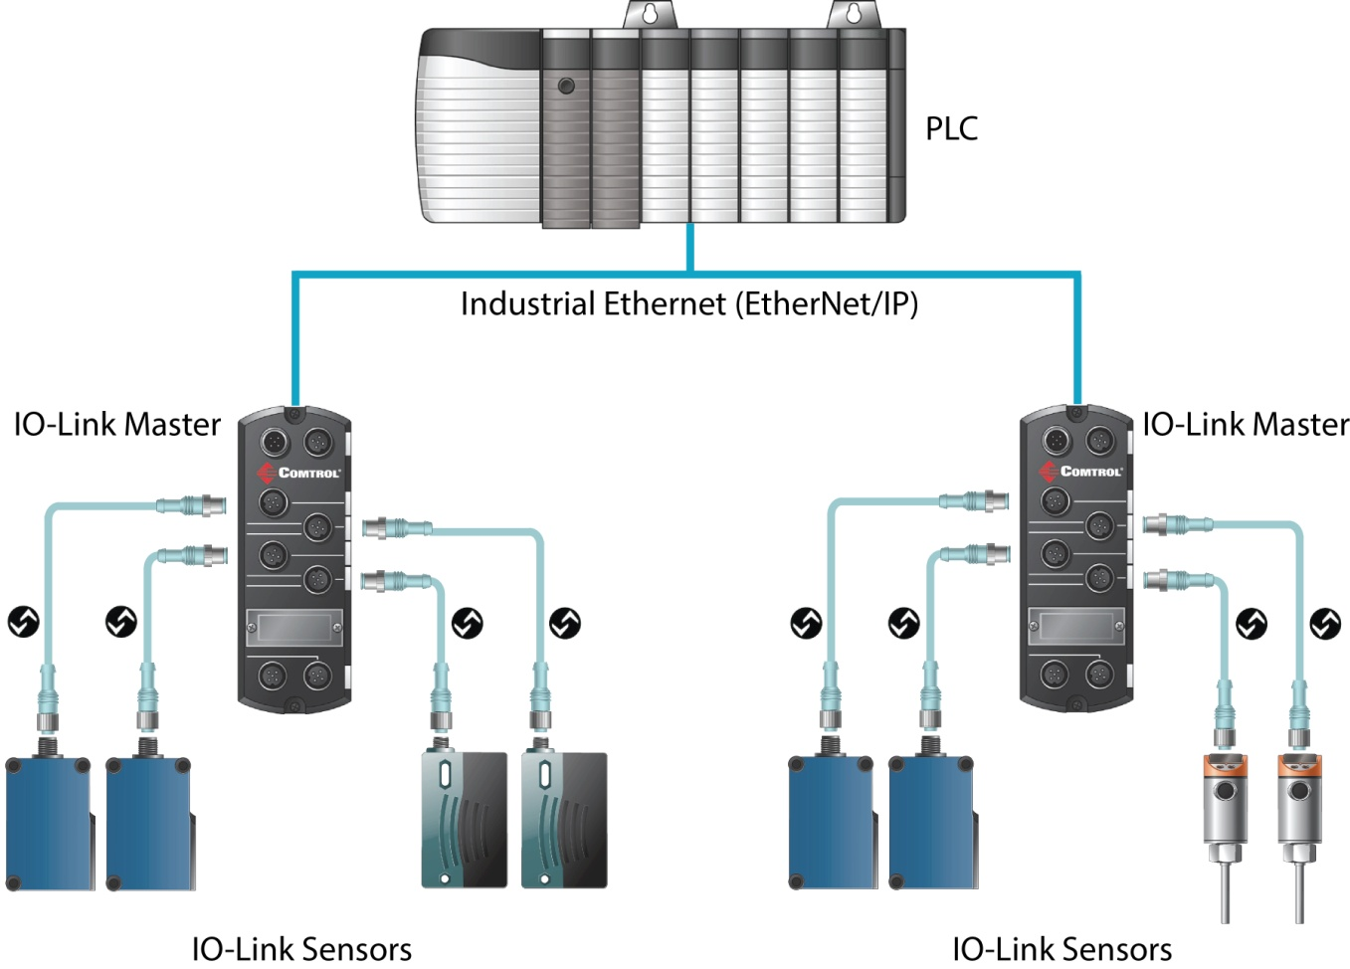
WHAT IS IO-LINK?
IEC 61131-9
IO-Link is a bi-directional point-to-point serial communication protocol used to communicate with sensors and/or actuators

Slide 4
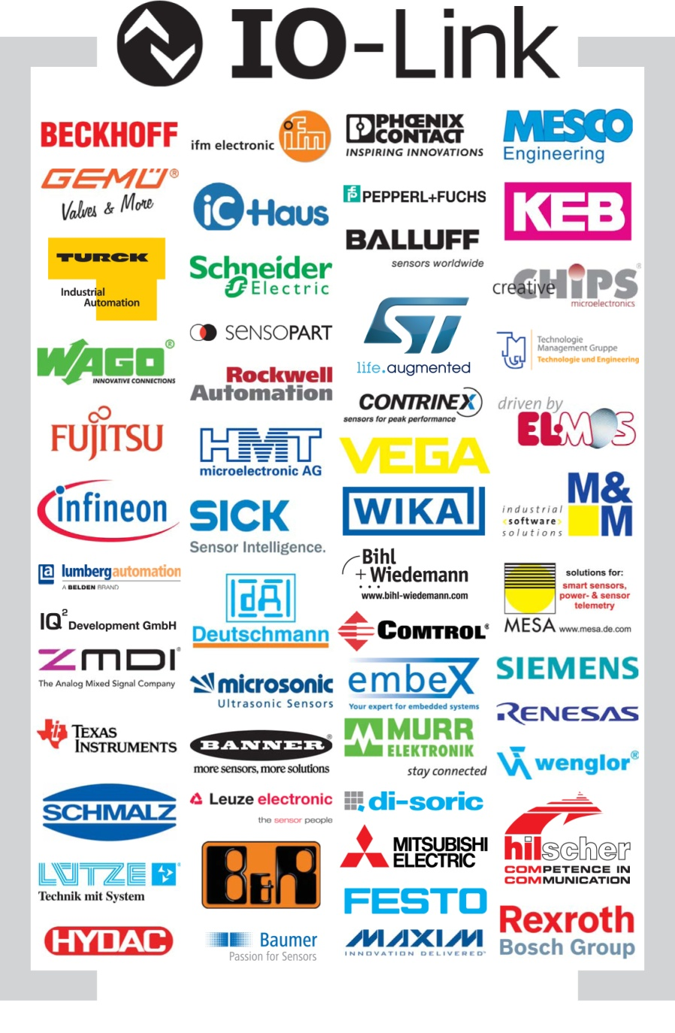
IO-Link Consortium Members
to develop and market IO-Link as a technology
to promote conformance to IO-Link, reducing exclusivity and reliance on specific fieldbus systems

Slide 5
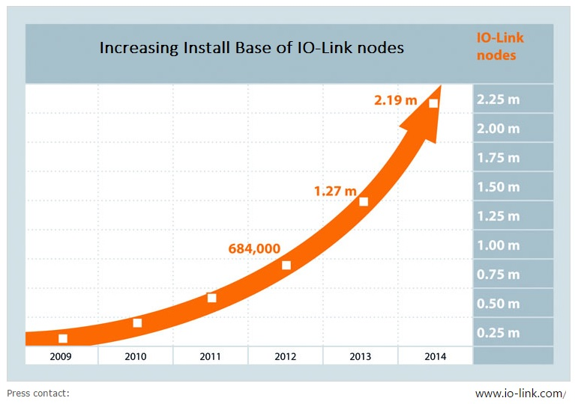

Slide 6
Comtrol serves as the North America Competency Center for IO-Link as is among the select few locations in the world where these are located
The designated Competency Centers are labs in which technical expertise and support are available and offered to IO-Link manufacturers and vendors

Slide 7
5 THINGS TO KNOW ABOUT IO-LINK
Higher Level Flexibility:
Easy to read, parameterize or configure smart devices without touching them.
Simple Device Replacement
Simple replacement of devices by being able to download parameters into the replacement right from the controller automatically. (Never redo work which you have already done!)
3. IO-Link is an Open Consortium of Manufacturers:
New products are released on a regular basis and IO-Link is gaining ground in North
America as well as in Europe where it is already in widespread use.
4. Simple Serial Point to Point Communication:
Uses a simple standardized cabling architecture.
5. Multiple Smart Devices per Address:
A basic benefit of IO-Link is to allow for multiple smart network type devices to
be connected to one address and thus allowing for more devices to be connected in
one network.

Slide 8
Primary User Benefits
Simplified installation
Automated parameter setting
Expanded diagnostics
Long-term cost reductions at all levels
Minimized downtimes through intelligent remote management
Standardized for easy operation
Comprehensive device diagnosis down to field level
Enhanced flexibility in application
Long-term investment security due to international standardization

Slide 9
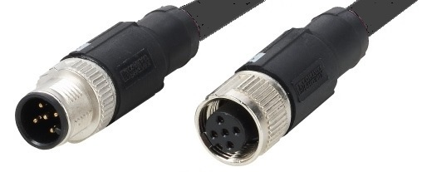
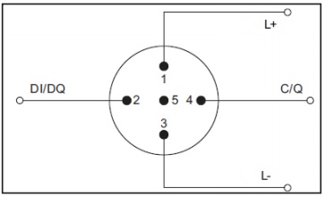
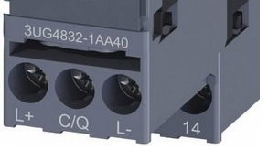
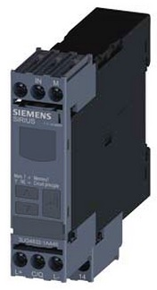
IO-Link Specification Basics
IO-Link is the first standardized IO technology worldwide (IEC-61131-9) for communication with sensors and actuators
The IO-Link Steering committee is 13 members- one each from several big stakeholders including Siemens and Rockwell
Power (24 VDC) and Signal (similar to 3 wire RS232) through one cable
Uses standard M12, M8, or M5 connectors for harsh areas or generic three wire cable for IP20 type locations
M12, the most common cable in IO-Link, has 5 pins. Typically only three are used but the 4th and 5th pins provide a greater breadth of options.
IO-Link COM1, COM2 and COM3 support (230K throughput) which is auto-configured upon first plugging in the device to a Master

Slide 10
IO-Link Specification Basics
Types of Data
Process Data
CYCLIC DATA - Information that device is intended to deliver or measure (ex. temperature, distance, weight, etc.)
Service Data
ACYCLIC DATA - All data that is not relative to the process data the sensor outputs to the PLC or controller (ex. manufacturer name, model number, parameter values, etc.)
Event Data
When specified critical events occur, “event flags” are transmitted to PLC or controllers for maintenance (ex. open circuits, communication aborts, overloads, etc.)

Slide 11
Outline of Comtrol IO-Link Benefits
Reduce cabling
Diagnostic Capabilities
Remote Parameterization
Mobile Access
Multi-Link
Auto-Device Configuration
(ADR) and how it works
Web Interface (Embedded Webpage)
ISDU Handling

Slide 12
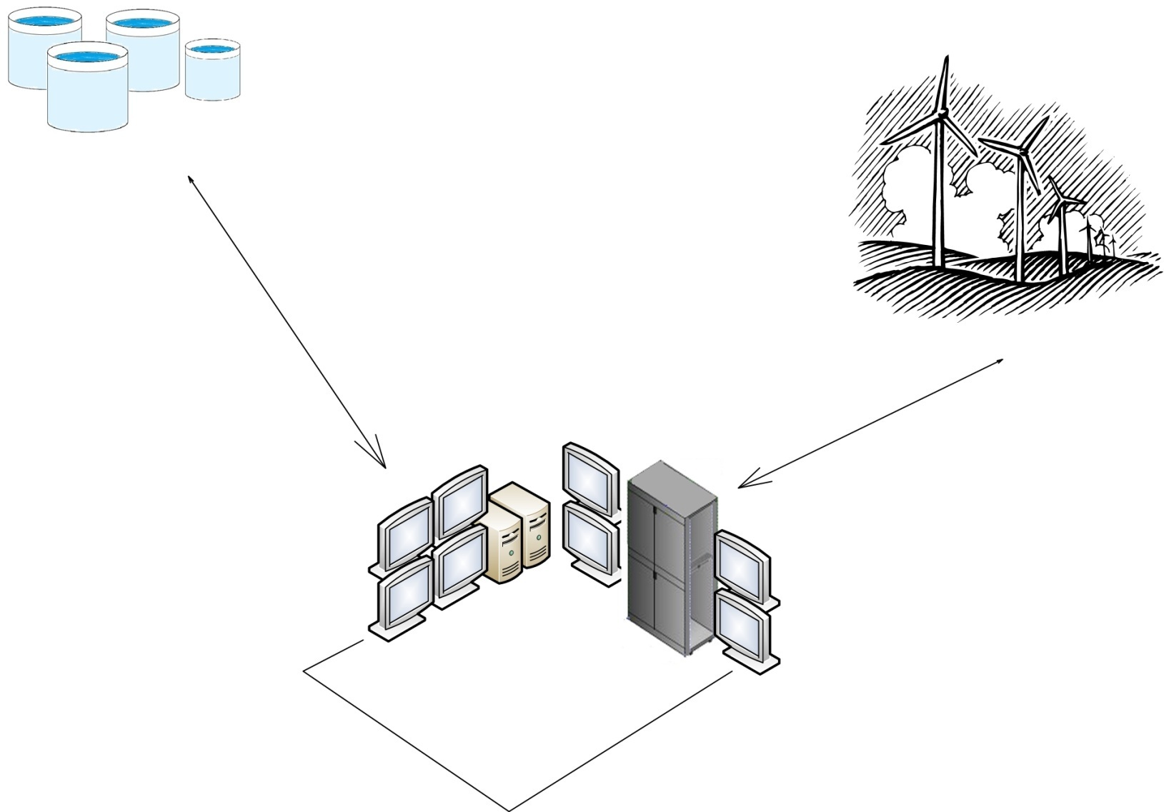
IO-LINK BENEFITS
Simplified Installation: Save significant Wiring Material and Time– Example 1

Slide 13
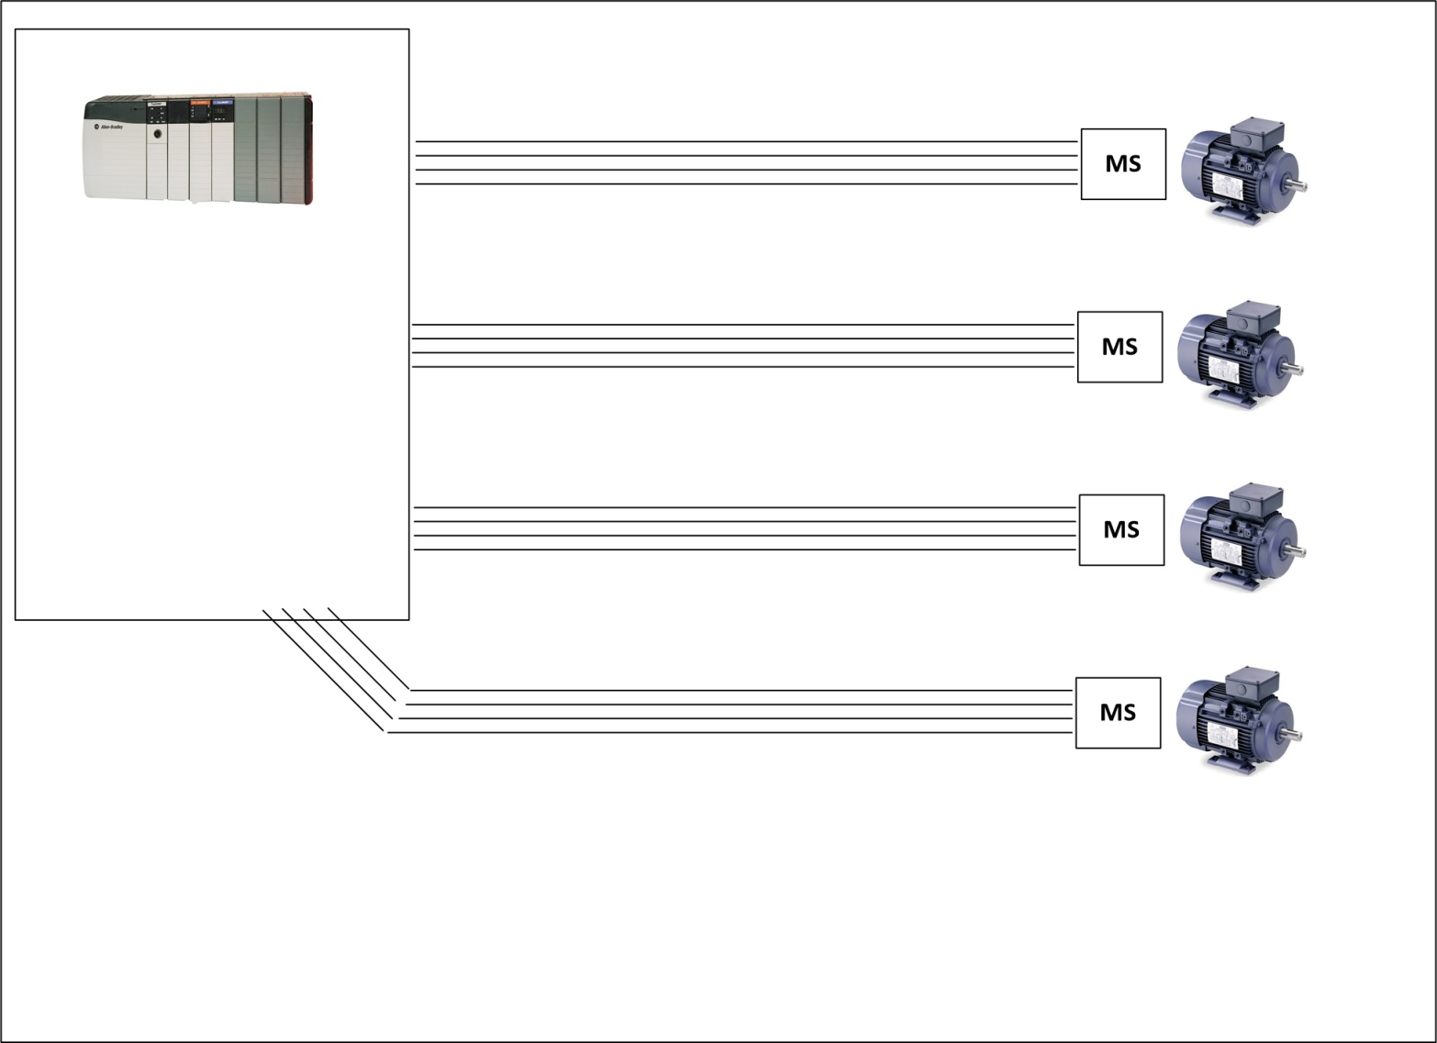
IO-LINK BENEFITS
Simplified Installation: Save significant Wiring Material and Time– Example 1
You could grab some wire spools and start pulling tons of wire through conduit for each motor starter back to the PLC…

Slide 14
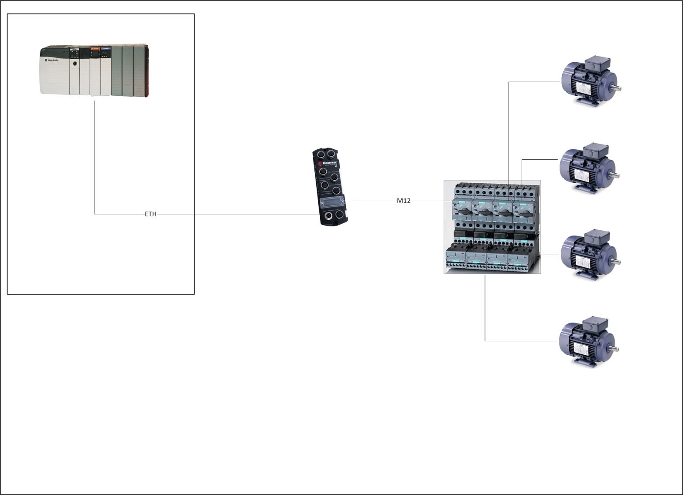
IO-LINK BENEFITS
Simplified Installation: Save significant Wiring Material and Time– Example 1
Or, much better: Just cover the distance with a single cable and then multiplex via IO-Link motor starters like the 3RA2711

Slide 15
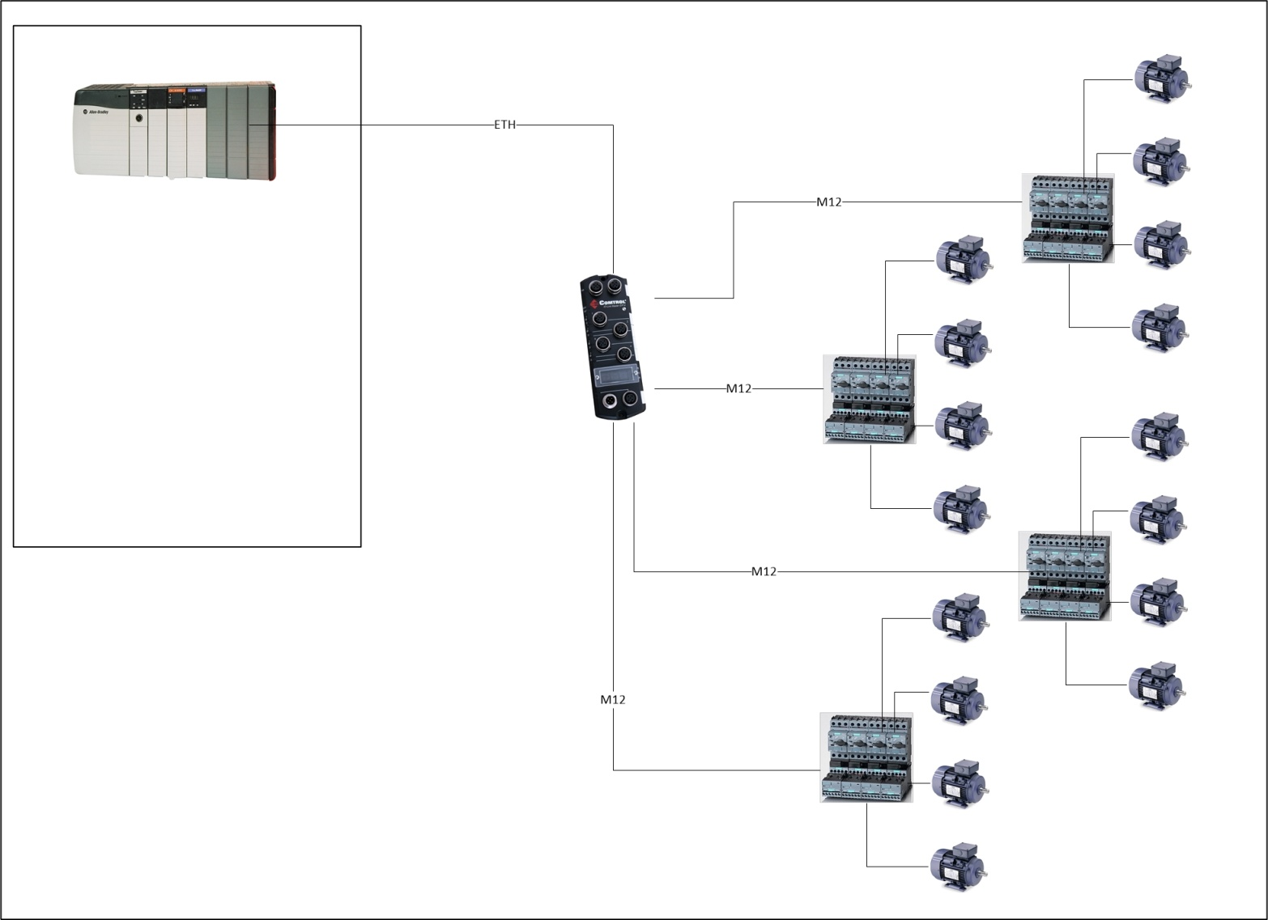
IO-LINK BENEFITS
Simplified Installation: Save significant Wiring Material and Time– Example 1
Here we see sixteen motor starters!

Slide 16
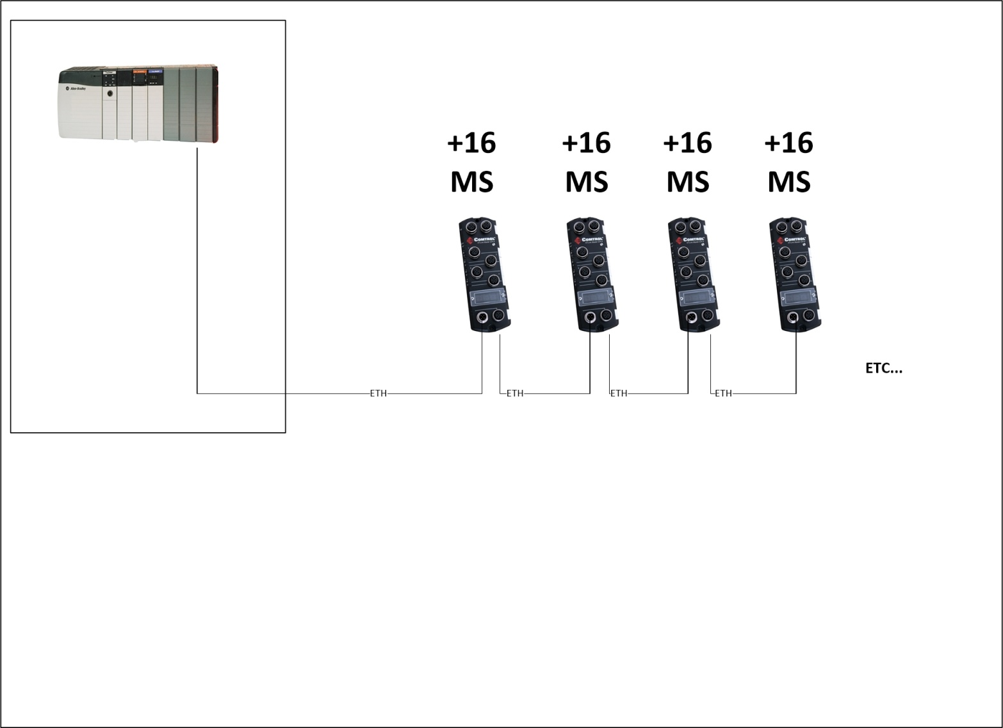
IO-LINK BENEFITS
Simplified Installation: Save significant Wiring Material and Time– Example 1
You can connect 16 motor starters on each EIP-4, which can be daisy chained…

Slide 17
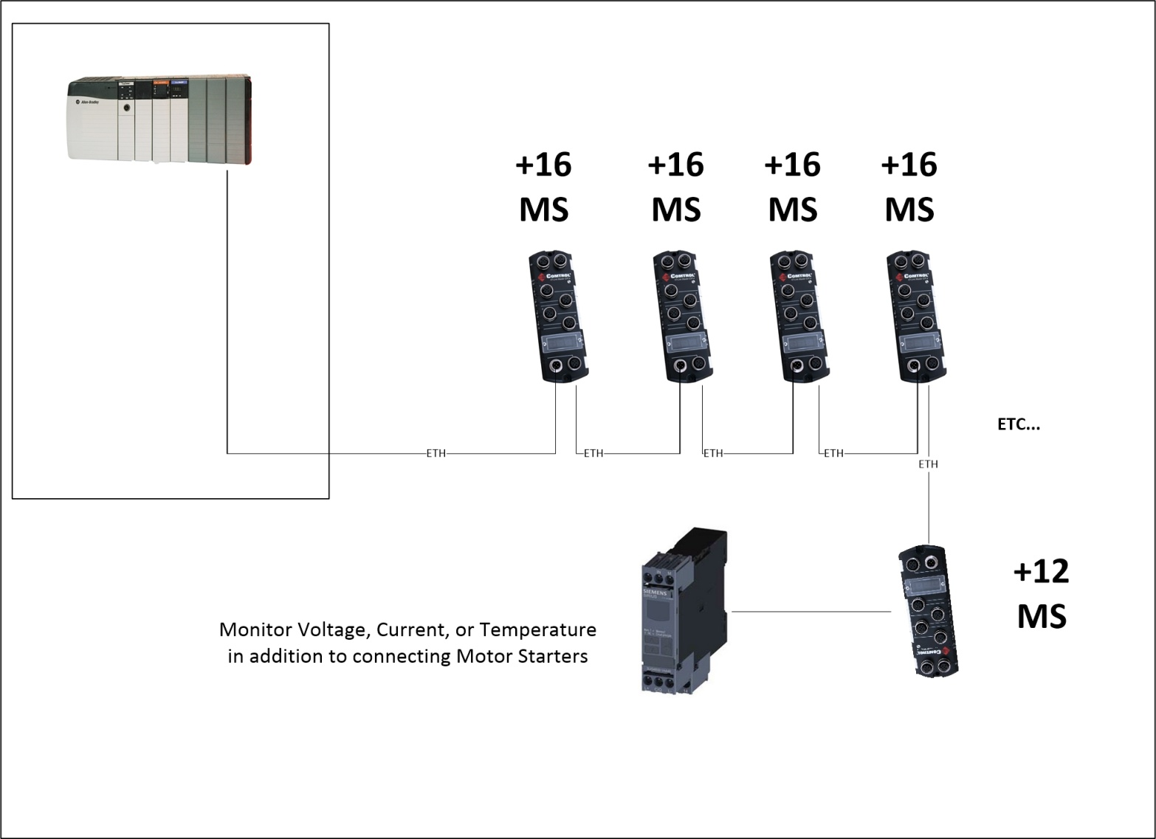
IO-LINK BENEFITS
Simplified Installation: Save significant Wiring Material and Time– Example 1
Connect as many motor starters as you want, and then add some intelligent monitoring (via IO-Link) to do predictive maintenance!

Slide 18
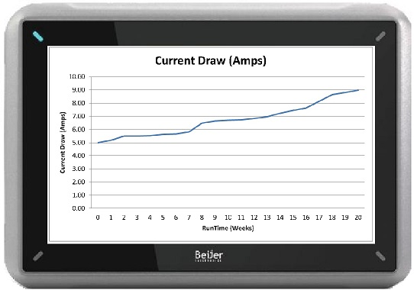
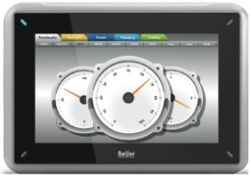
IO-LINK BENEFITS
Simplified Installation and Advanced Diagnostics– Example 1.1
Trending actual values means you are predicting events rather than reacting to disaster, and can plan maintenance accordingly

Slide 19
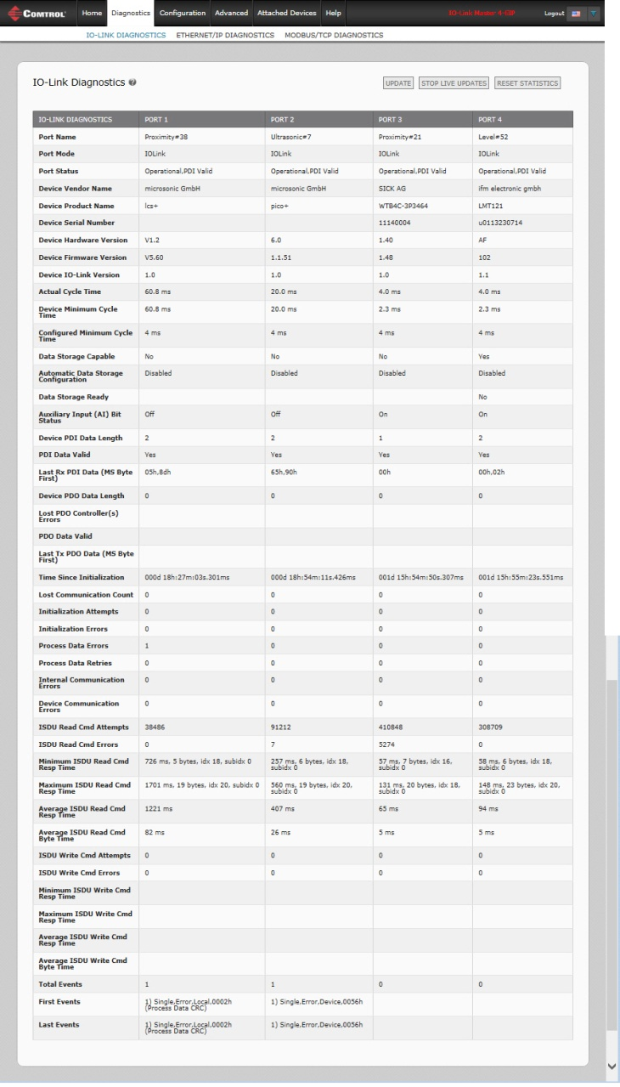
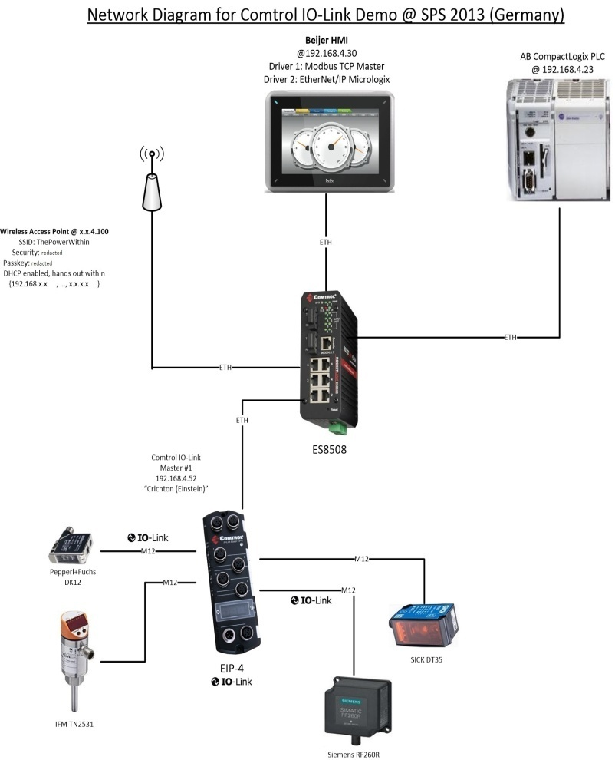
IO-LINK BENEFITS
Advanced Diagnostics
IO-Link Specific Diagnostics

Slide 20
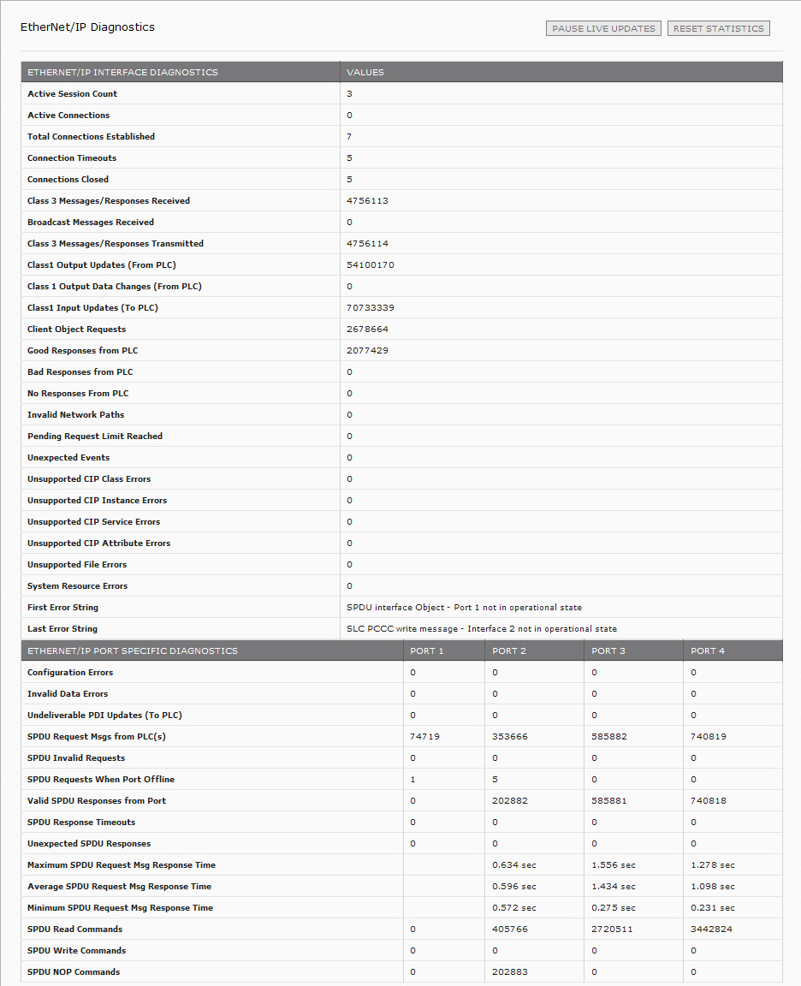
PLC Protocol Specific Diagnostics
EtherNet/IP
Advanced Diagnostics

Slide 21
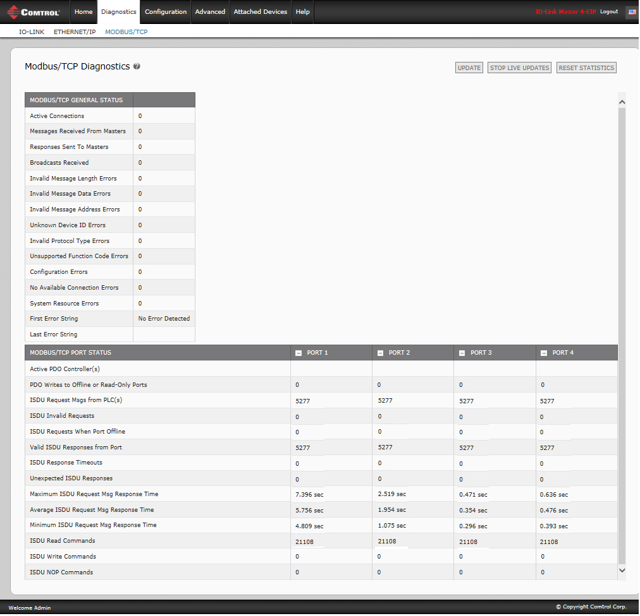
PLC Protocol Specific Diagnostics
Modbus TCP
Advanced Diagnostics

Slide 22
IO-LINK BENEFITS
Remote Parameterization
Comtrol’s IO-Link enables remote communication from a PLC or HMI to a sensor in order to change a sensor’s configuration or operational behavior
Additionally, you can change a sensor’s configuration using the IO-Link master web interface without a PLC/HMI
Dynamic reconfiguration of sensor properties such as distance read range, attenuation or code library
Reconfigure sensors in hard-to-reach or hazardous areas
Dramatically extend the diversity and duty cycle to get more use out of capital which was previously idle at times

Slide 23
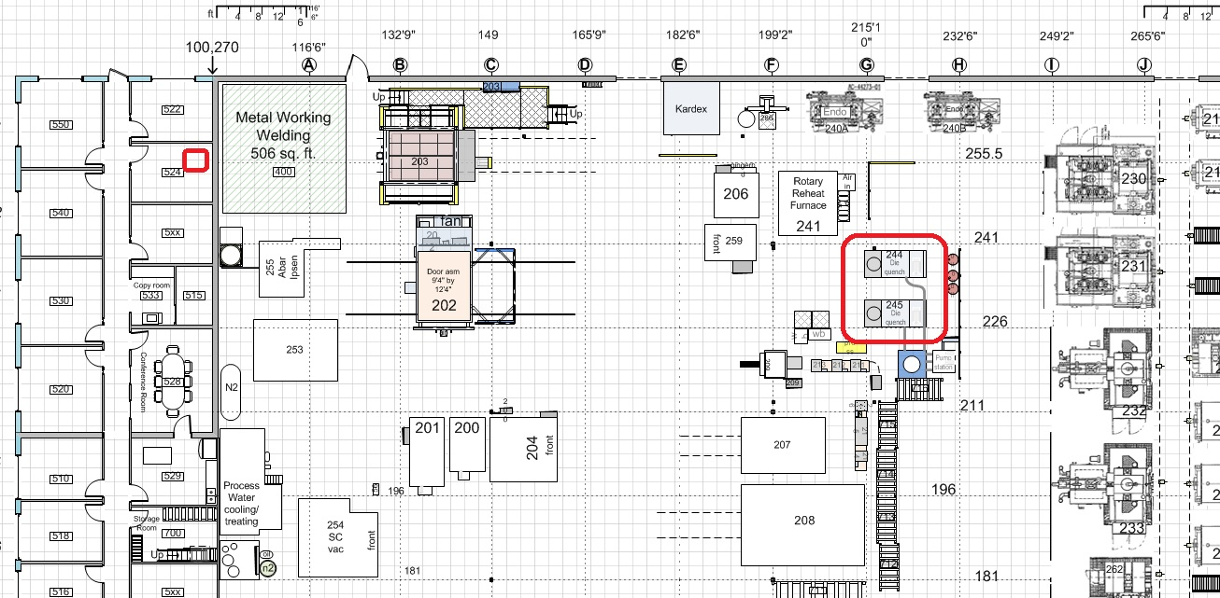
IO-LINK BENEFITS
Remote diagnostics and programming can increase safety, comfort, and uptime.
A large factory may have a huge variety of sensors, instruments, devices, PLCs, and Industrial Computers. Many areas may contain hazards when actively running. Remotely monitor/make changes with IO-Link

Slide 24
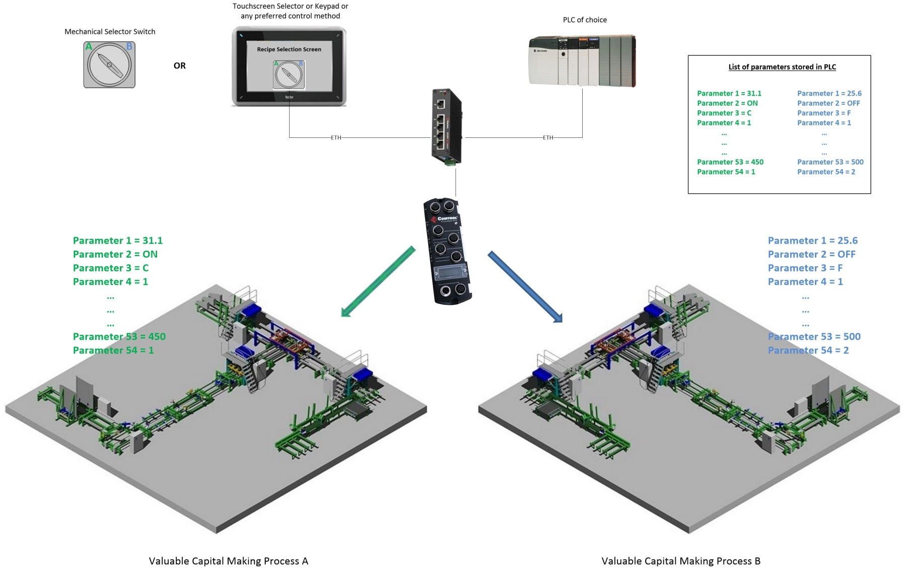
IO-LINK BENEFITS
Reconfigure dozens or hundreds of your smart devices with the flip of a switch or button on an HMI. ISDUs can be written out to all IO-Link devices from PLC in mere moments

Slide 25
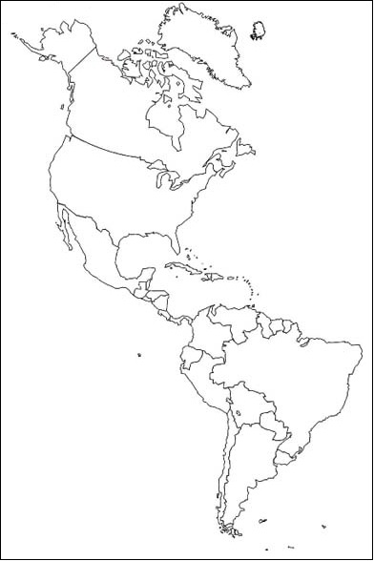
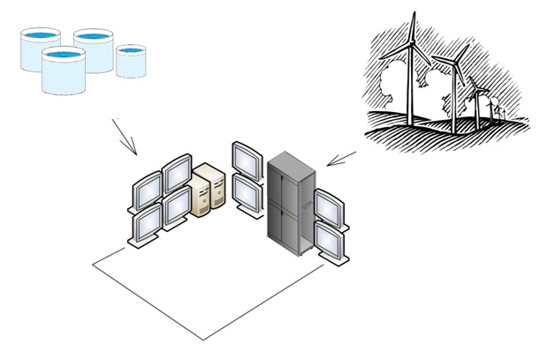
IO-LINK BENEFITS
Having access to detailed diagnostics and troubleshooting data from the PLC down to the tips means you can repair from afar!

Slide 26
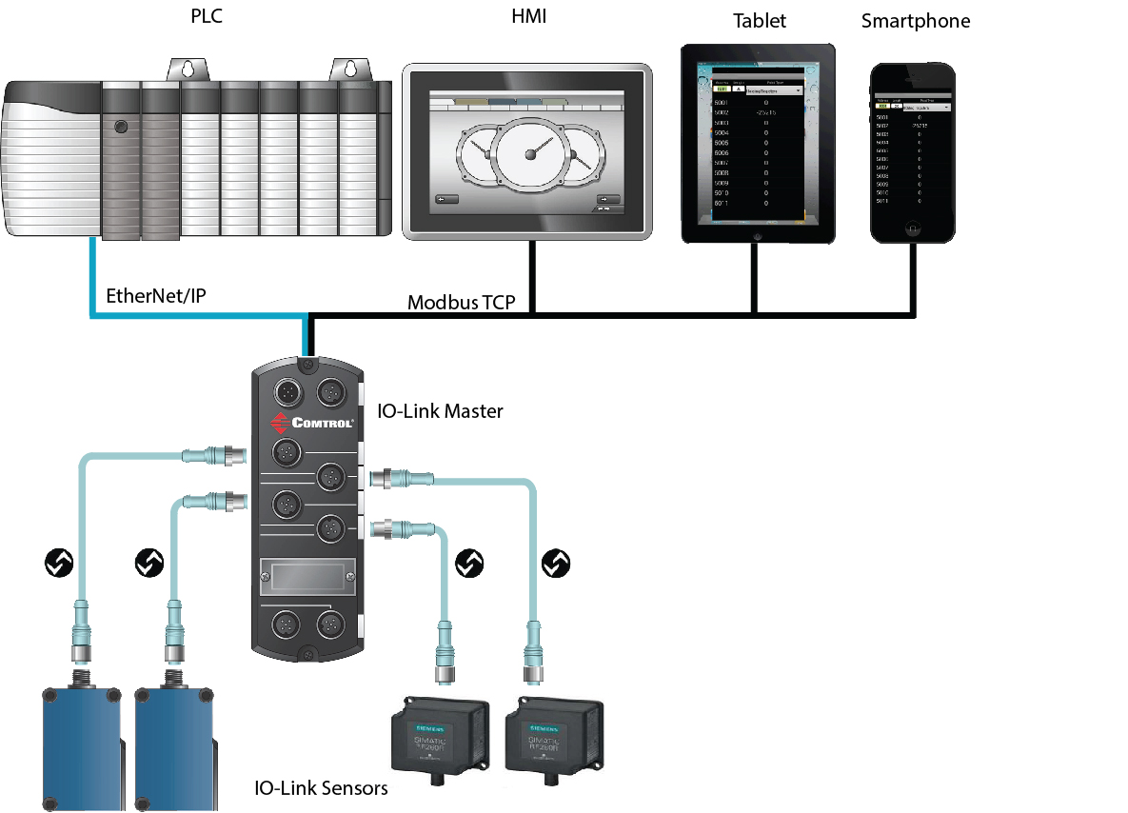
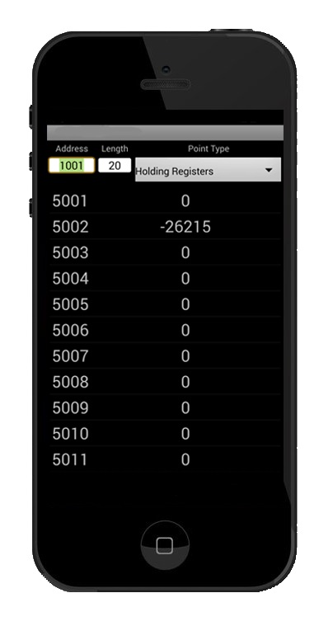
Mobile access to IO-Link data via any Modbus Client

Slide 27
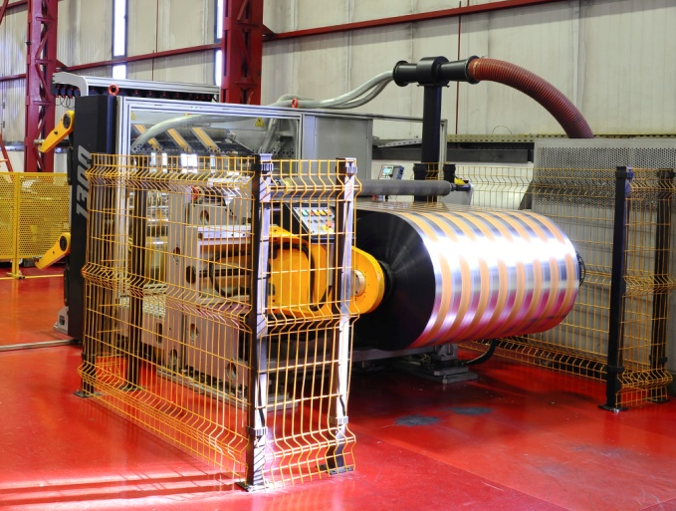
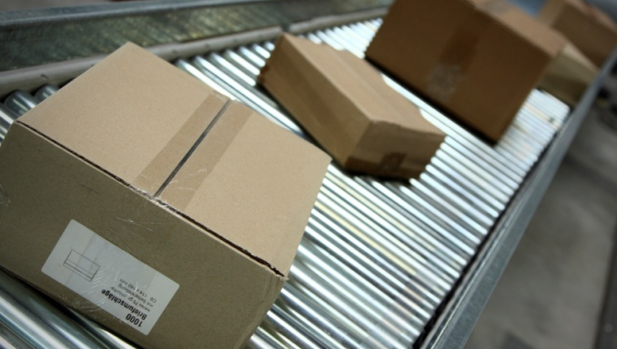
IO-Link Solution
A CPG (consumer product good) manufacturer produces several varieties of one product, requiring different printed labels during packaging.
The label printing occurs in the middle of the packaging cycle and the area is blocked off due to safety concerns making it inconvenient and difficult
Luminosity sensor – access is needed for
configuration due to different printing requirements
Photoelectric sensor – access is needed for
process data (quantity)
IO-Link Master is able to remotely configure and gather the correct information from multiple manufacturers’ sensors in your network
Users can remotely view and update configurations based on current production requirements, making it easy to manage sensors in isolated or hazardous areas
Enhanced diagnostic data visibility is also made available

Slide 28
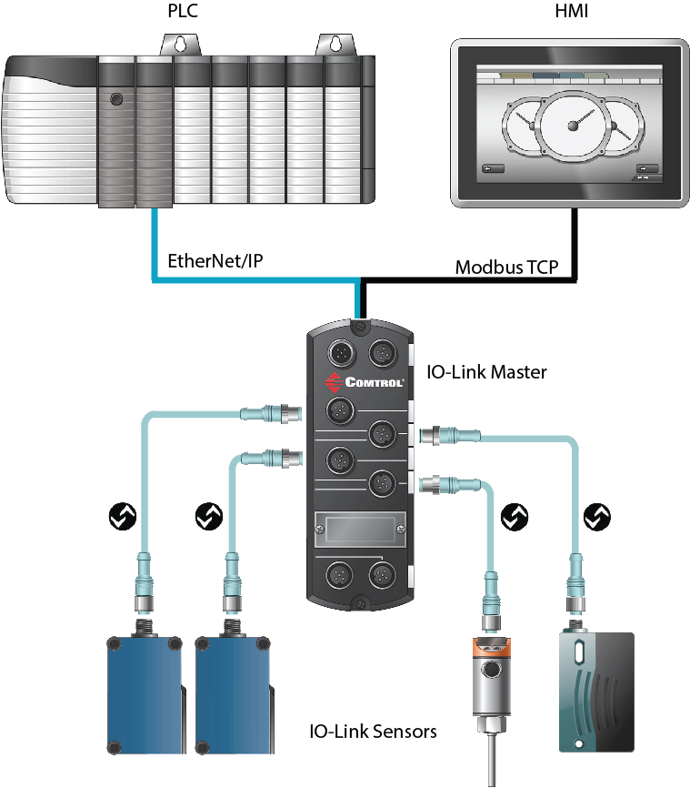
MultiLink Capability
Simultaneously Provide IO-Link Device Access to Multiple Controllers
Comtrol’s IO-Link Master simultaneously connects both EtherNet/IP and Modbus TCP based controllers to IO-Link devices.
USER BENEFITS
Provide simultaneous access to the PLC and
the HMI
Multiple PLC Ethernet communication options (Schneider, GE/Fanuc, Mitsubishi)
Simultaneously control and monitor various systems (ex. SCADA or DCS, plant controller)

Slide 29
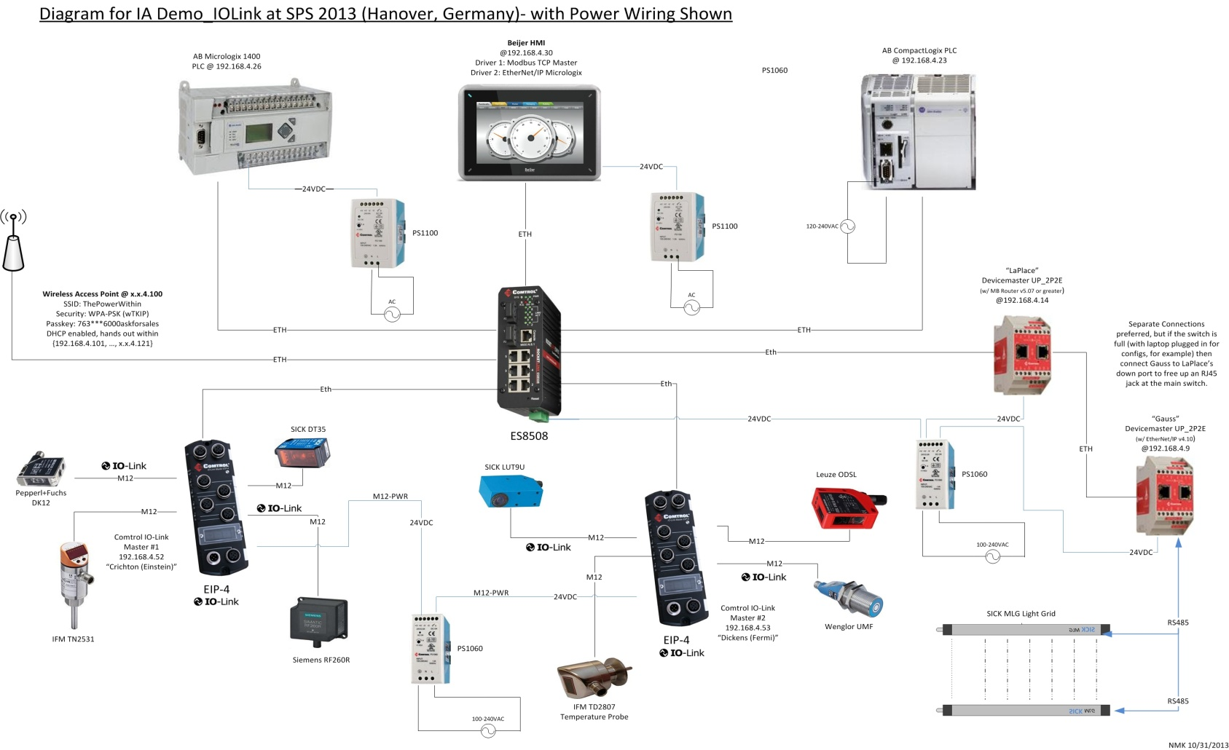
MultiLink - Simultaneously Provide
IO-Link Device Access to Multiple Controllers

Slide 30
ADR (Auto-Device Replacement)
Comtrol’s IO-Link master allows the user to replace a sensor with another “as easily as changing a lightbulb”
Parameters of sensors are stored in Comtrol’s IO-Link master and may then be uploaded automatically to any newly connected sensor of the same type
USER BENEFIT
Minimizes downtime by eliminating the need to set the parameters of the newly connected sensor (never repeat work which has already been done)

Slide 31
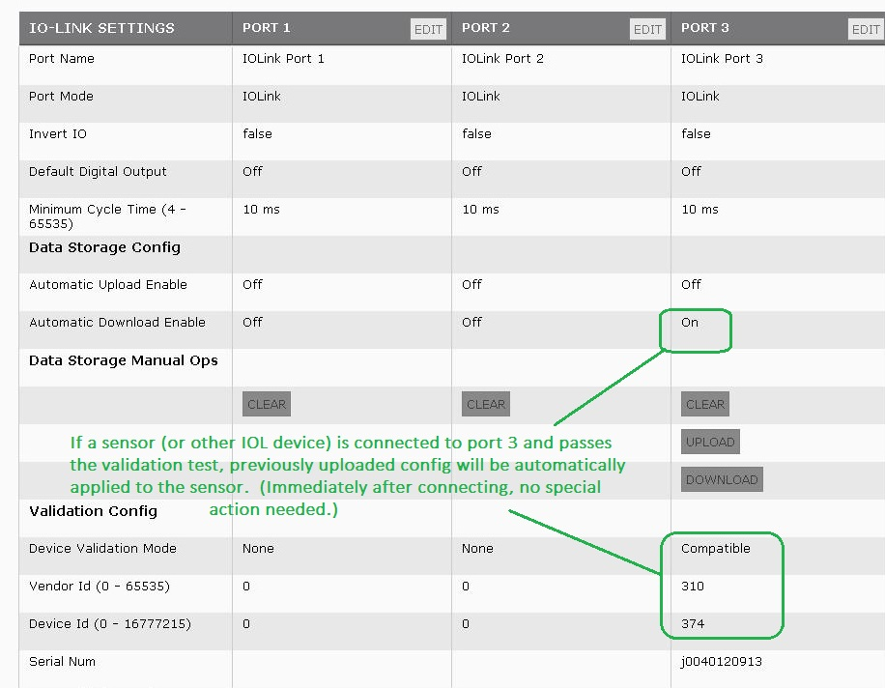
ADR (Auto-Device Replacement)

Slide 32
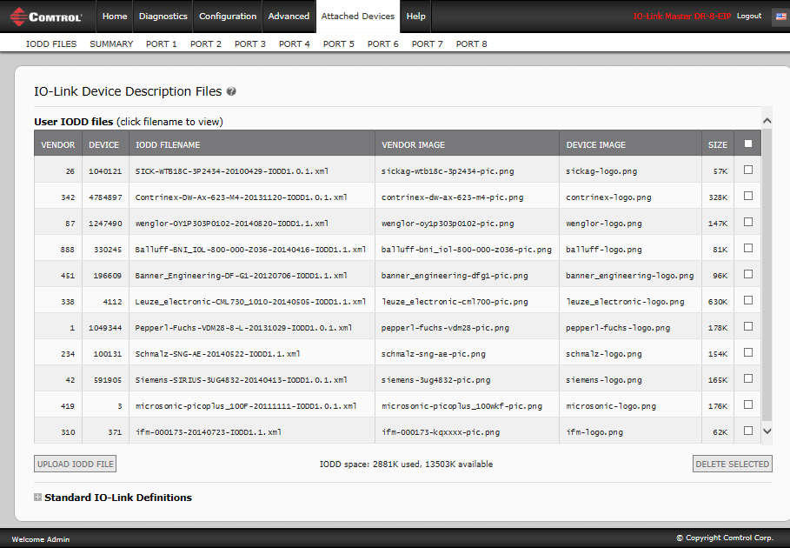
How ADR Works
Load IODD (IO Device Description) Files
Upload the IO-Link manufacturer’s IODD files into Comtrol’s IO-Link Master to quickly and easily configure IO-Link devices.

Slide 33
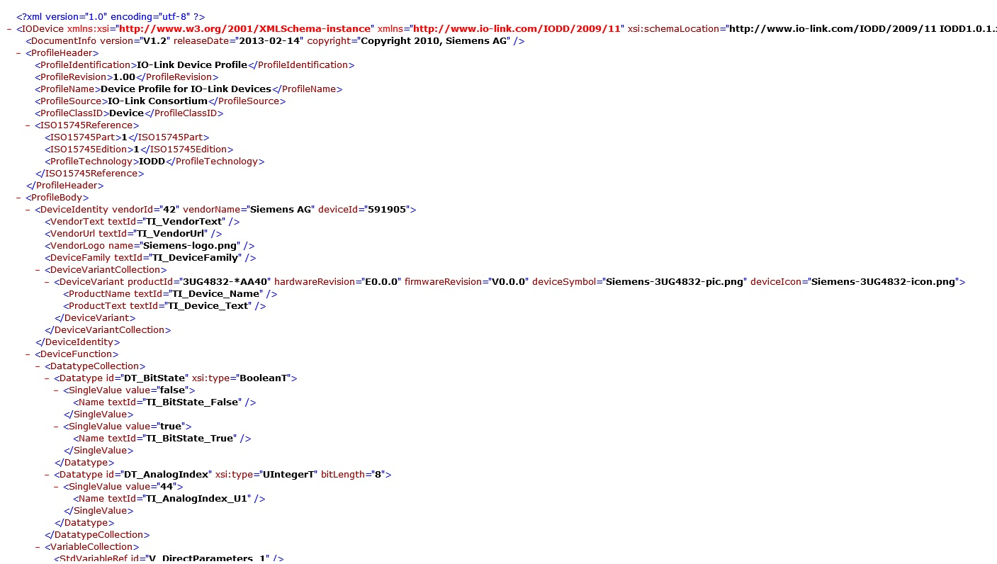
IO-Link Master FEATURE
Optionally, View the xml File
An XML file describing a device

Slide 34
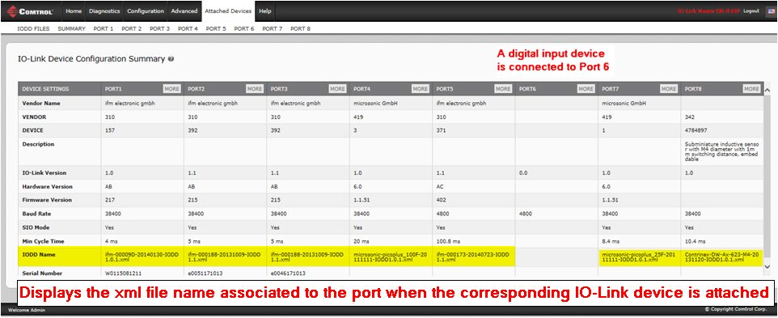
IO-Link Master FEATURE
Verify the Correct IODD Files are Loaded
You can verify that the correct IODD files are loaded for your IO-Link devices using the Summary page.

Slide 35
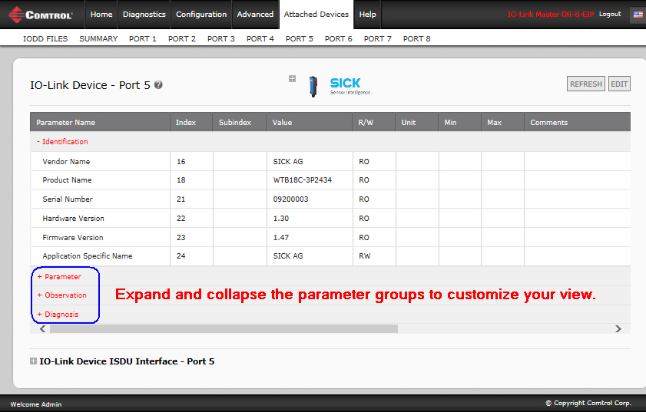
IO-Link Master FEATURE
IO-Link Device Description – Port Page

Slide 36
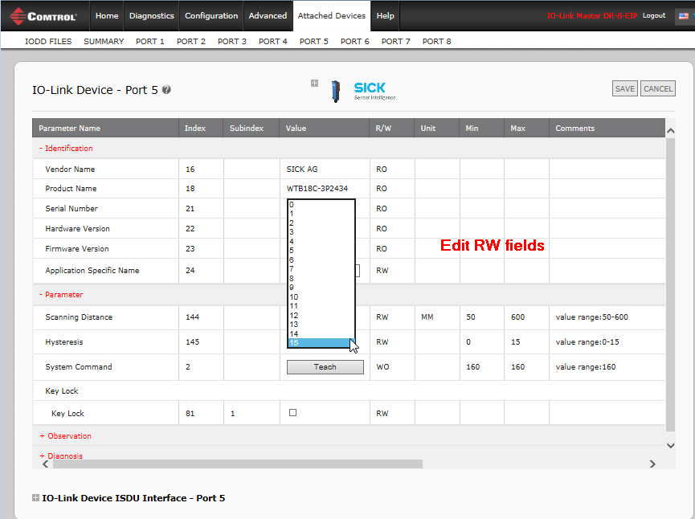
IO-Link Master FEATURE
Edit Device Parameters – Port Table

Slide 37
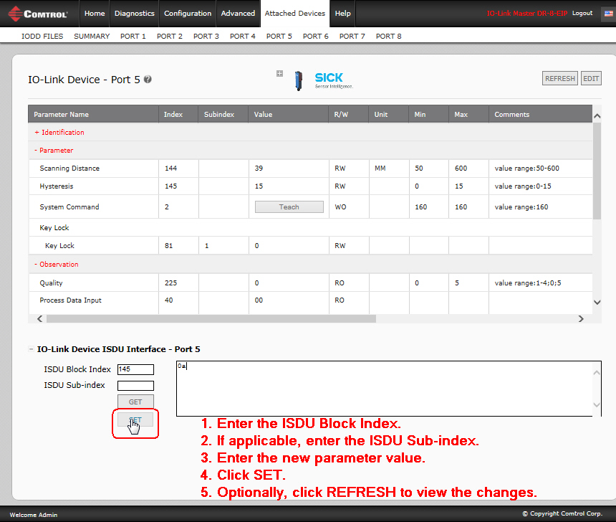
IO-Link Master FEATURE
Edit Device Parameters – ISDU Interface

Slide 38
Comtrol IO-Link Web Interface
Type in IO-Link Master IP address
Configure IO-Link, EtherNet/IP, Profinet IO and Modbus TCP settings for your IO-Link device
View real-time diagnostics for IO-Link, EtherNet/IP™, and Modbus TCP activity
Load IODD (IO Device Description) files onto the IO-Link Master for your convenience
Configure IO-Link devices in minutes using the IO-Link Device – Port table (GUI) or the IO-Link Device ISDU
Data Storage (automatic or manual) for Auto Device Configuration
IO-Link Device Validation (compatible and identical) to link a specific IO-Link device to a specific port

Slide 39
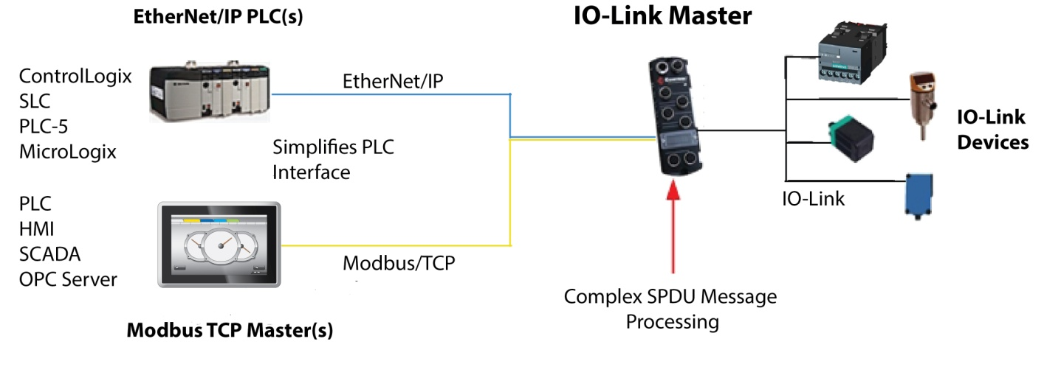
IO-Link Master FEATURE
ISDU Handling – (Indexed Service Data Unit)
Handles all programming to provide PLC access to IO-Link ISDU blocks with a flexible and simplified interface – provides multiple or single ISDU command message support and blocking and non-blocking messaging methods
USER BENEFIT
Eliminates lengthy and complex PLC programming to provide access to ISDU and process data

Slide 40
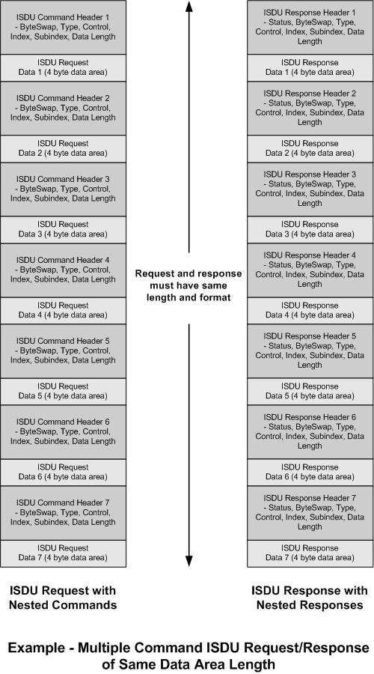
IO-Link Master FEATURE
ISDU Handling
The PLC ISDU message format is designed for flexibility and ease of use. Each message can contain a single command, multiple commands with the same data area size, or multiple commands with varying data area sizes.

Slide 41
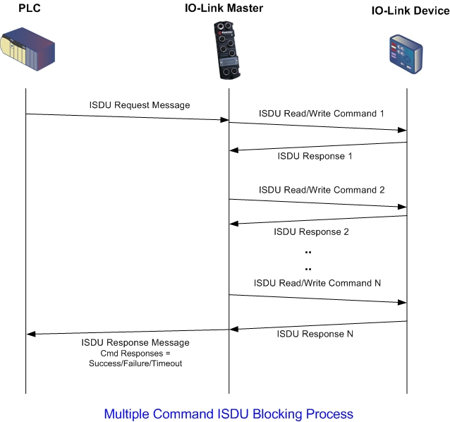
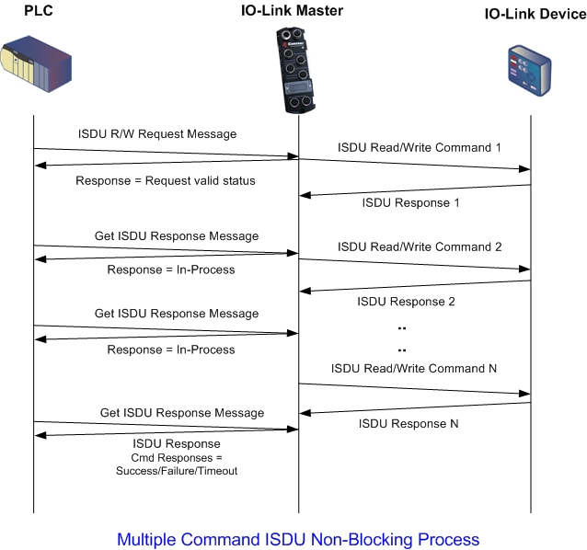
IO-Link Master FEATURE
ISDU Handling

Slide 42
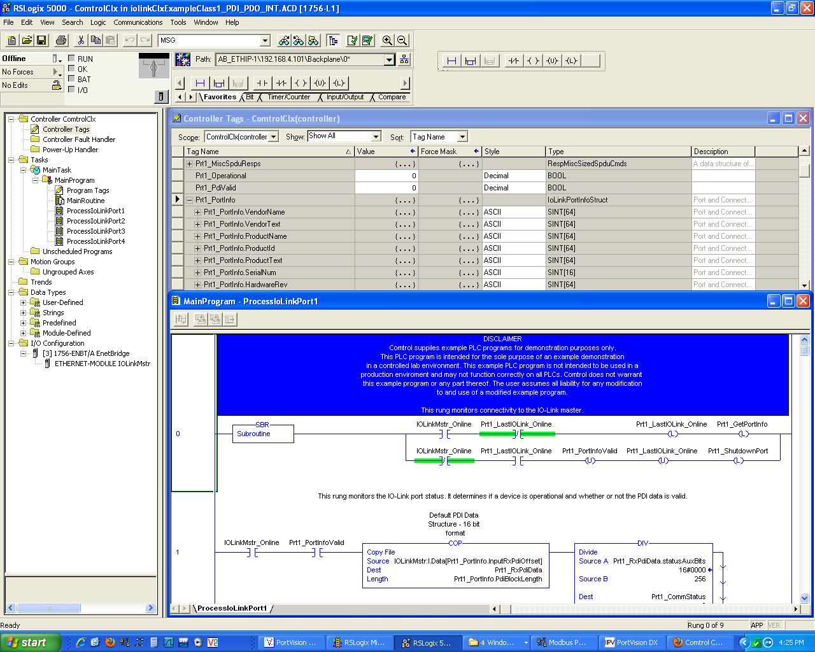
IO-Link Master FEATURE
Integration - PLC Interface
Comtrol provides easy PLC interface options for quick integration
PLC example programs included to drop into RSLogix

Slide 43
IO-Link Master FEATURE
Network Management Tools
Comtrol’s PortVision DX management application allows you to configure network settings, upload firmware, manage and monitor IO-Link attached devices.
FEATURES of PortVision DX
Scan the network for attached devices
View networked Comtrol devices in real-time
Access product-specific network settings configurations
Assign IP addresses and network settings to one or multiple devices
Upload the latest software (images and/or applications)
Save and load IO-Link Master configuration files
Access Comtrol configuration web pages
Access Telnet/SSH sessions
Remotely reboot devices
Download technical documentation
Enable event logging to assist in monitoring and troubleshooting
Create shortcuts to quickly access your favorite applications
Organize devices into folders and create multiple views
Enter notes about a folder or device

Slide 44
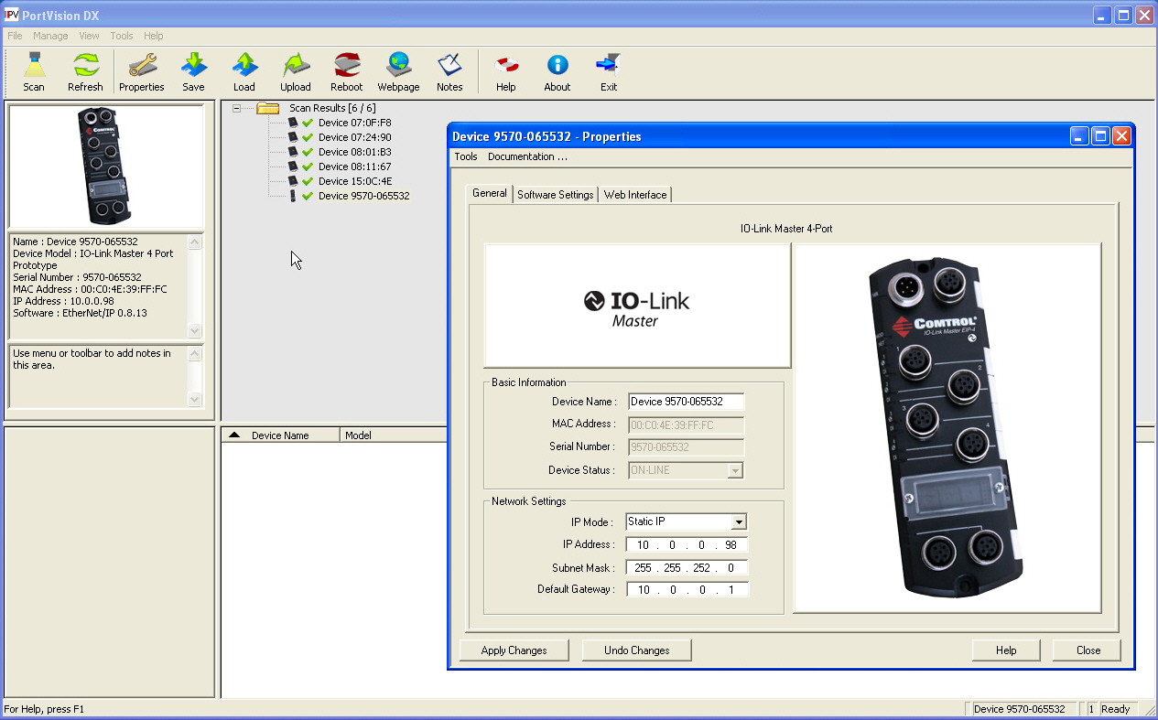
IO-Link Master FEATURE
Easy Network Configuration

Slide 45
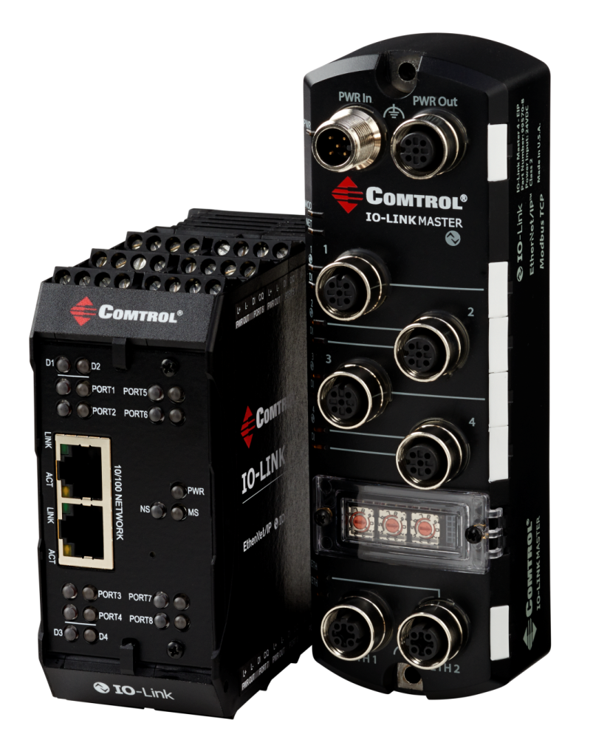
Recap: Comtrol IO-Link Master
Reduce Cabling
Enhanced Diagnostics Capability
Remote Parameterization
Mobile Application
MultiLink – simultaneously provides IO-Link device access to multiple controllers
Auto-Device Configuration and ADR
Powerful IO-Link Master web interface
ISDU (Indexed Service Data Unit) Handling
RSLogix Integration – PLC Interface
Network Management Tools

Slide 46
What separates us from the competition?
Multi Link- Allows for communication with Ethernet/IP or Profinet/IO AND Modbus TCP devices simultaneously
Also do not need a PLC just to run and operate the master
Only North American IO-Link gateway provider to have a DIN-Rail option
Class 1 and 3 Ethernet/IP supported
Do not have to upgrade older PLC’s just to use our IO-Link master
North American IO-Link Competency Center
Have tested and worked with nearly all present IO-Link sensor manufacturers
Superior knowledge to help explain or configure an IO-Link system
Simplicity in operation and ease of use
Through PortVision, Comtrol’s embedded webpage and our tech support team, we provide not only the most robust IO-Link solution but also compliments to make integration easy

Slide 47
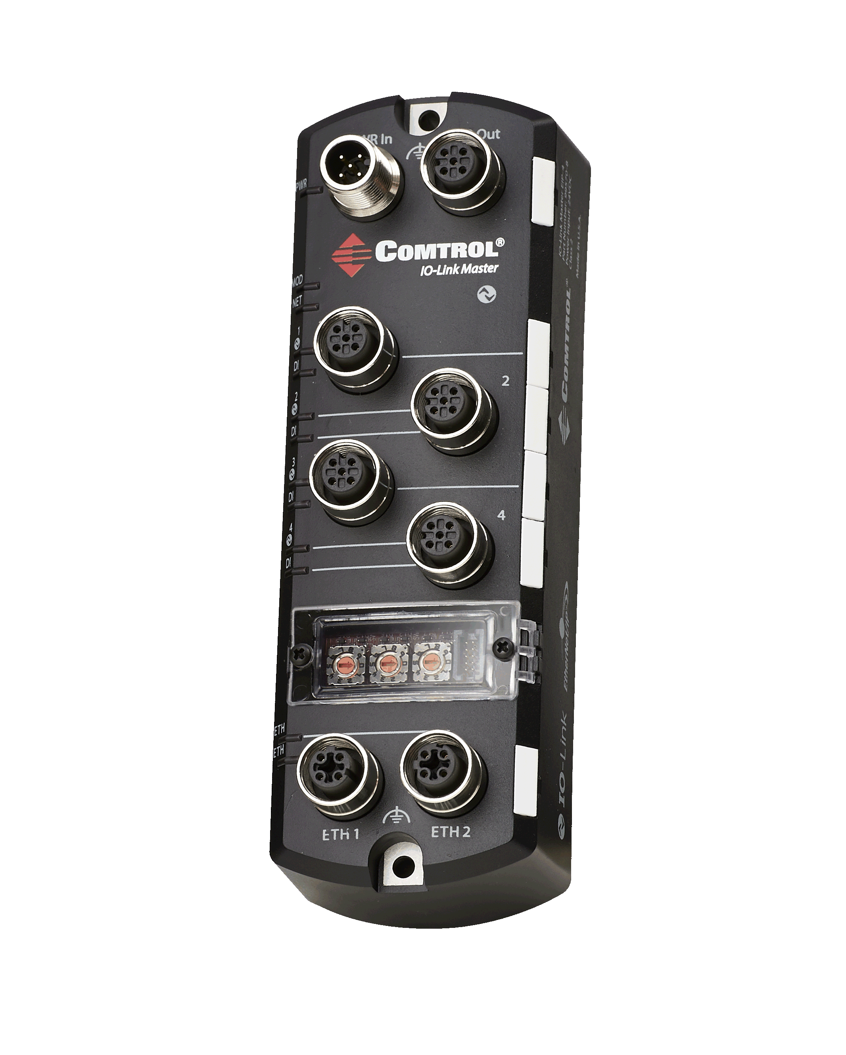
Comtrol IO-Link Master 4-EIP
Specifications
Four channel IP67 IO-Link Master to EtherNet/IP
Modbus TCP access to IO-Link sensor service and process data
EtherNet/IP Class 1 and Class 3
Powerful web interface for configuration and diagnostics
PortVision DX to quickly configure network information
Wide operating temperature (0 to 55ºC)
Additional digital input on every port
IO-Link V1.1 compatibility
IO-Link COM1, COM2 and COM3 support (230K throughput)
Innovative MultiLink technology

Slide 48
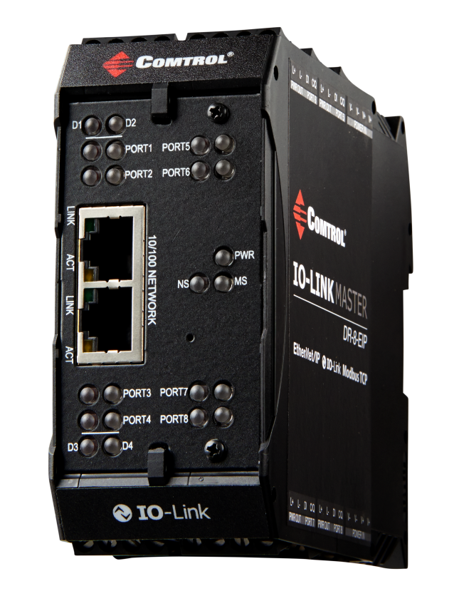
Comtrol IO-Link Master DR-8-EIP
Specifications
Eight channel IO-Link Master to EtherNet/IP™
Modbus TCP access to IO-Link sensor, service, and process data
EtherNet/IP™ Class 1 and Class 3
IP20 DIN rail mount enclosure
Screw terminal connectors for IO-Link, Power, and
Digital IO
Wide operating temperature (0° to +70°C)
Powerful web interface for configuration and diagnostics
Additional digital input on every port
PortVision DX to quickly configure network information
IO-Link V1.1 compatibility
IO-Link COM1, COM2 and COM3 support
Up to 8 IO-Link connections and 12 Digital IO Inputs

Slide 49
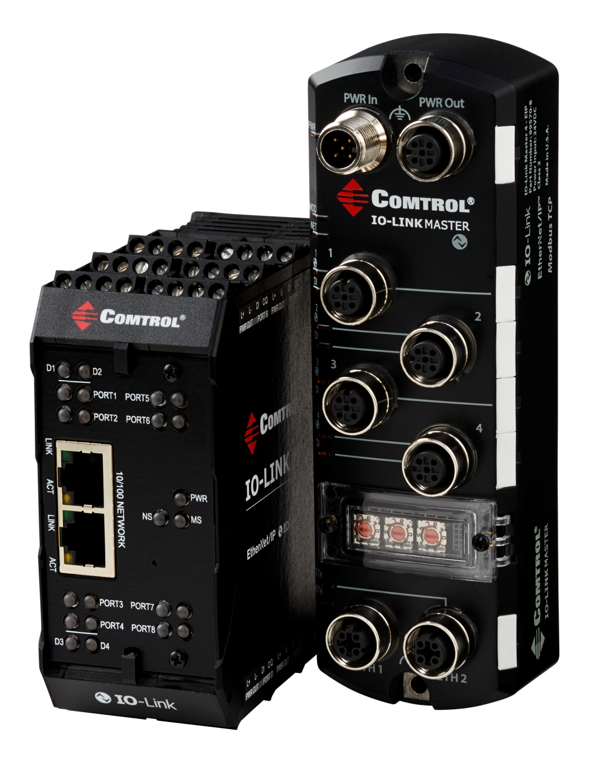
Comtrol IO-Link Master
IOLM 4-EIP
Part Number: 99570-8
IOLM DR-8-EIP
Part Number: 99590-6

Slide 50
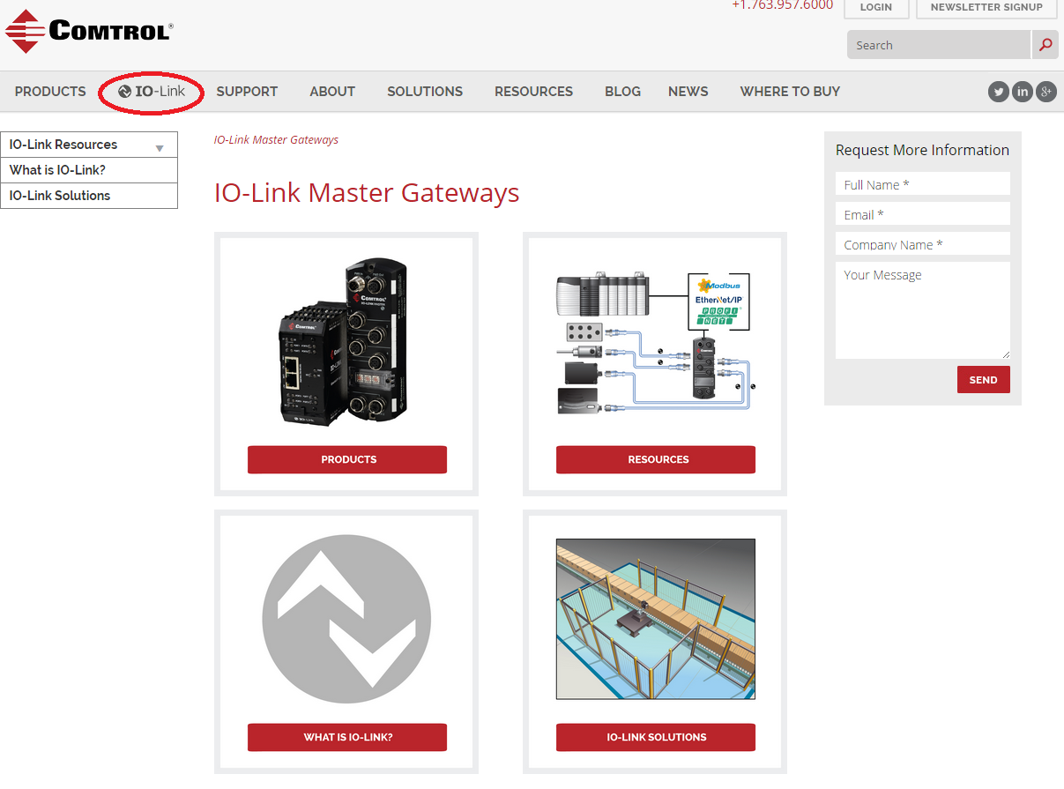

Slide 51
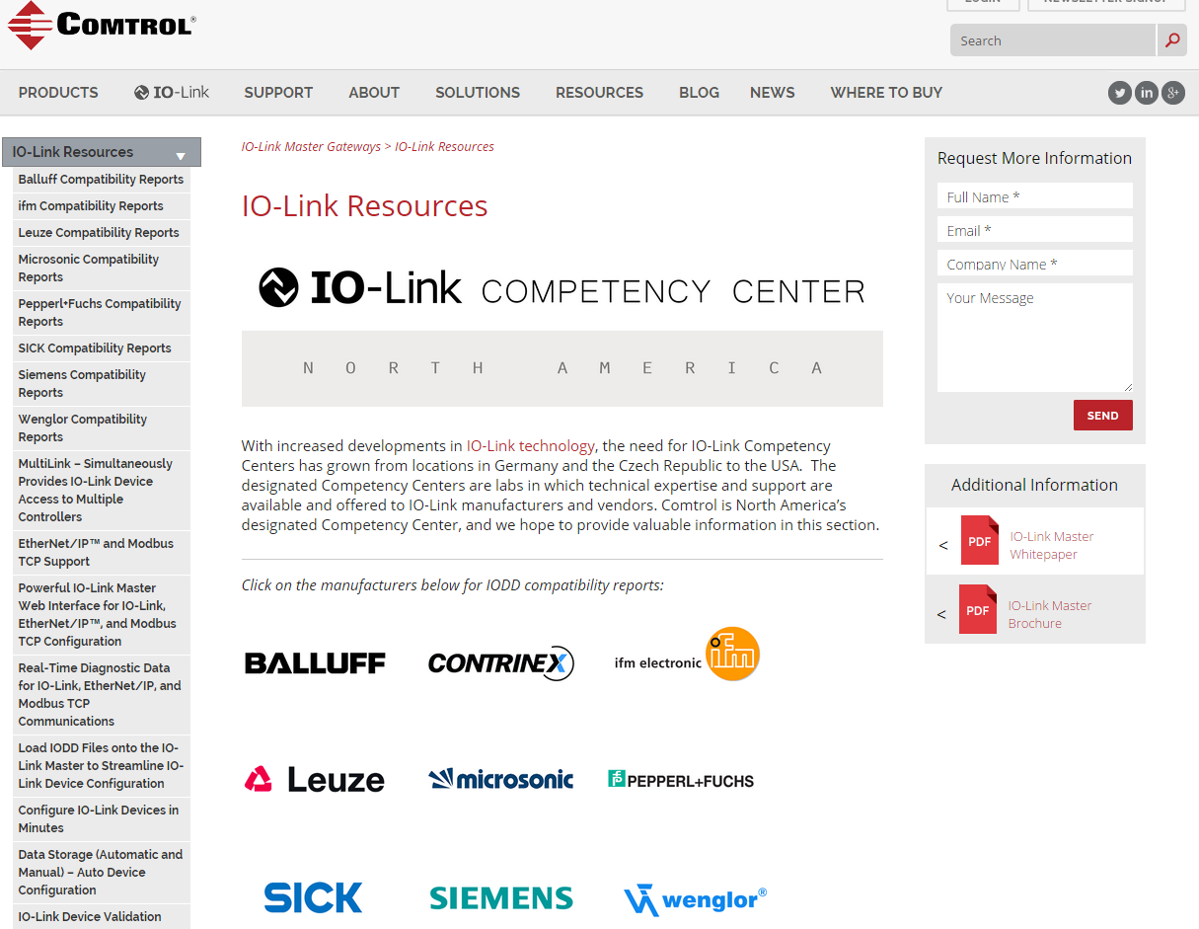

Slide 52
Thank You
Brad Beale - President
brad.beale@comtrol.com
763.957.6000
Dennis Christensen – EMEA Sales Director
dennis.christensen@comtrol.com
Direct: 763.957.6113
Nolan Kariniemi – Field Application Engr.
nolan.kariniemi@comtrol.com
Direct: 763.957.6140

