Slide 1
Pepperl+Fuchs –
COMTROL Inc.
Application and
Product Training

Slide 2
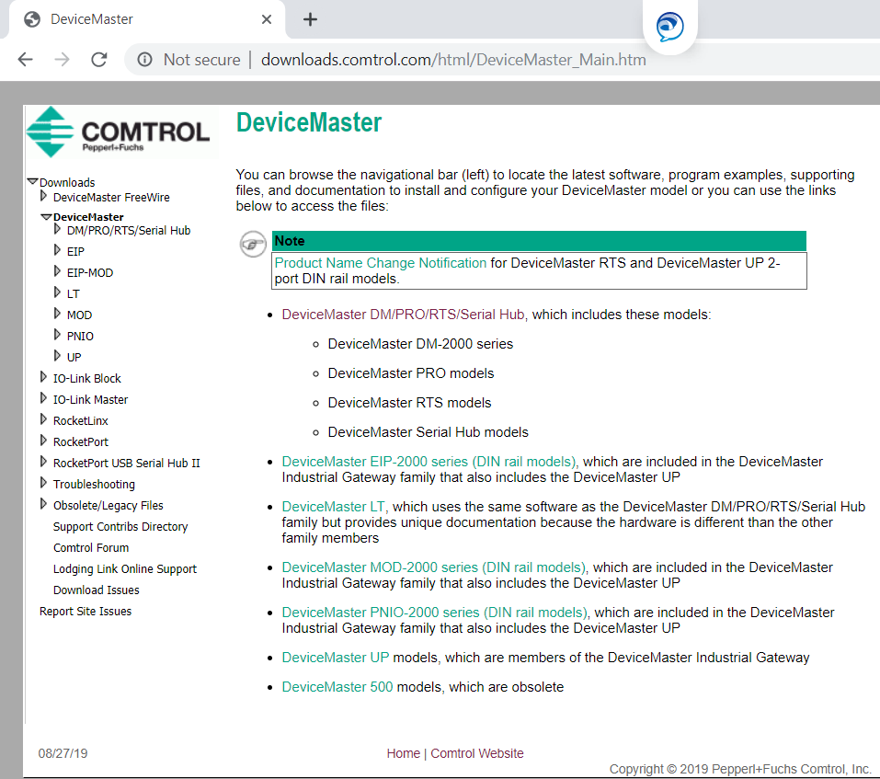
Goto www.comtrol.com

Slide 3
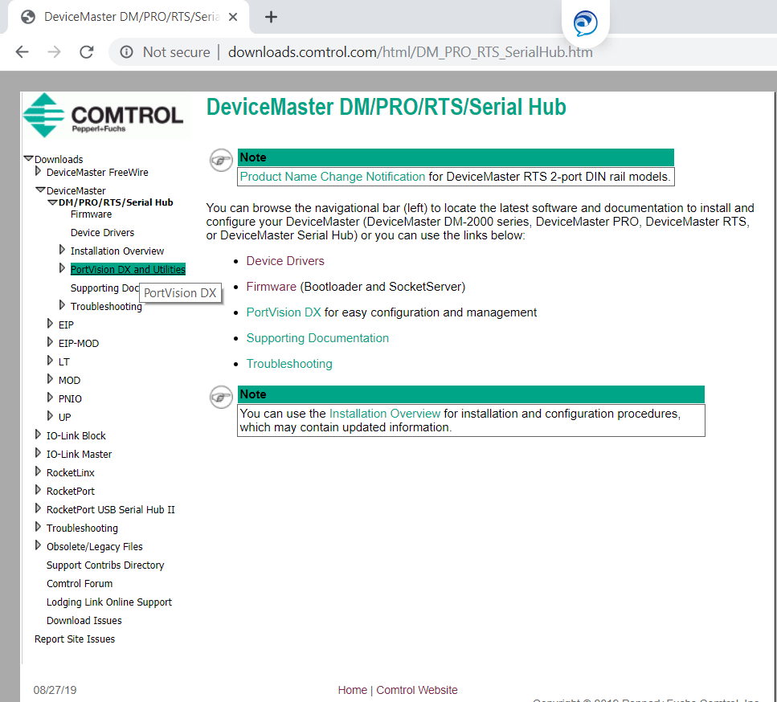
Choose DeviceMaster/DM/PRO/RTS Portvision DX

Slide 4
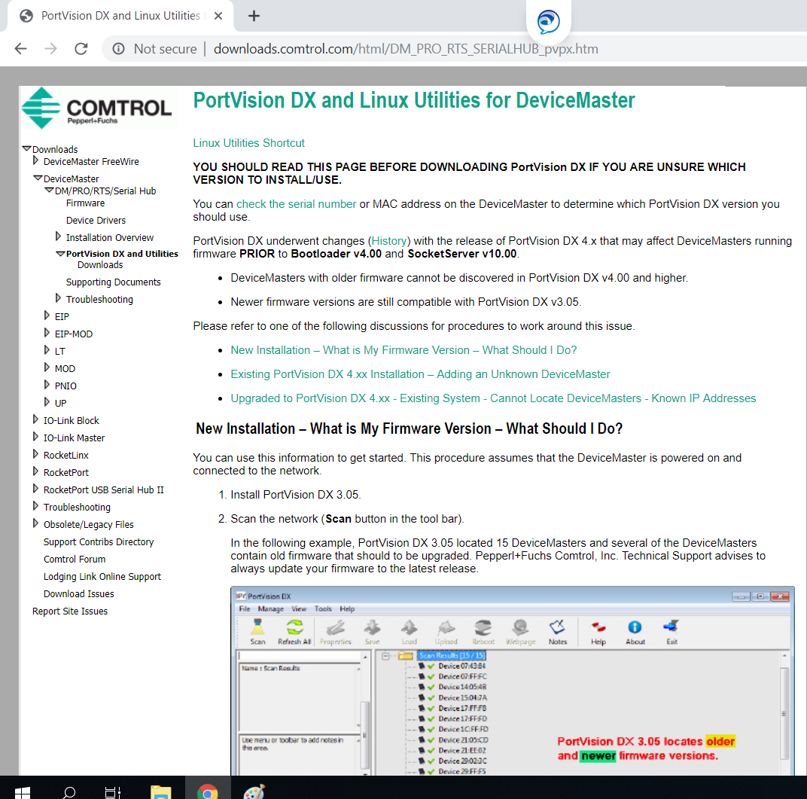
Downloads

Slide 5
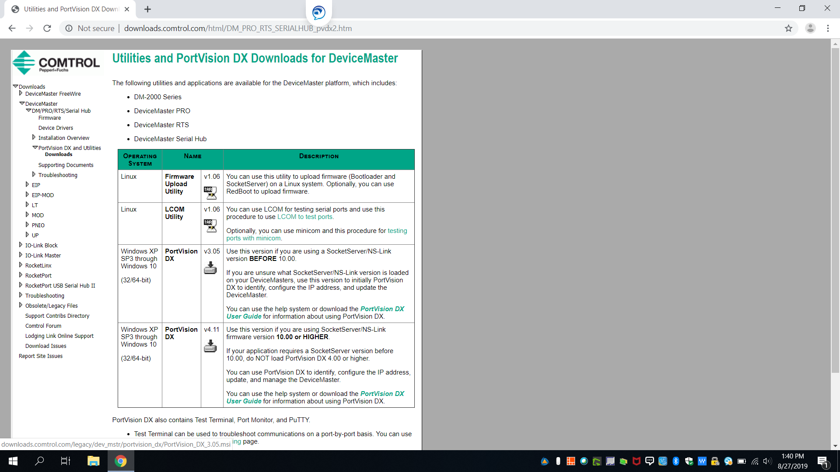
Download Portvision DX V4.11

Slide 6
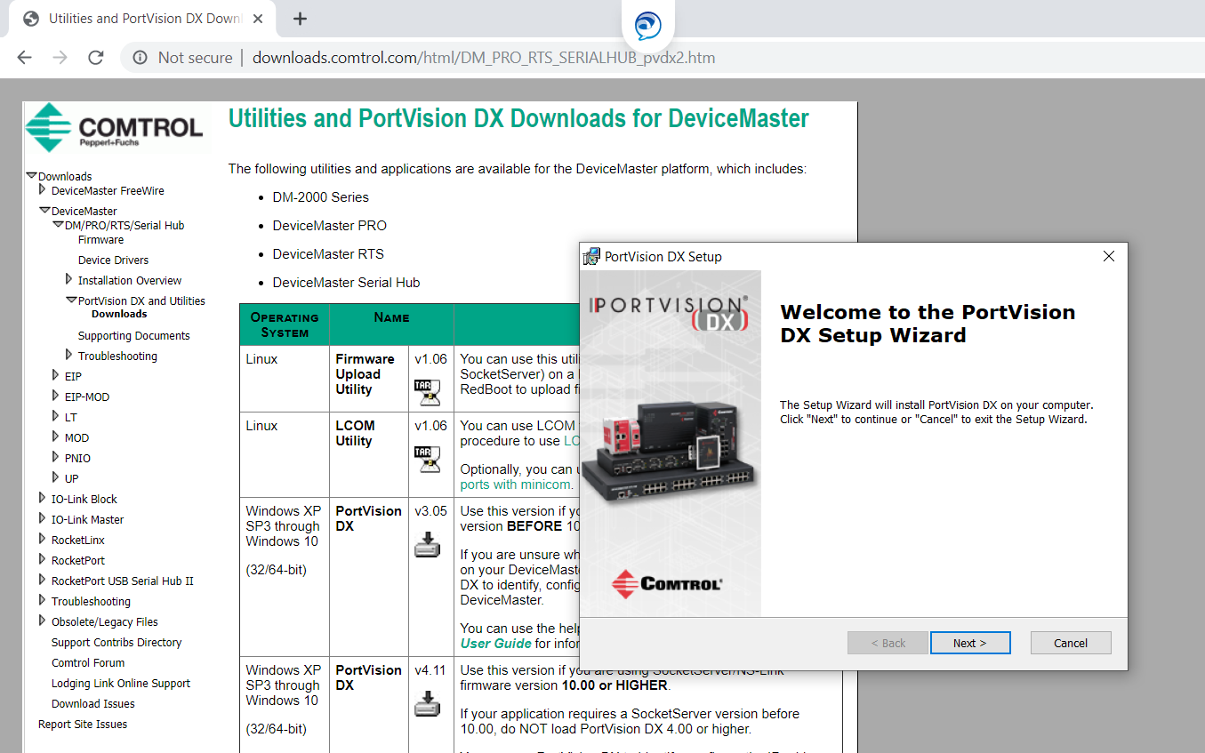
Run Wizard

Slide 7
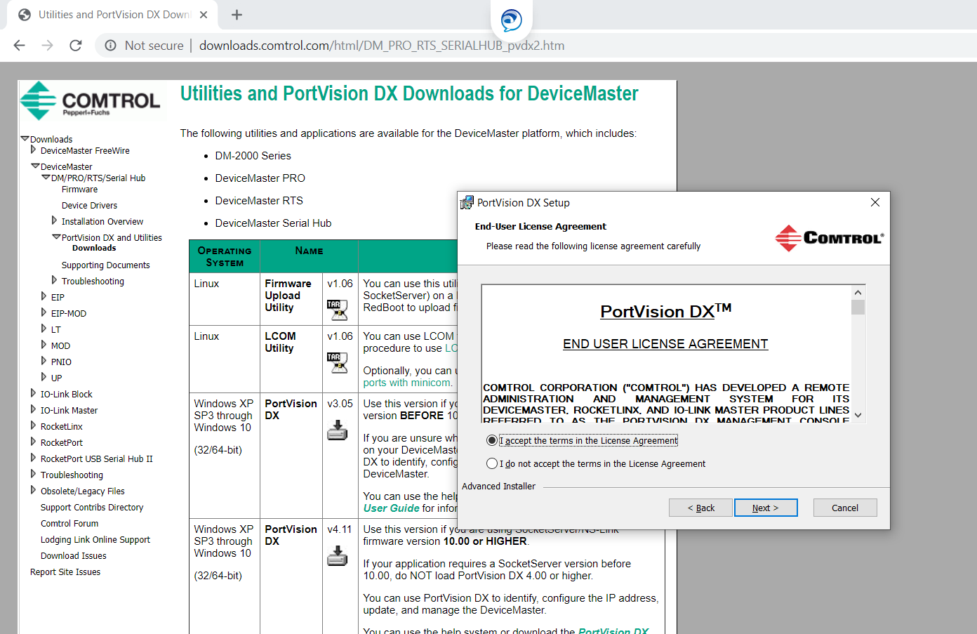
Accept User Agreement

Slide 8
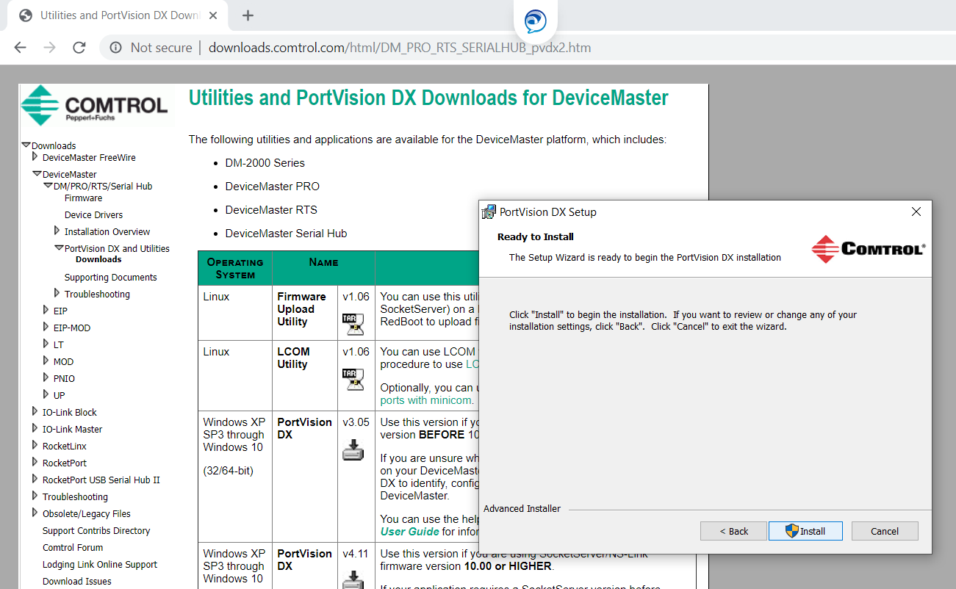
Install Portvision

Slide 9
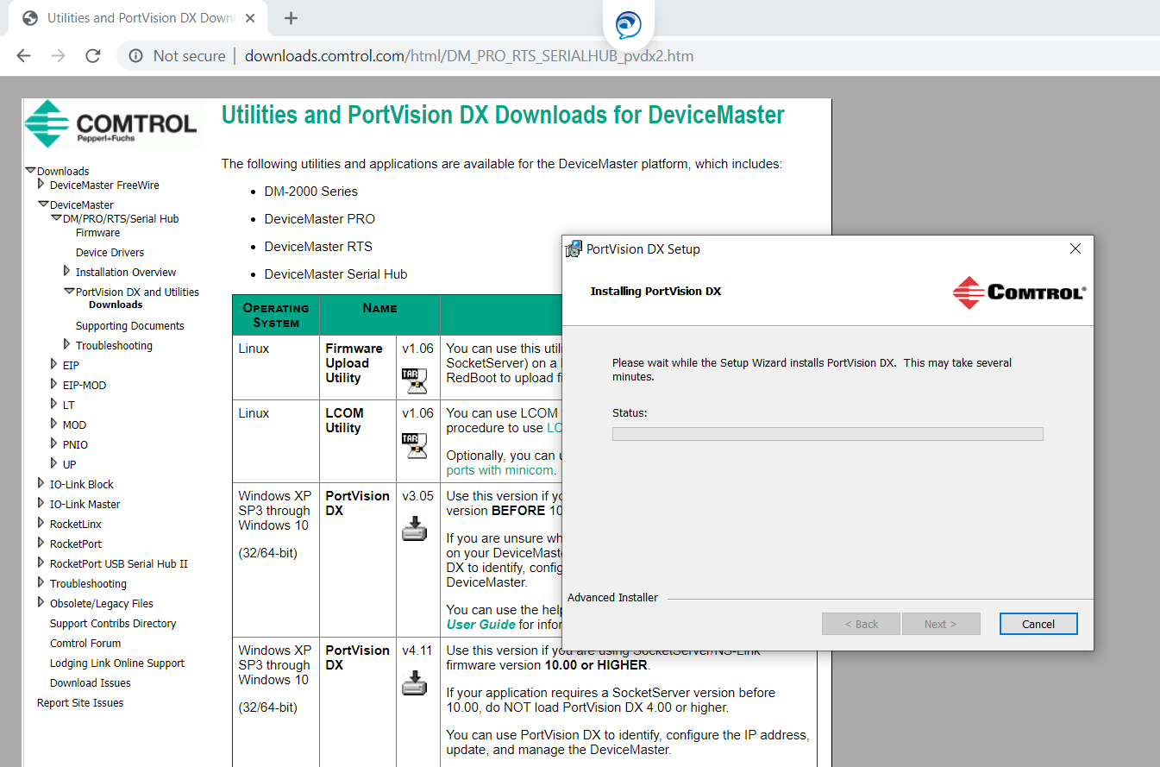
Continue Install until completed

Slide 10
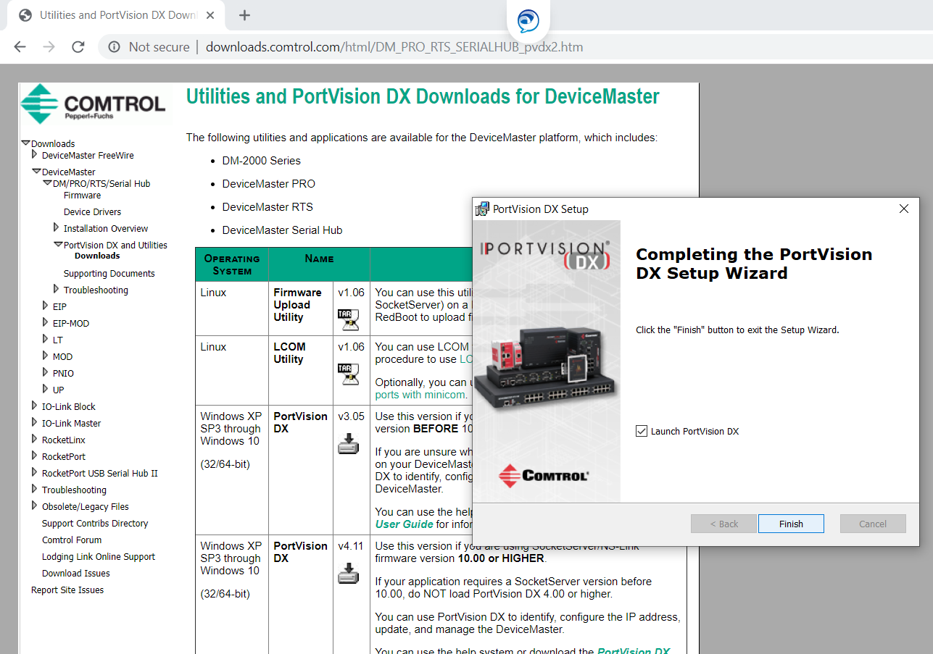
Finished Install

Slide 11
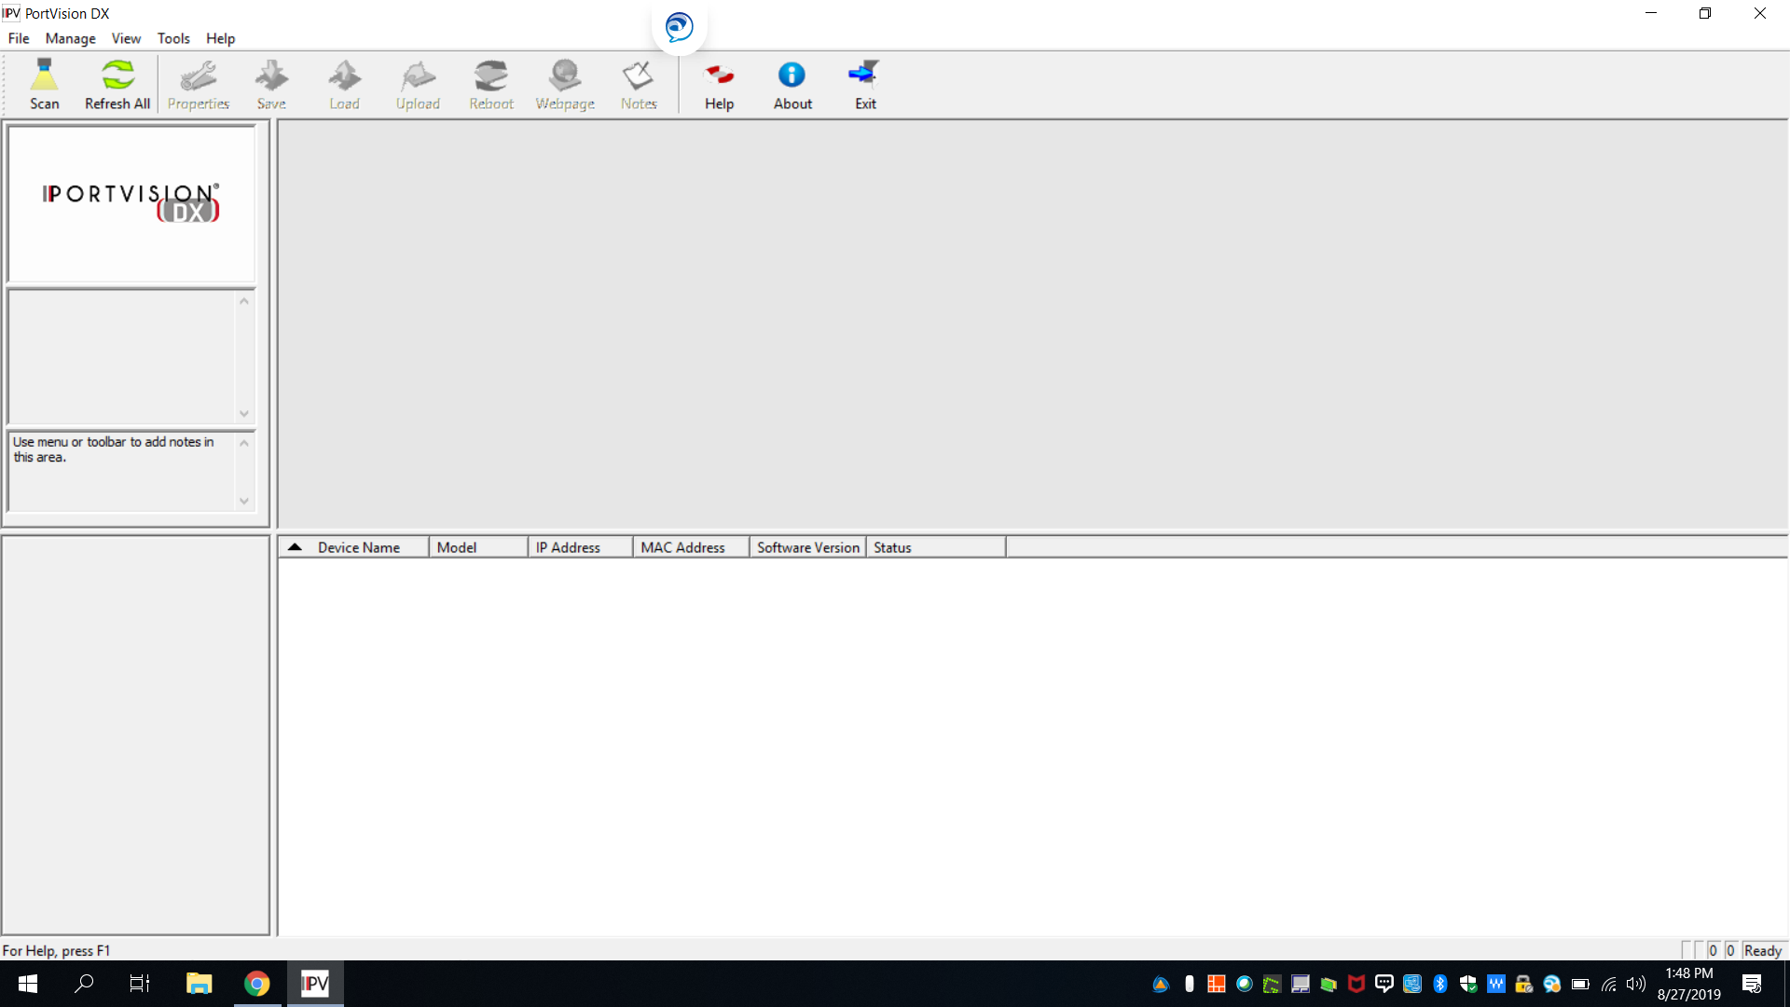
Pull up Portvison DX

Slide 12
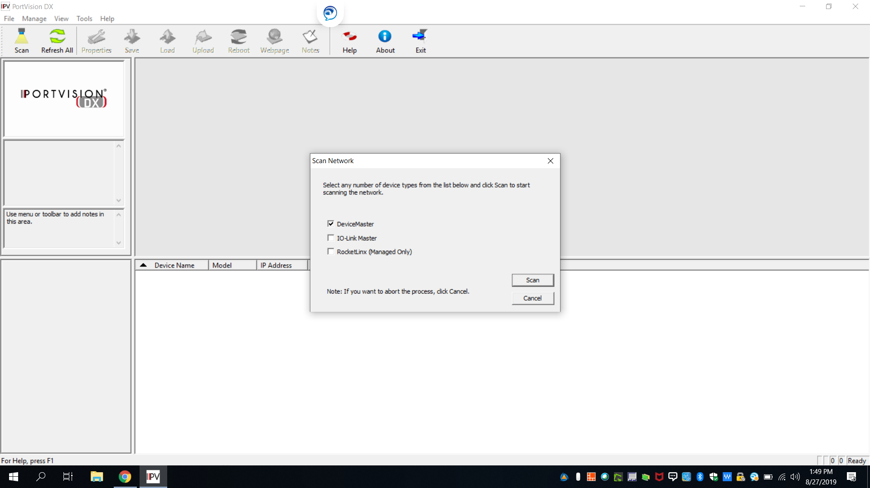
Hit Scan- Choose DeviceMaster and Scan

Slide 13
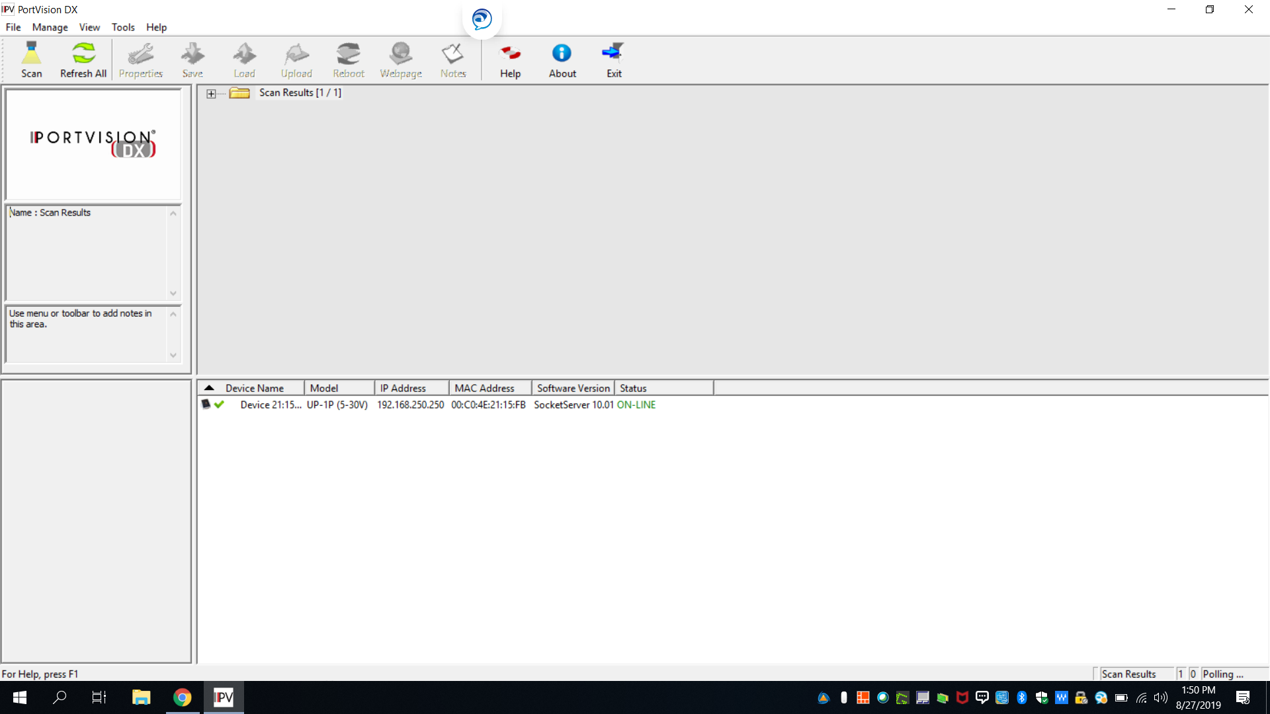
Discover DeviceMaster

Slide 14
Change Network Settings if needed for PC

Slide 15
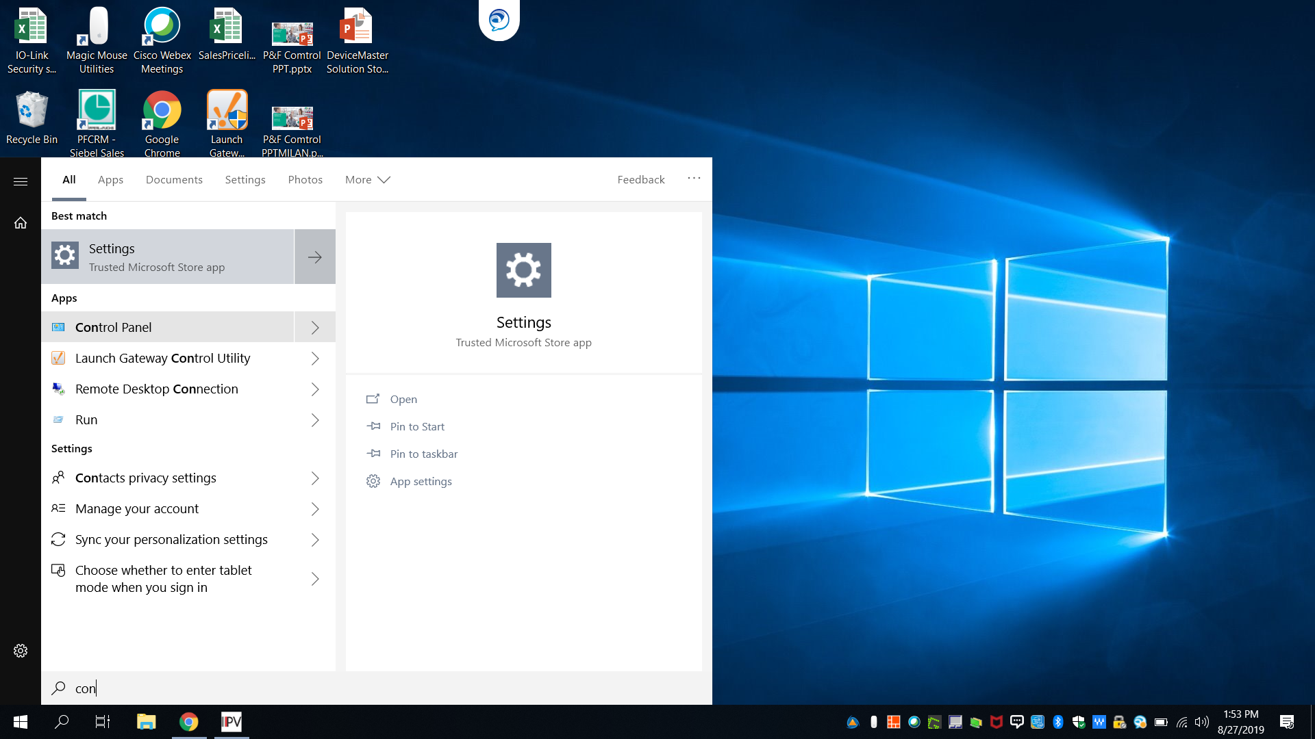
Start- Control Panel

Slide 16
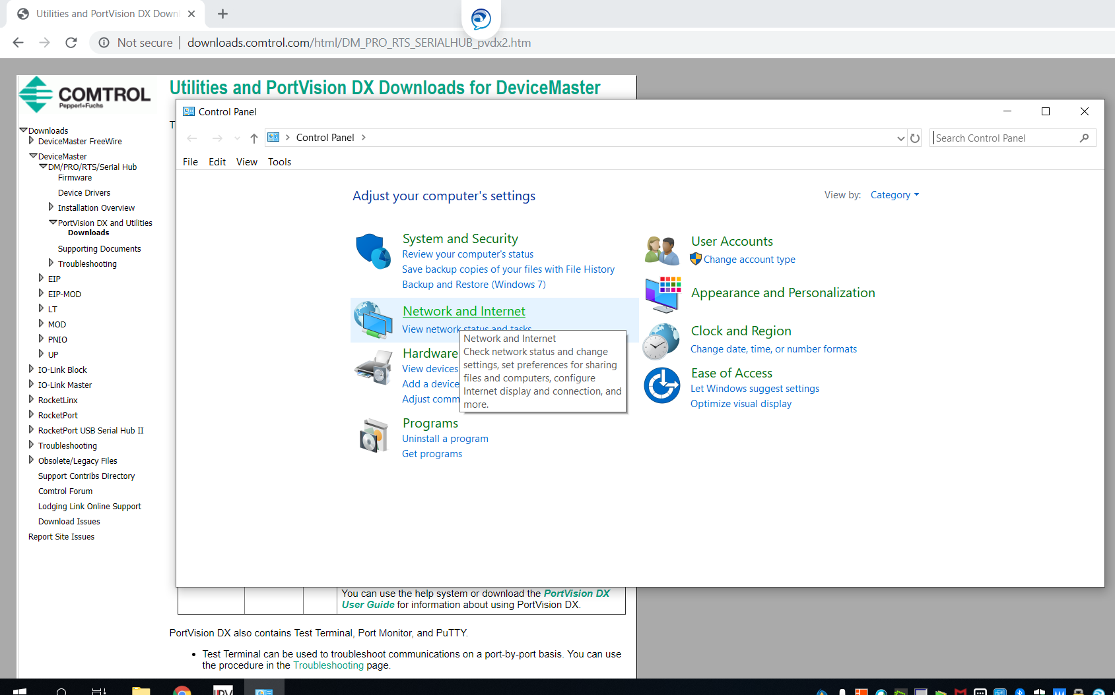
Select Network and Internet

Slide 17
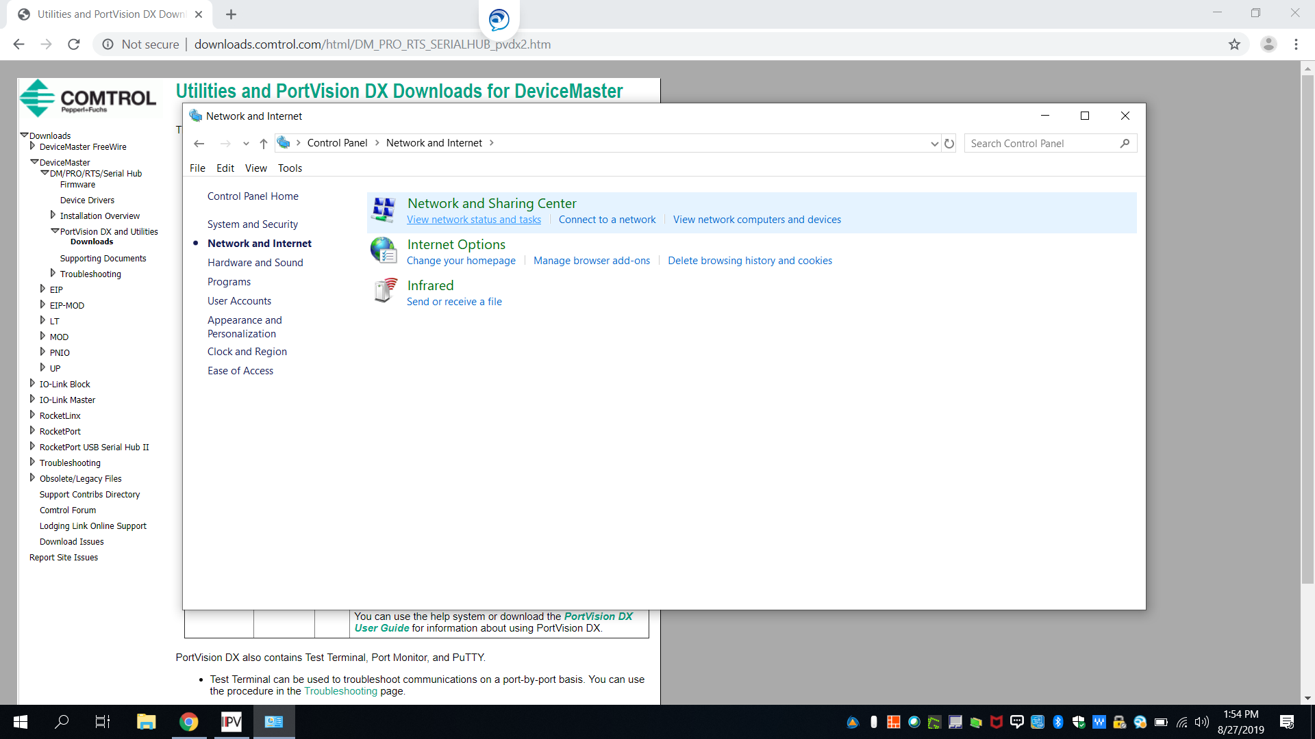
Choose View Network Status and Tasks

Slide 18
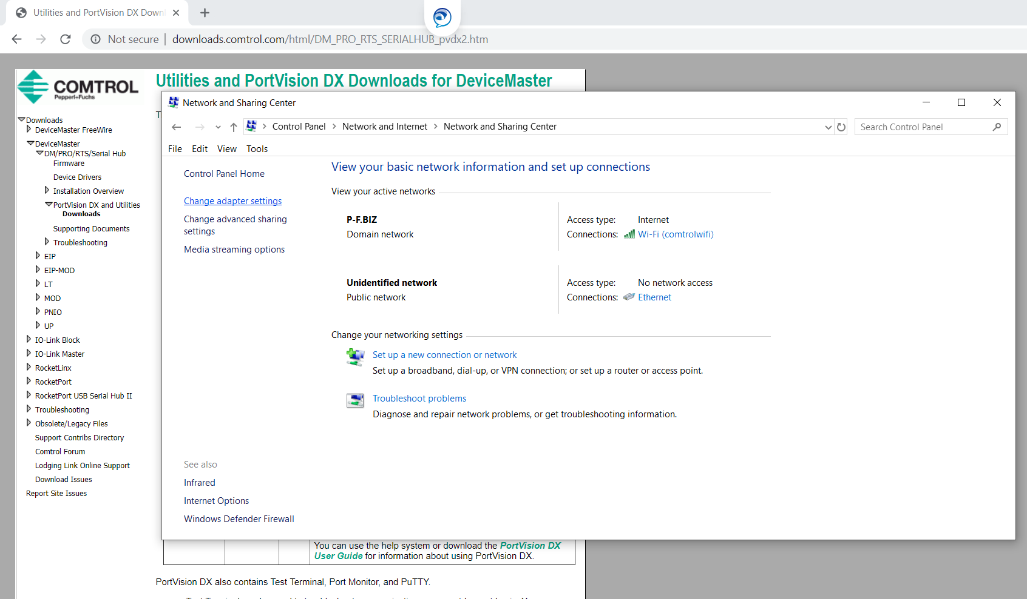
Change Adapter Settings on Left

Slide 19
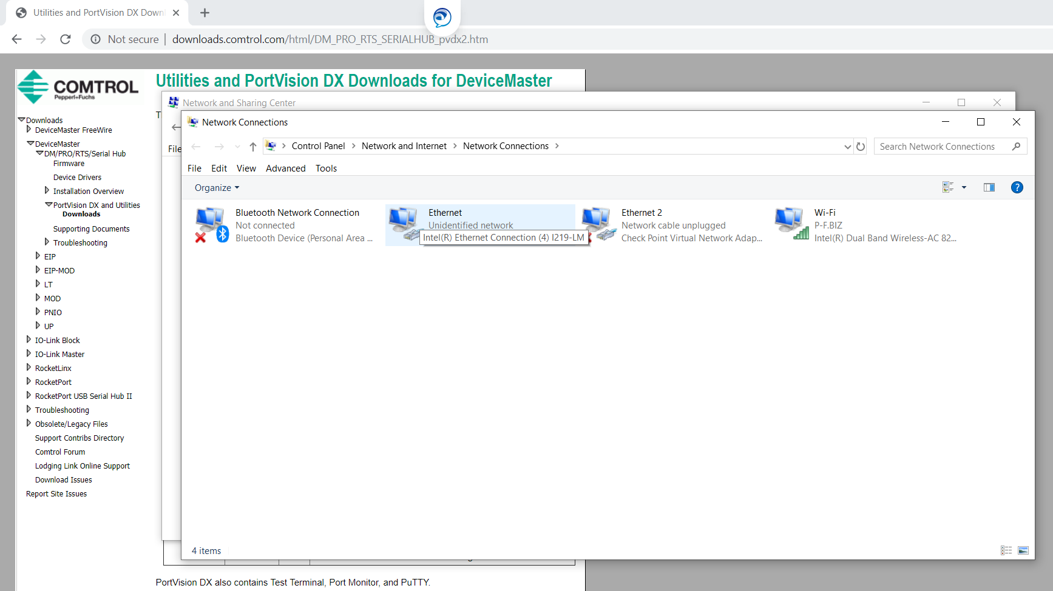
Choose Network Card

Slide 20
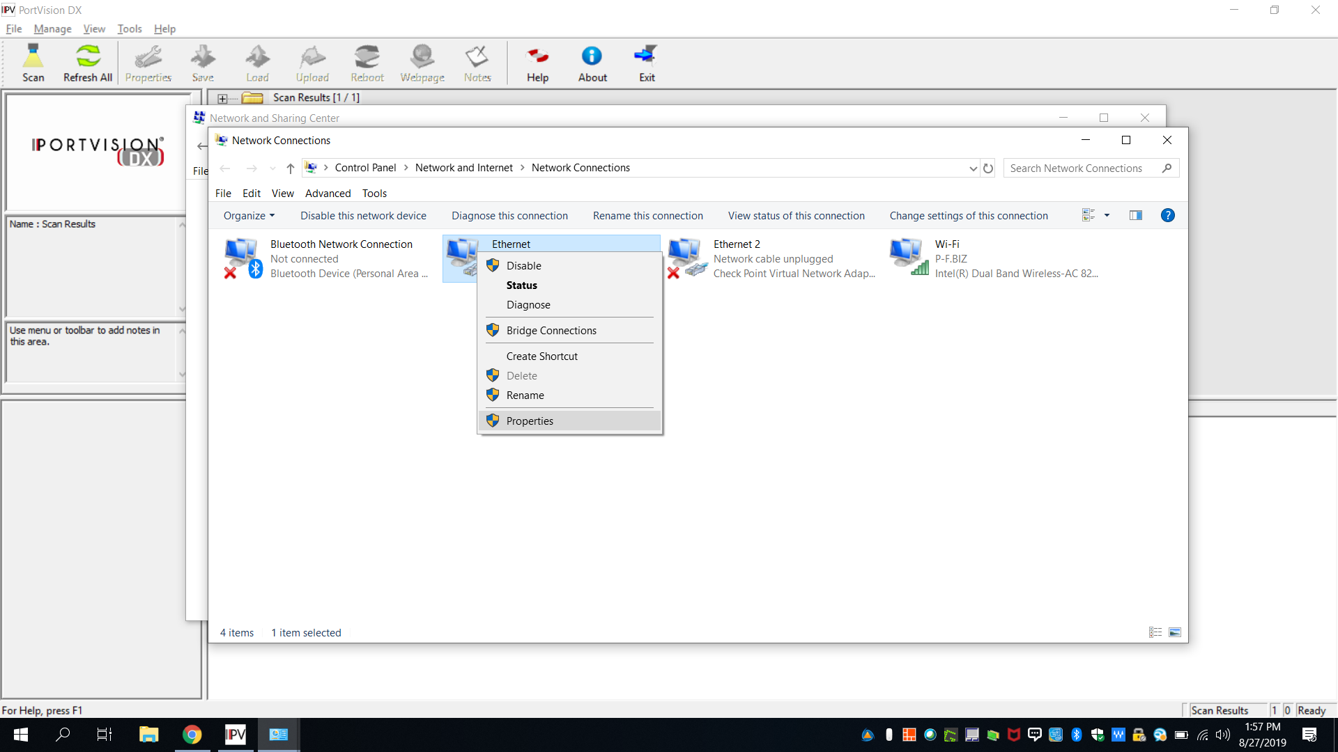
Choose Properties

Slide 21
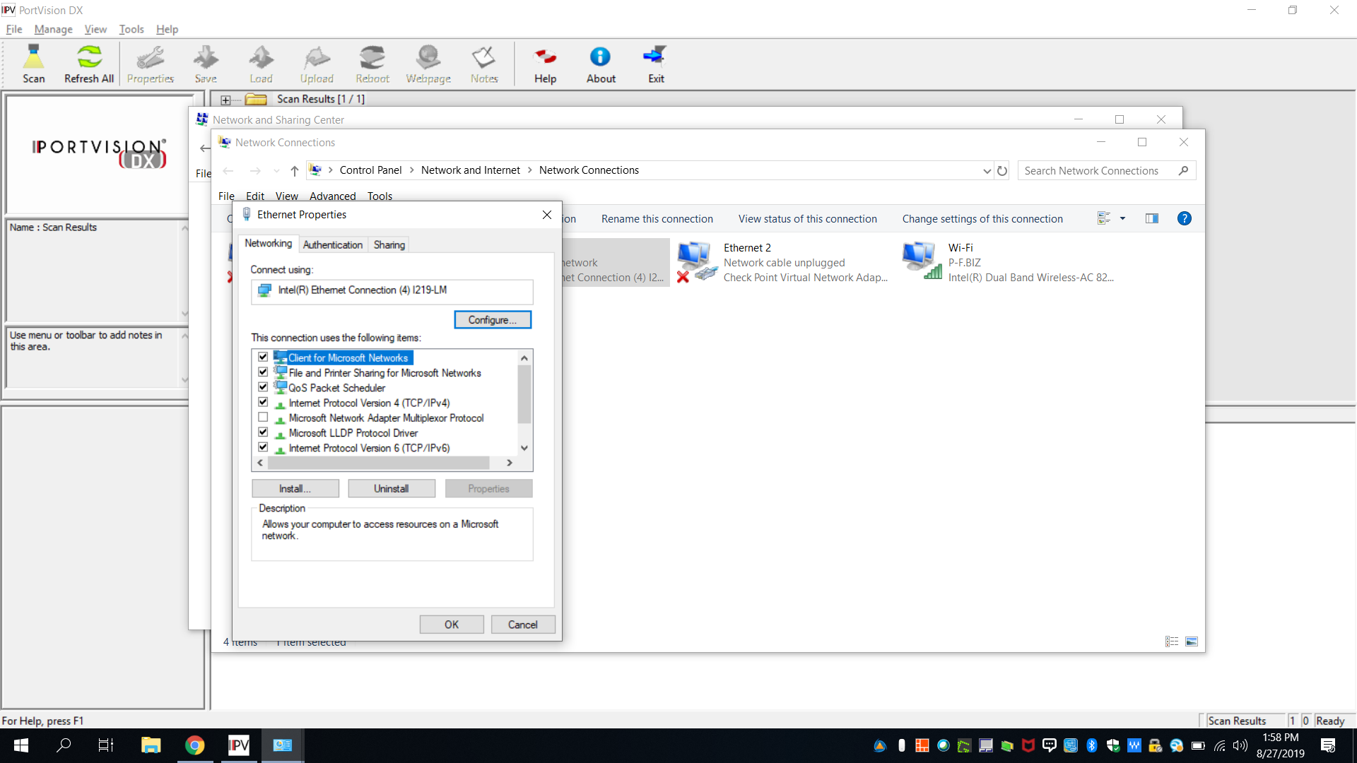
Choose TCP/IPv4

Slide 22
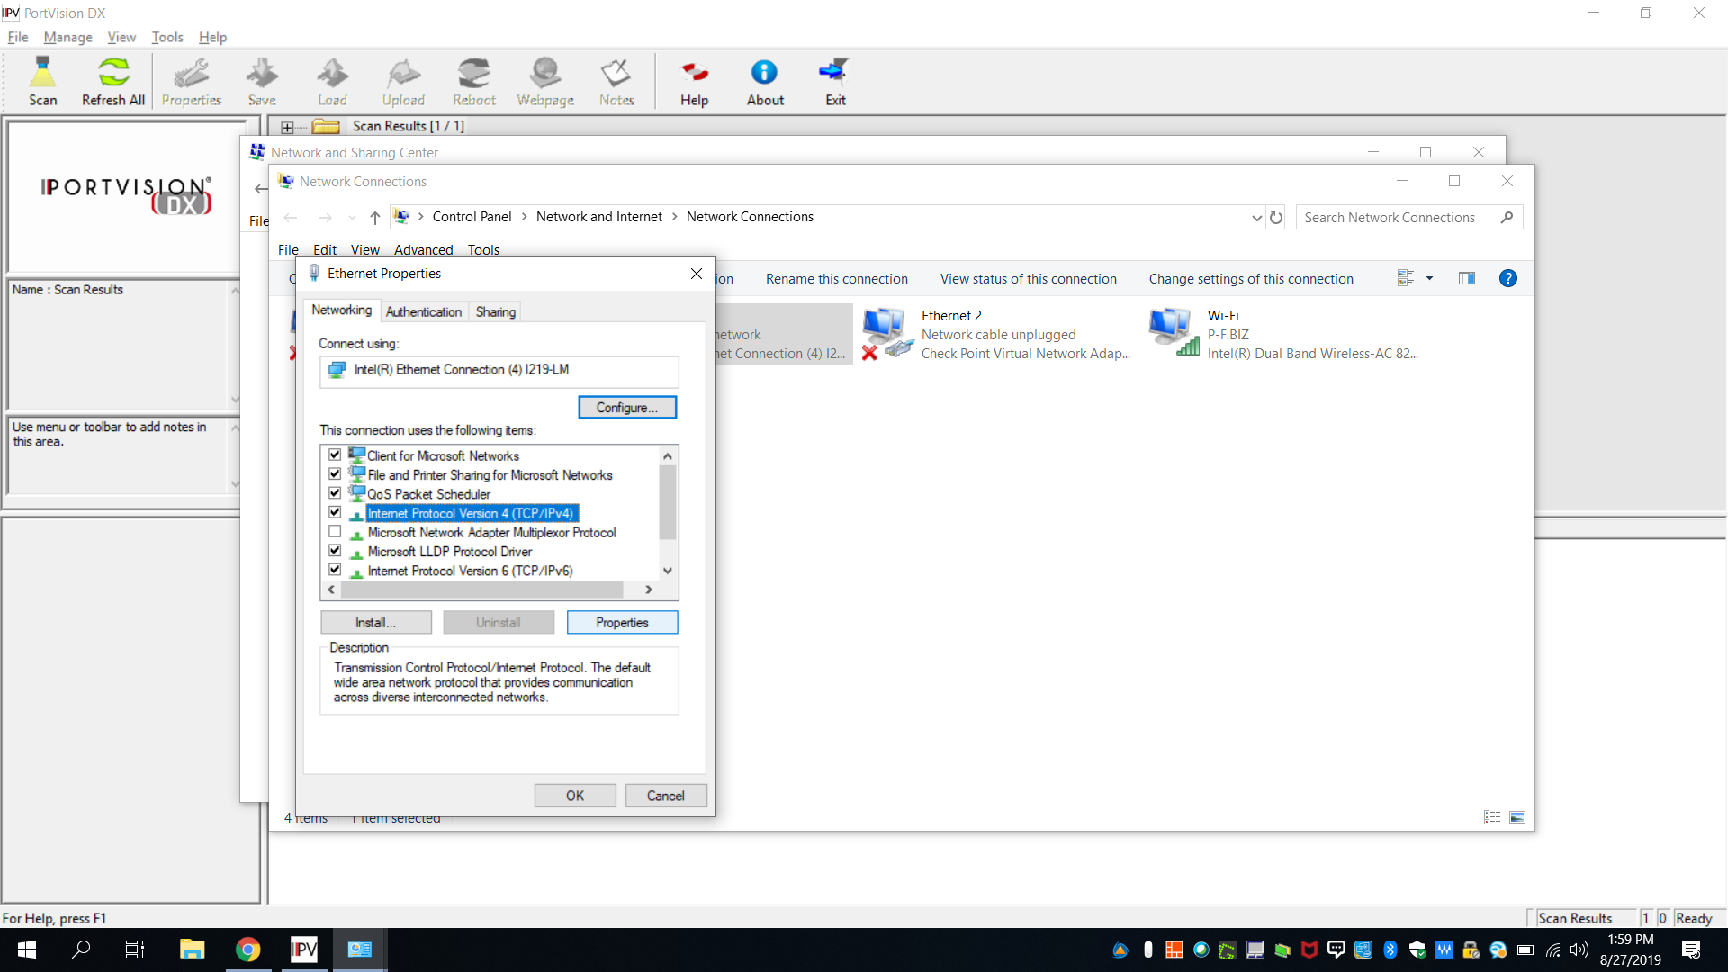
Choose Properties

Slide 23
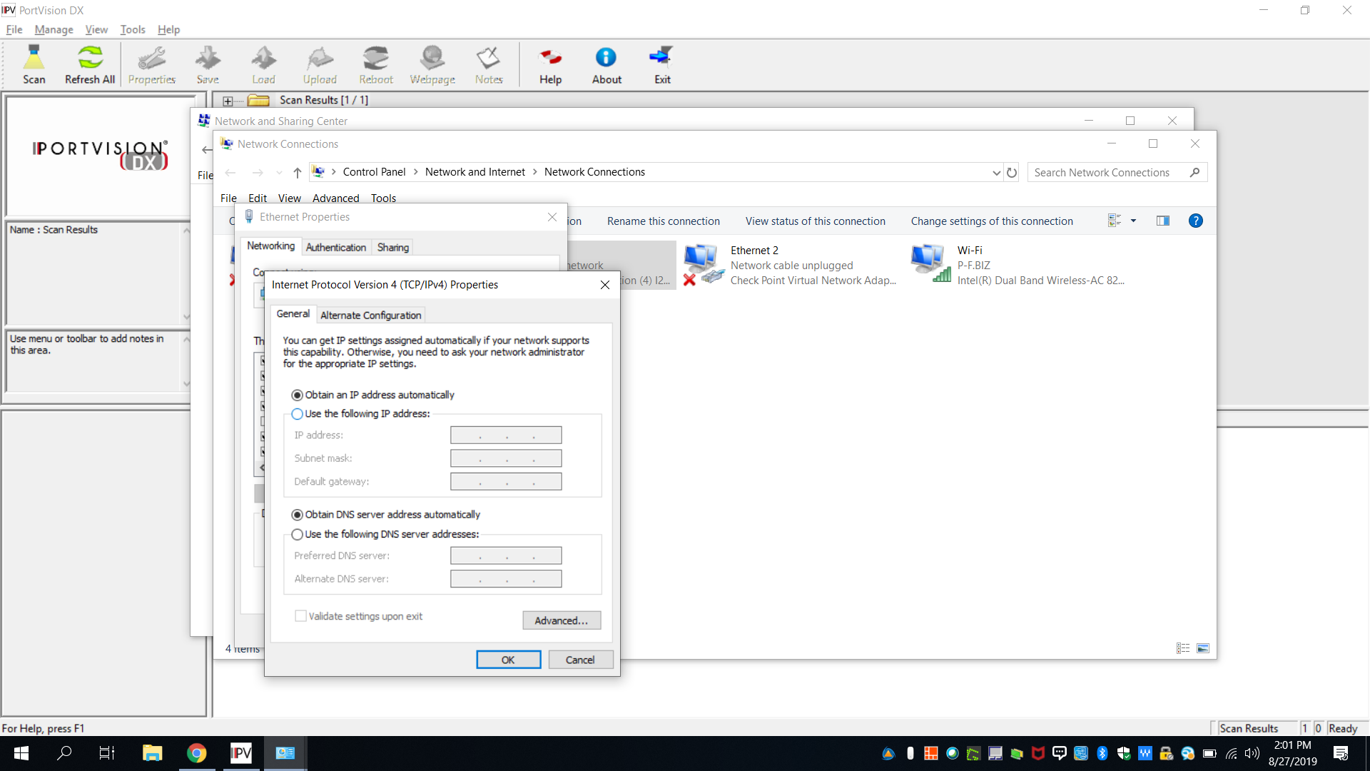
Network windows come up- Note original settings

Slide 24
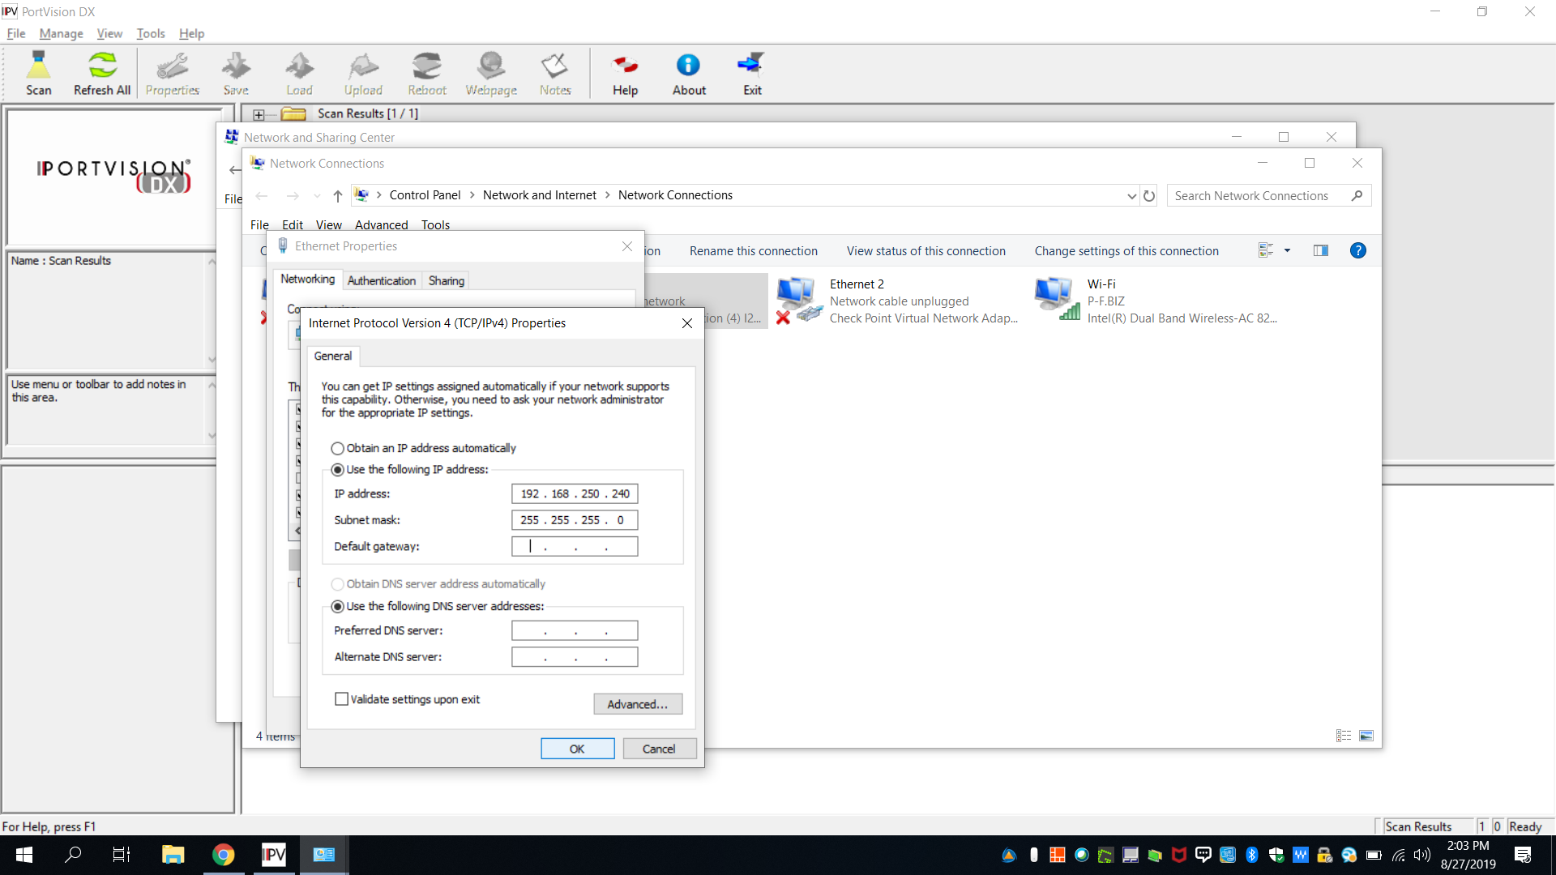
Change Network setting to Static IP (Last octet unique)

Slide 25
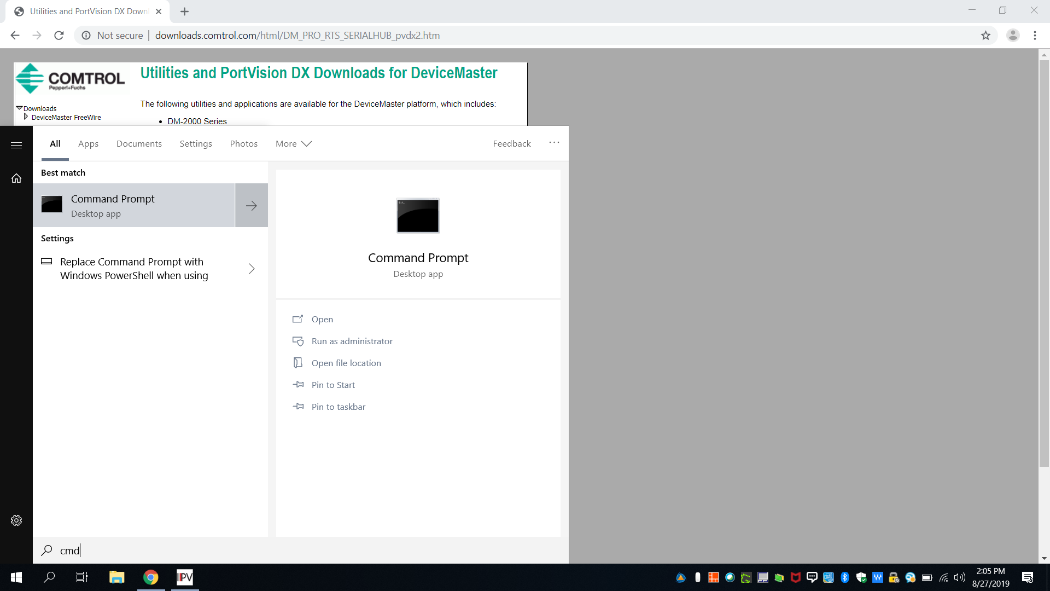
Open Command Prompt

Slide 26
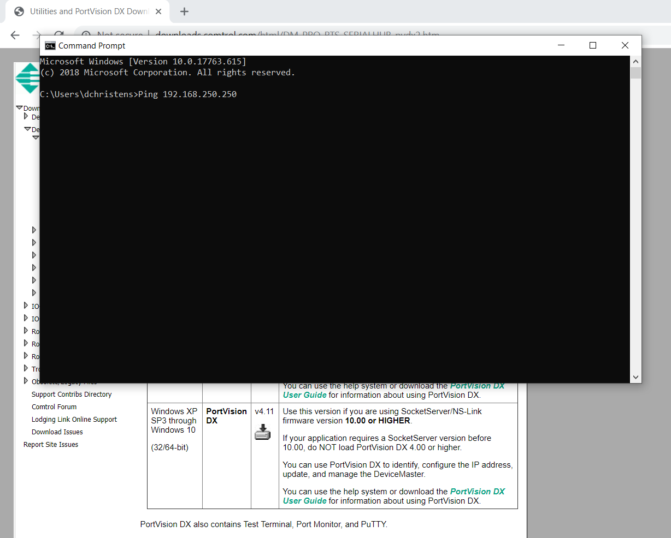
Ping DeviceMaster IP Address (192.168.250.X)

Slide 27
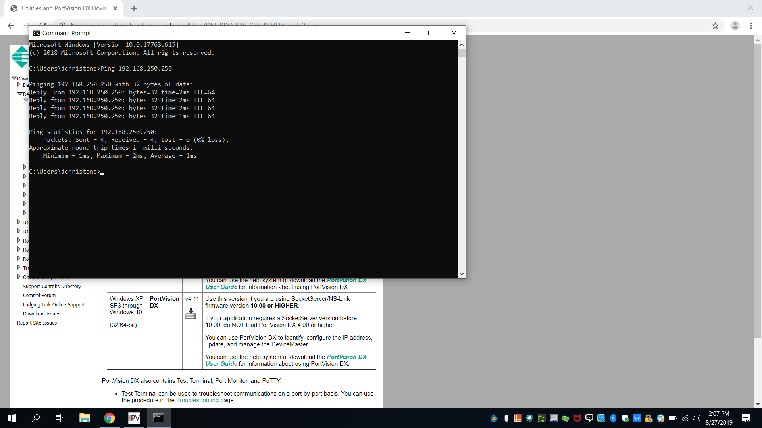
Ping Successful

Slide 28
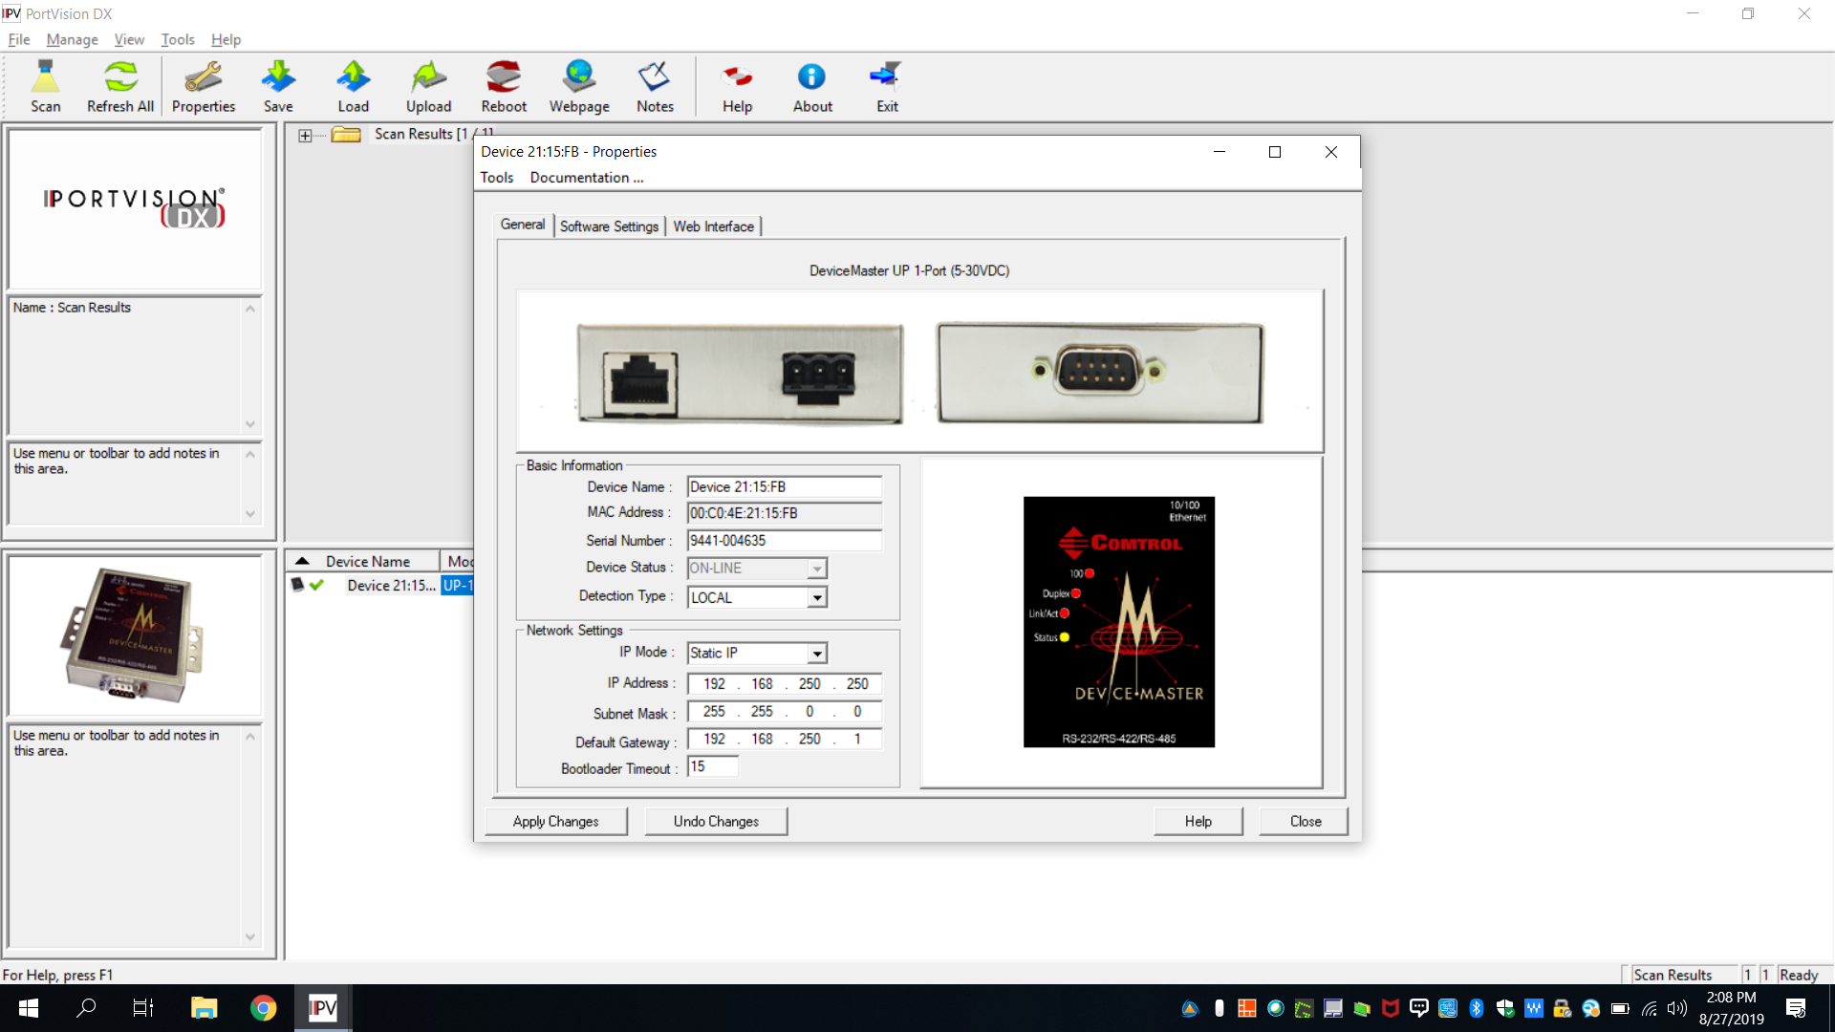
Pull portvision up- Double Device – Set IP for DM

Slide 29

Set Octet to unique address (1-250)

Slide 30
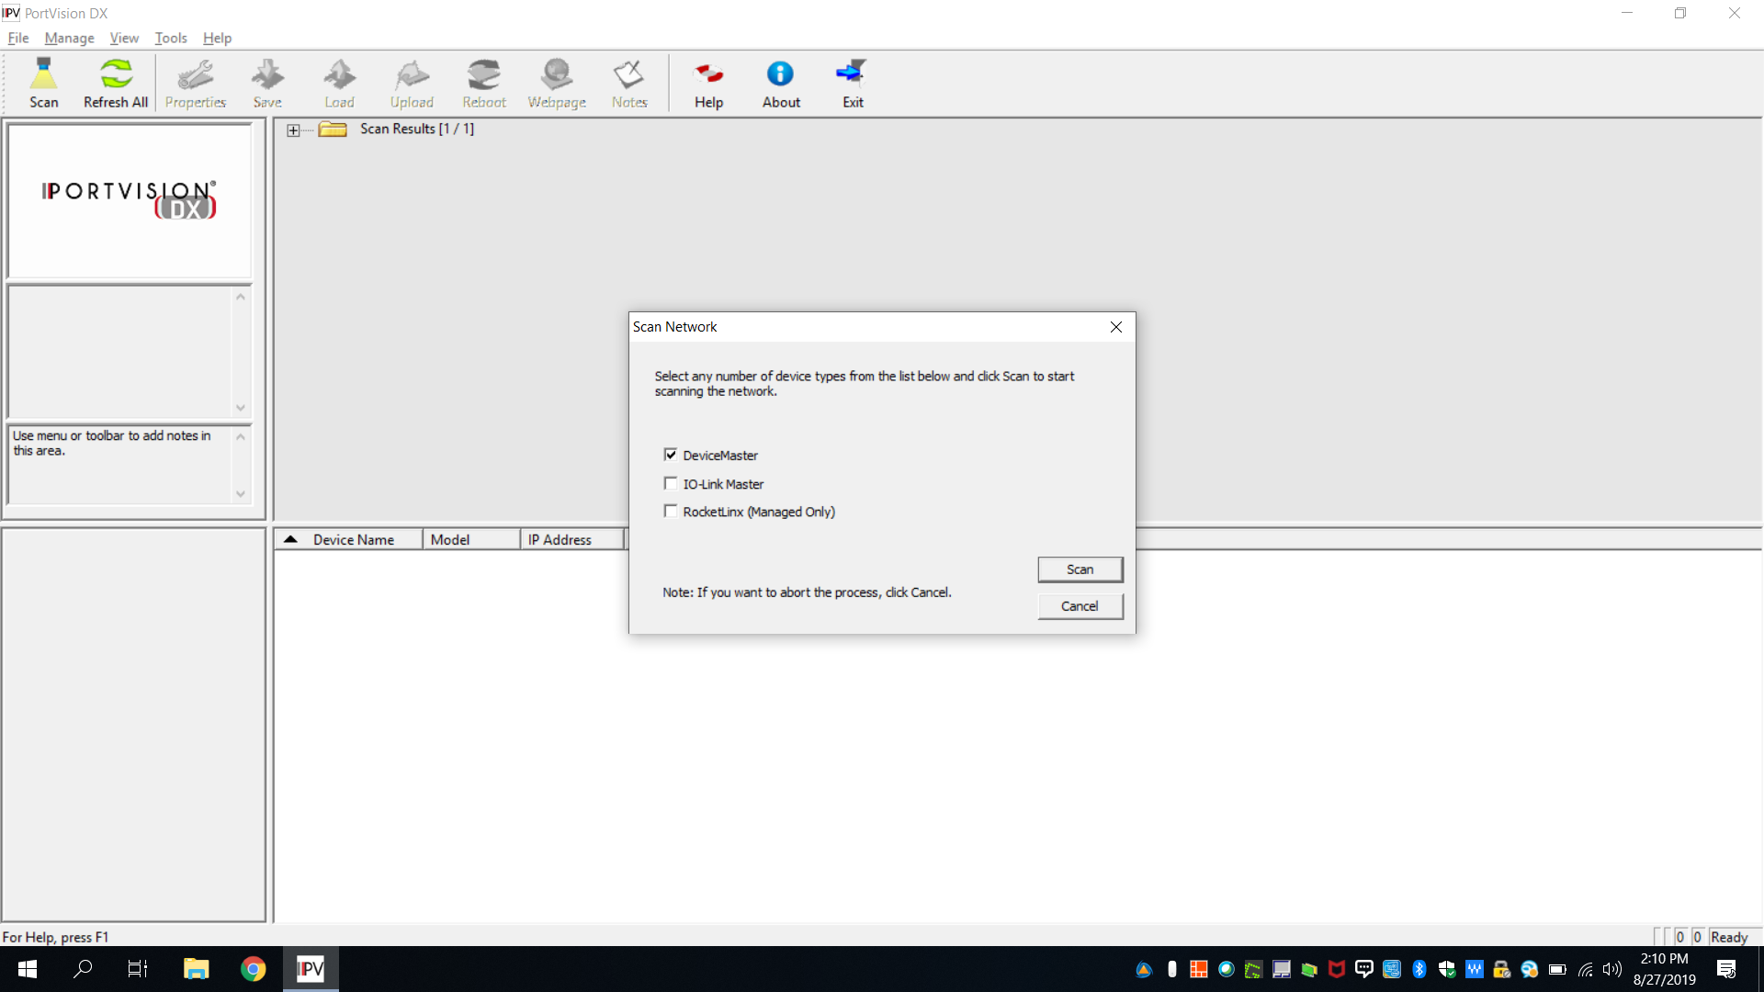
Scan Network Again- Check DM

Slide 31
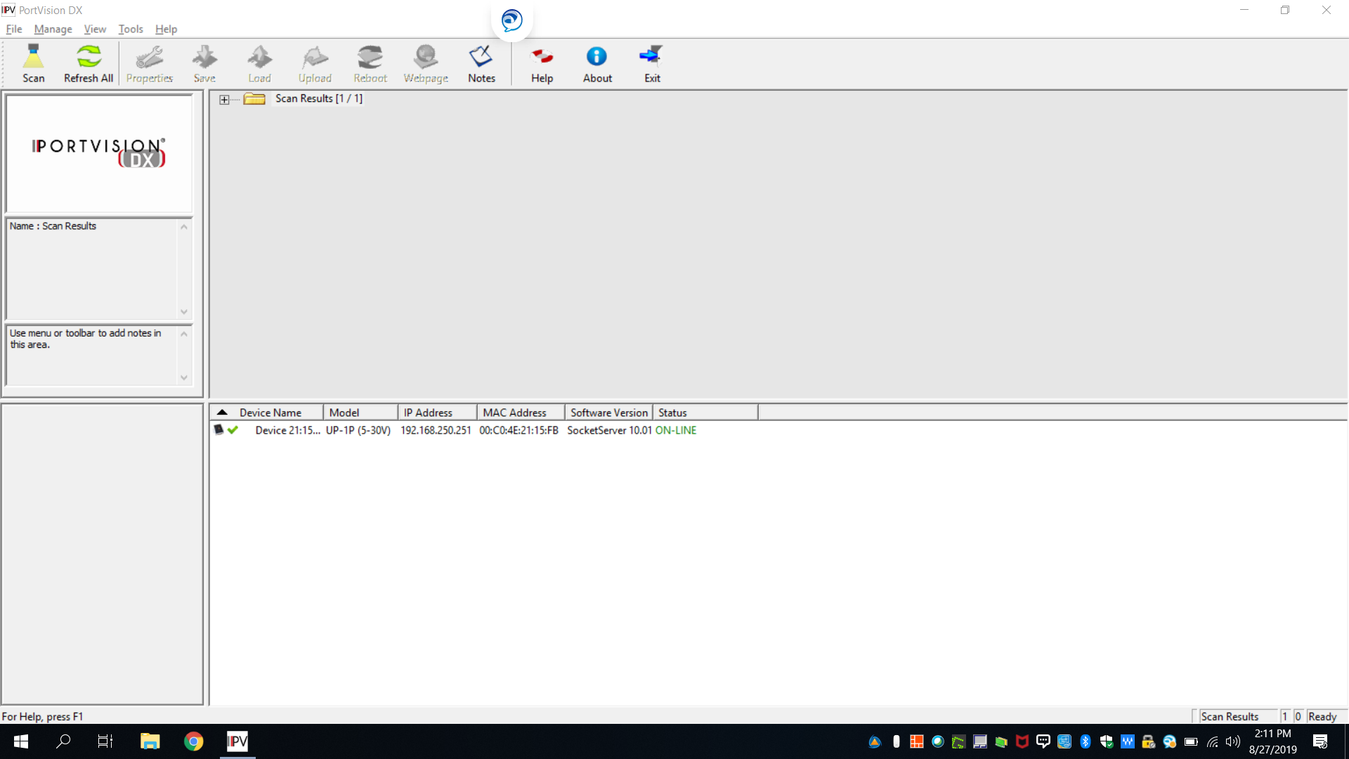
DM Found

Slide 32
Changing DM Firmware process
www.comtrol.com
Support
Driver/downloads
Choose Product type (DM/RTS/PRO/Serial hub)
Choose Firmware

Slide 33
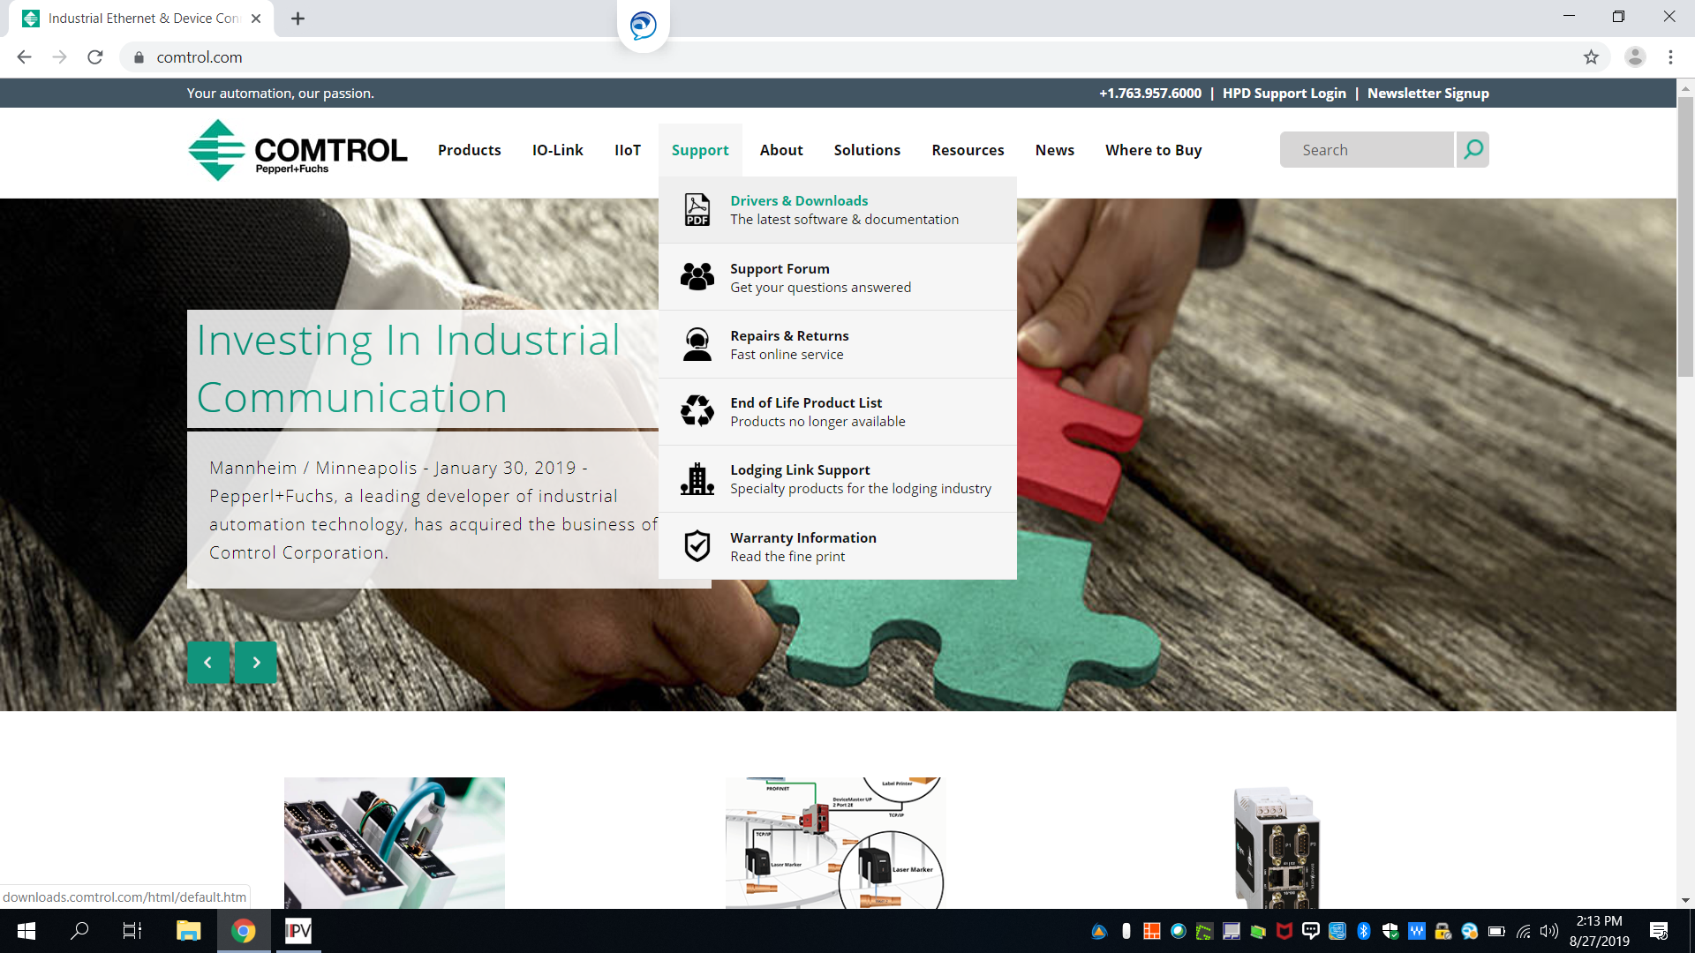
Firmware update- www.comtrol.com , Support, Drivers and Downloads

Slide 34
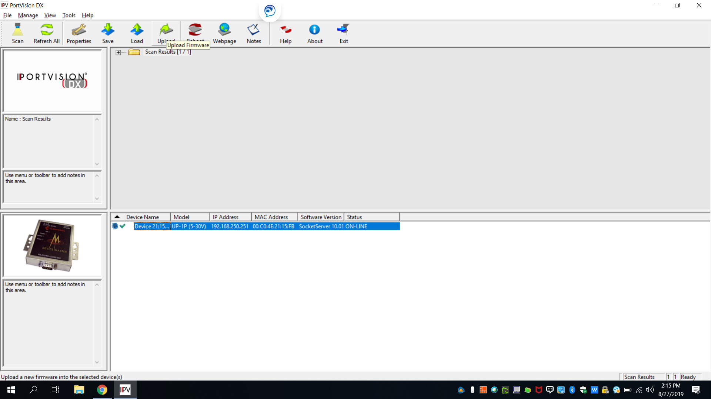
Choose Upload

Slide 35
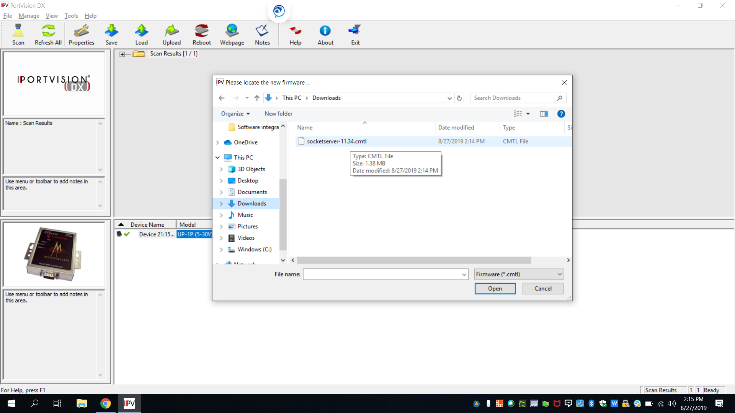
Choose Socketserver file

Slide 36

Upload Complete- Status should be online. Verify Software Version

Slide 37
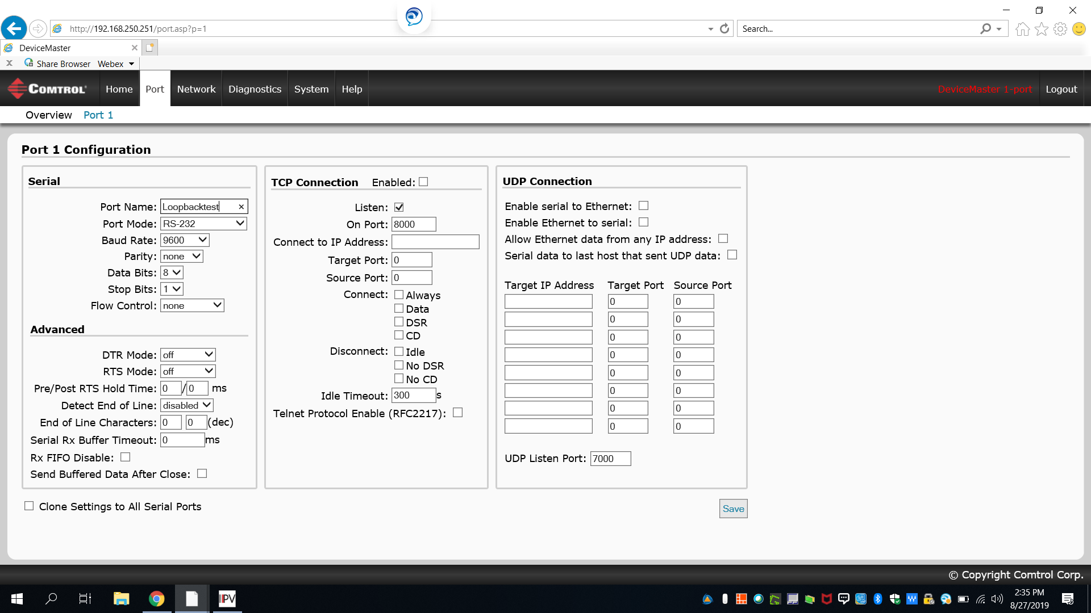
open Webpage type IP address (192.168.250.X)

Slide 38
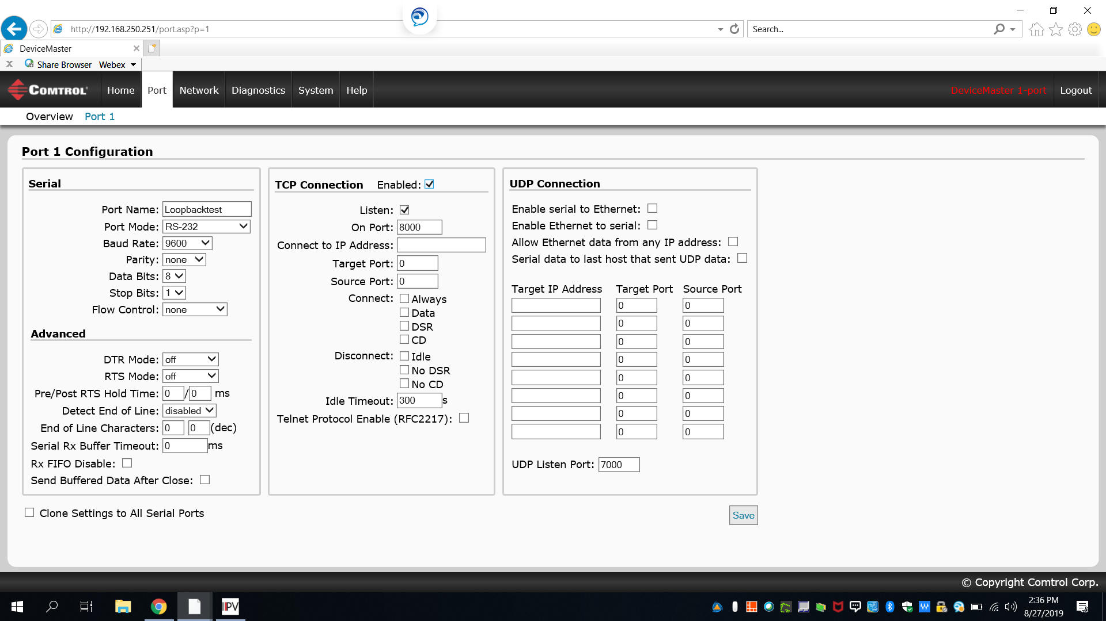
TCP Connection Enable Check- Set Serial Device

Slide 39
Testing Setup
Loopback Plug attached
Run Putty from Portvision or Putty.org

Slide 40
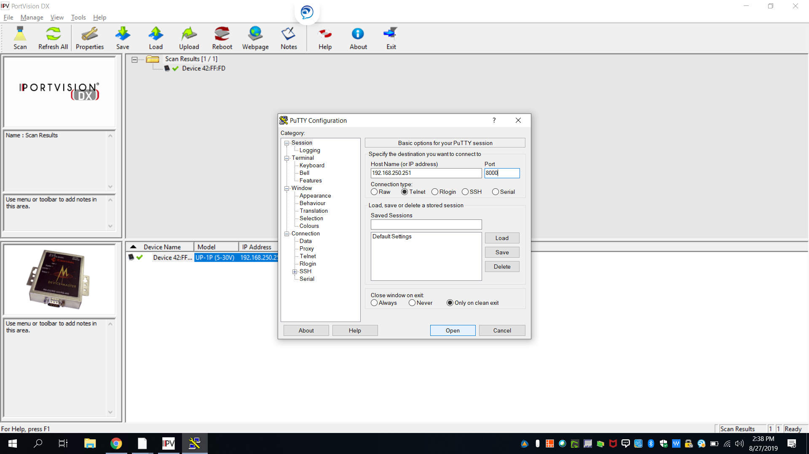
In portvision – Tools – Applications- Putty

Slide 41
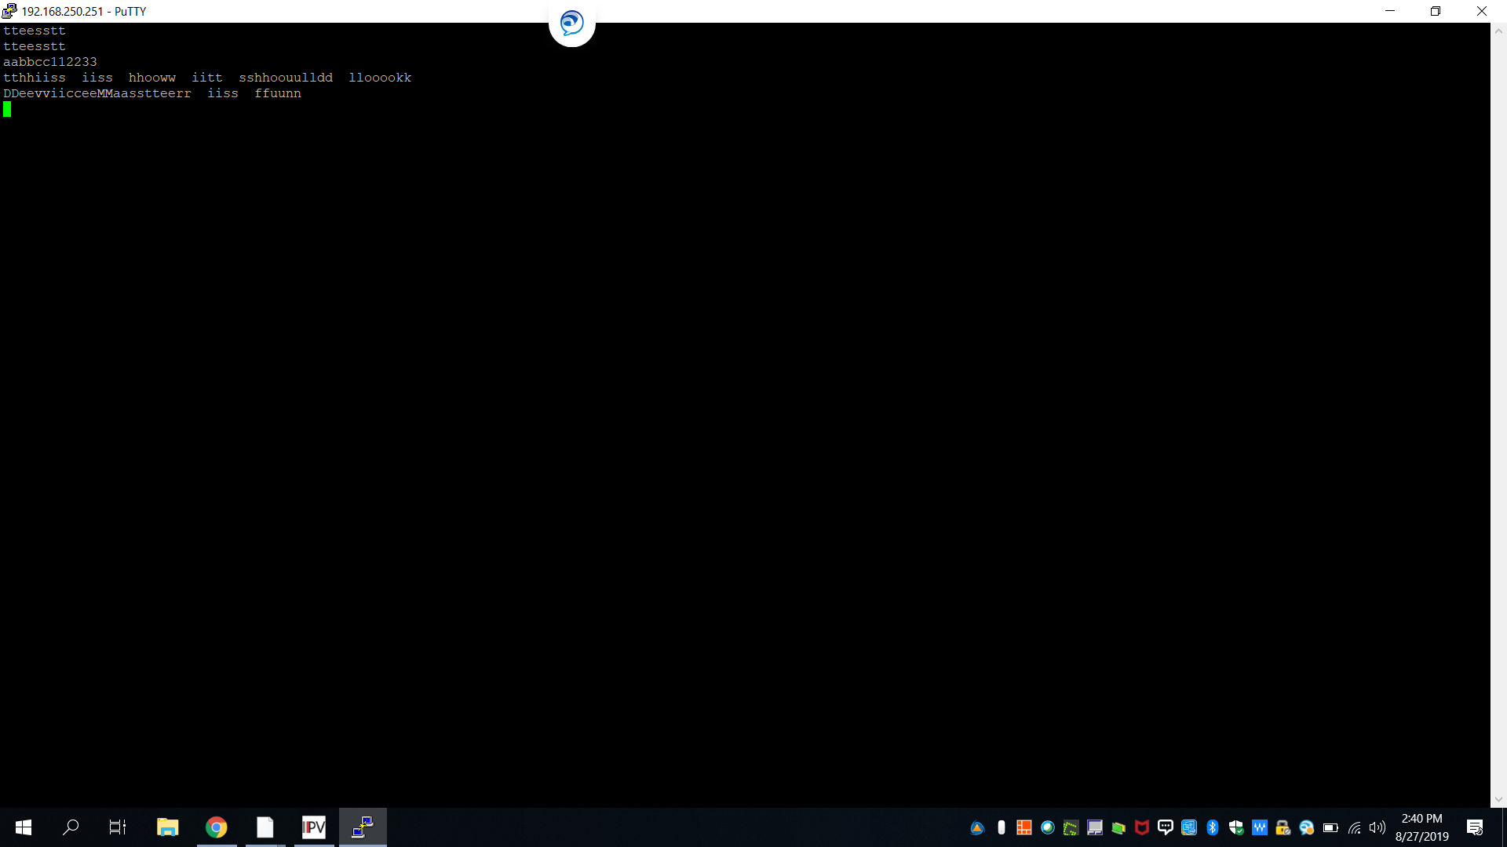
Type Test Data- Should be double Characters

Slide 42
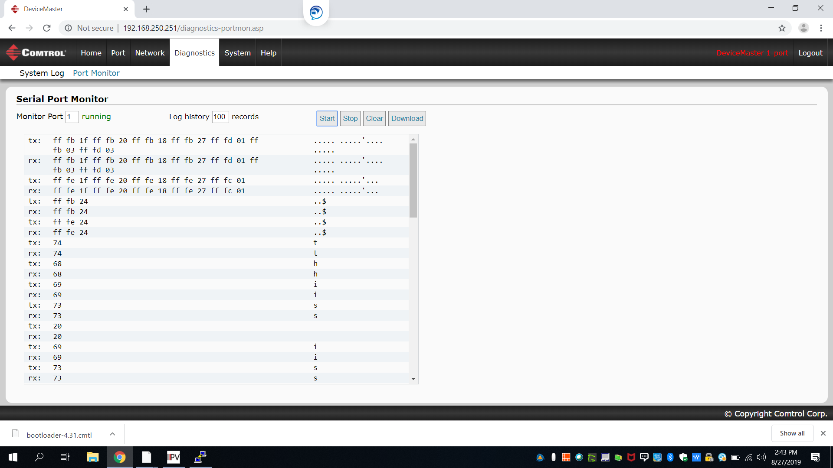
Open Webpage- Diagnostics, Port Monitor, Successful Data Exchage (TX-RX)

Slide 43
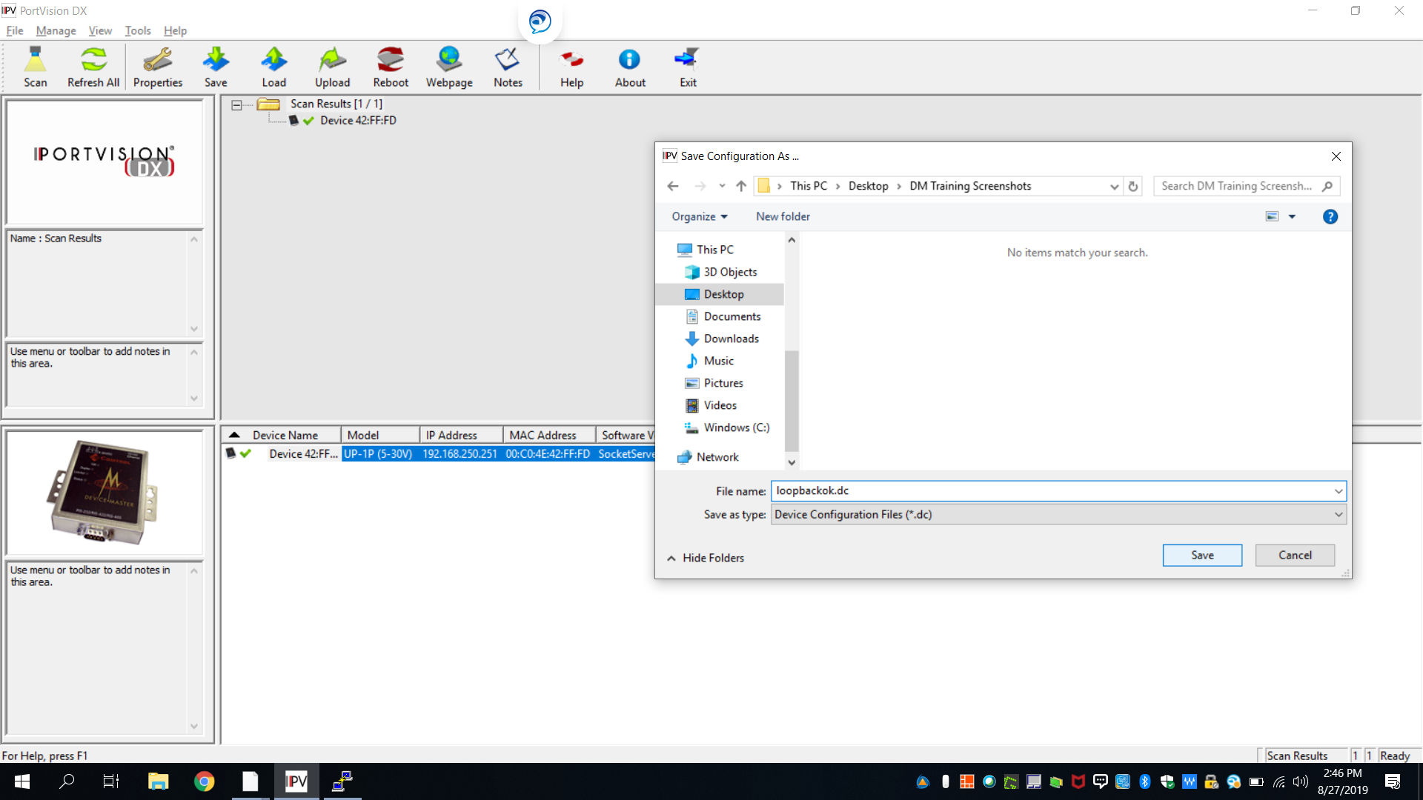
Save Successful file- Portvision, Save, Name.DC

Slide 44
Dennis Christensen
Email: dennis.christensen@comtrol.com

